Slide 1

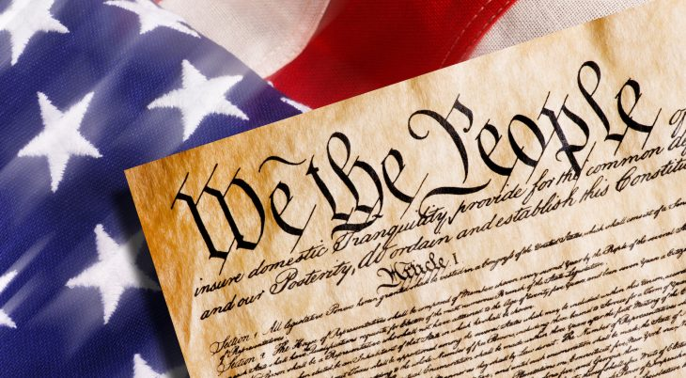
CONSTITUTION DAY – September 17
Thomas Patterson
Kennedy School of Government
Harvard University

Slide 2
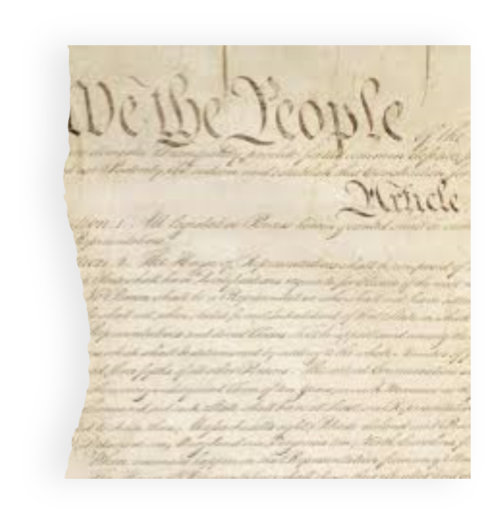
The Constitution has also endured because it was intended to be a document that could adapt to meet new challenges.
Said James Madison, “In framing a system which we wish to last for ages, we should not lose sight of the changes that ages will produce.”
I want to discuss one of those changes:
The threat that disinformation poses to our 1st Amendment right to free speech.

Slide 3
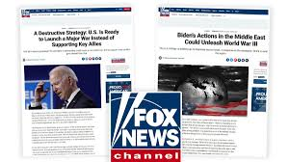

Slide 4
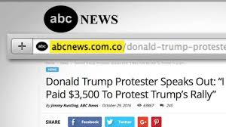

Slide 5
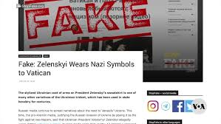
DISINFORMATION - False information communicated with the intent to mislead and manipulate us.

Slide 6

The messages were part of Russia’s Disinformation effort
As it did in 2016 and 2020, Russia is attempting to influence the 2024 presidential election by spreading disinformation.
Earlier this month, the Justice Department shut down nearly three dozen Russian-operated disinformation websites.
That action was taken under a U.S. law that prohibits foreign governments from interfering in American elections.

Slide 7
But here’s the challenge
Russian disinformation likely makes up less than 1 percent of the total disinformation Americans see.
Our fellow Americans create nearly all the rest.
As a nation, we are flooded with disinformation intended to:
stir up hate and turn us against each other
produce confusion and doubt
replace facts with “alternative truths”
erode trust in our institutions
manipulate our behavior and beliefs
And when Americans create disinformation, the 1st Amendment prevents the government from stopping it. Doing so, would violate the right of free speech.

Slide 8
The Harm of Disinformation – COVID-19
As a result of disinformation, millions of Americans falsely believed:
Covid-19 is no more deadly than the seasonal flu
Covid-19 vaccines are ineffective or dangerous
Social distancing and mask-wearing do not protect against Covid-19
These false beliefs were far more prevalent in the U.S. than in Canada.
US death rate was: 279/100,000
Canada’s rate was: 94/100,000
If the U.S. had Canada’s death rate, more than 600,000 Americans who died from Covid-19 would still be alive today.

Slide 9
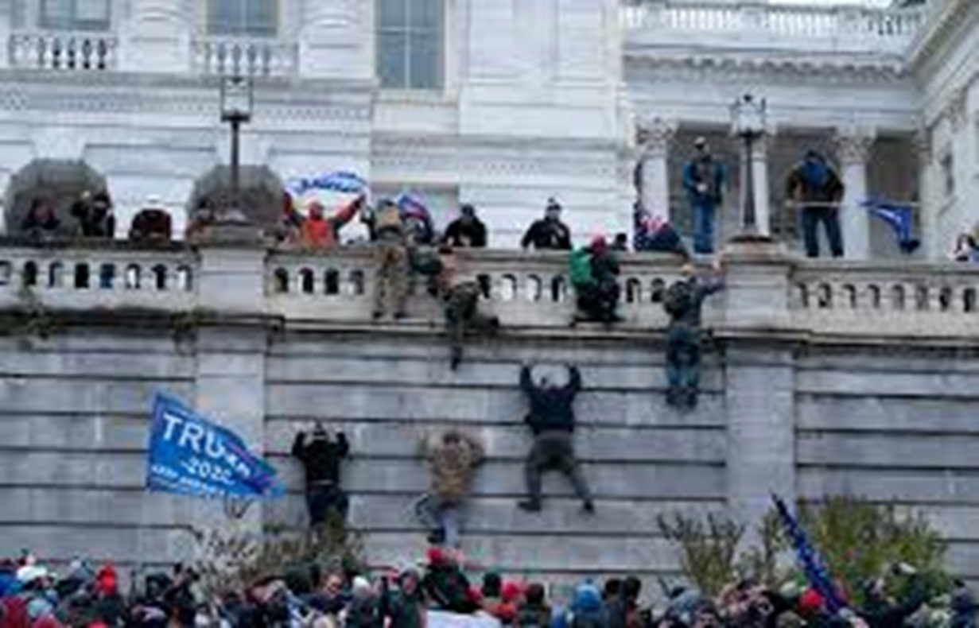
The harm of disinformation is real –
January 6 Assault
on U.S. Capitol Building
The crowd was driven to violence by disinformation – the false claim that the 2020 election had been stolen.

Slide 10
The Trend – False Beliefs Have Risen Sharply
Note: Ballpark estimates by author based on opinion poll questions.

Slide 11
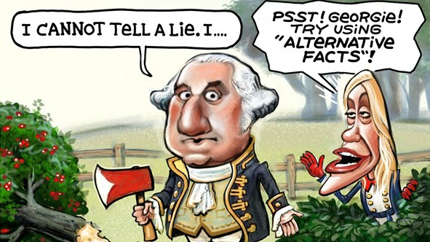
Explaining the Rise in Misinformation – Party Polarization
As the divide between our parties has widened, the norms that once inhibited lying and deception by political leaders have weakened.
Misinformation is highest for issues “on which elites prominently and persistently [make] incorrect claims.”
      Josh Pasek, Gaurav Sood, and Jon A. Krosnick,
      “Misinformed . .. “ Journal of Communication

Slide 12
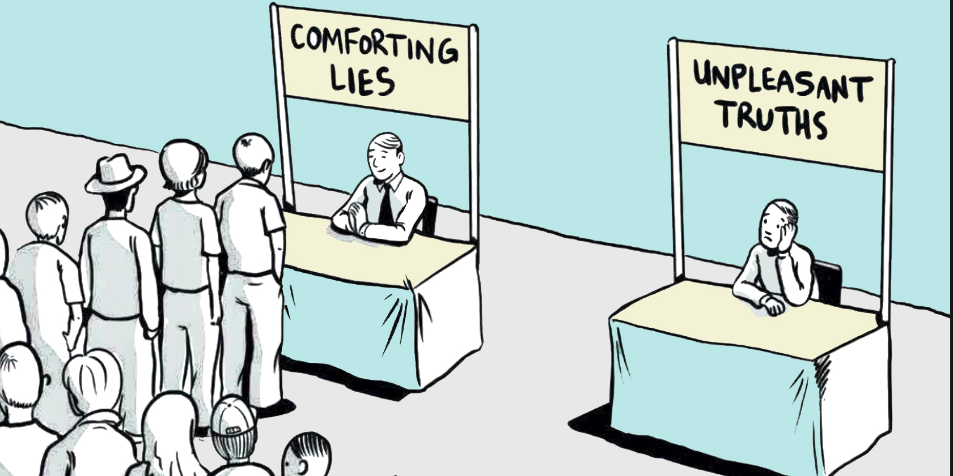
Party polarization and confirmation bias
Confirmation bias is our psychological tendency to accept information that aligns with what we believe or would like to believe, and to reject contradictory information.
The process is largely subconscious, which makes us susceptible to disinformation that plays on our party loyalty.
That’s always been true but has intensified with polarization.

Slide 13
False claims made in 2020 election
Kamala Harris was not born in United States
CDC manipulated numbers to exaggerate number of dead from Covid-19
Donald Trump faked having Covid-19 in order to win sympathy votes
Joe Biden is mentally incapacitated
Dr. Anthony Fauci funded a lab in Wuhan to develop the coronavirus
If reelected, Donald Trump planned to eliminate social security and Medicare
President Trump went to the hospital last year after suffering a stroke
Vote counting machines overcounted the Biden vote

Slide 14
None of the claims was true, but each was believed by a large percentage of Americans
Source: Indiana University’s Observatory on Social Media survey, November 2020

Slide 15
Confirmation Bias –
Partisan loyalty and false beliefs, 2020 election
Percentage of respondents with false belief
Source: Indiana University’s Observatory on Social Media survey, November 2020

Slide 16
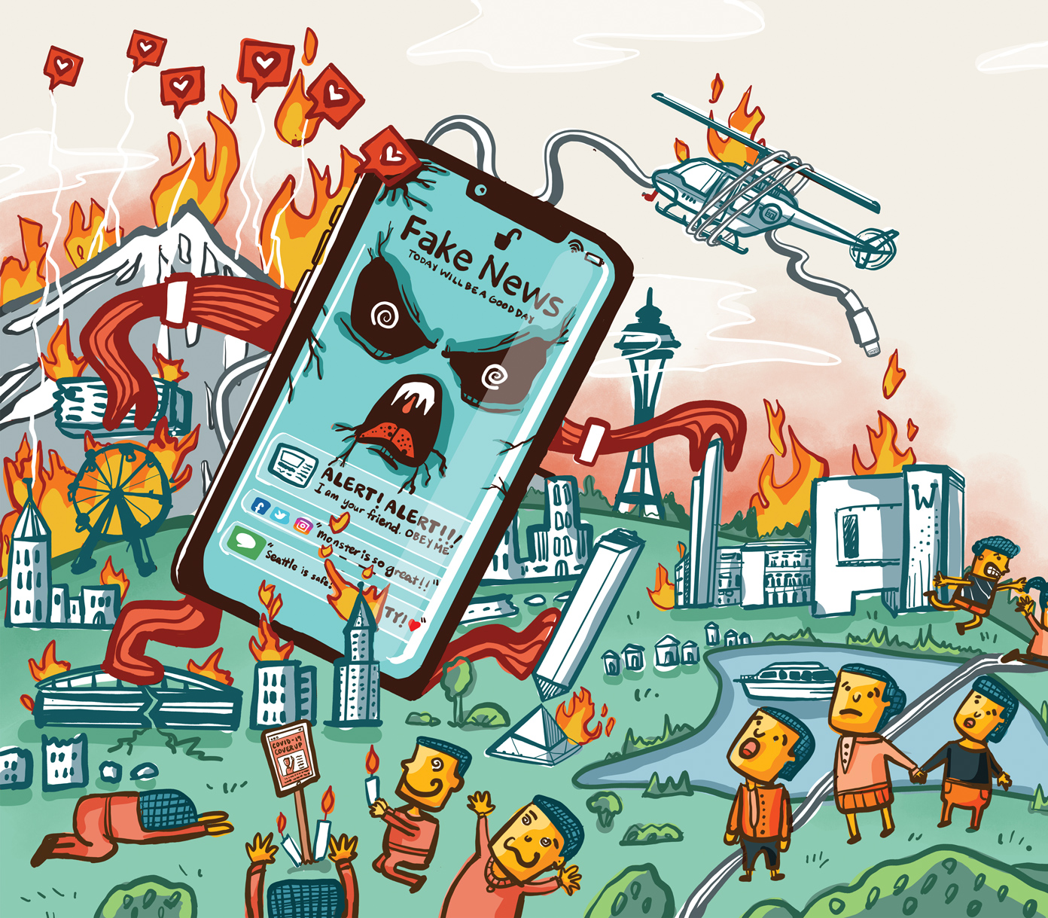
Explaining the Rise in Misinformation – The Digital Revolution
The Digital Revolution has spurred the rise in misinformation.
The introduction of cable, the Internet, and social media greatly expanded our information sources.
Many of these sources attract their audience by twisting the facts, stretching the truth, and peddling lies and false realities.

Slide 17
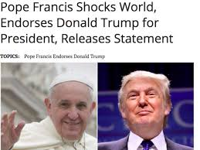
And here again, we’re part of the problem
Studies have found that social media users are roughly 6 times more likely to share fake news stories than real ones, presumably because the fake stories are usually more sensational.
And we are 3 times more likely to share stories that support our beliefs than those that contradict them, heightening both party polarization and misinformation.

Slide 18
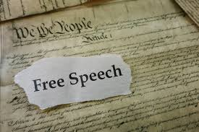
Why the government is powerless to limit disinformation
As currently interpreted, the Supreme Court holds that the 1st Amendment prohibits the government from regulating the “content” of speech.
When it comes to politics, Americans are free to say nearly anything they want, including “hate speech” directed at those of a different race, ethnicity, or gender.

Slide 19
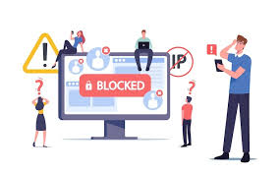
But the Platforms Can Restrict Content
The 1st Amendment applies only to government action.
As private companies, the platforms (for example, Google, Facebook, X, and TikTok) are not bound by the 1st Amendment and can engage in content moderation – blocking, de-platforming, and marking content.

Slide 20
Is there a role for government in the platforms decisions?
Through various agencies, the federal government monitors public communication.
When noting objectionable content, it could alert the platforms and request they remove or mark it.
The Biden administration did exactly that. It contacted social media companies and asked them to consider removing disinformation relating to Covid-19 as a threat to public health.
Is that legal?

Slide 21
Missouri claimed it was illegal
Missouri state officials filed suit to block the administration from referring content to the platforms, claiming it was “censorship” that infringed on the platforms’ 1st Amendment rights.
In 2024 (Murthy v. Missouri), the Supreme Court dismissed Missouri’s suit on grounds the state’s officials lacked “standing” – they failed to show they were personally harmed by the administration’s action.
The vote was 6-3. The Court’s majority did not address the 1st Amendment issue.

Slide 22
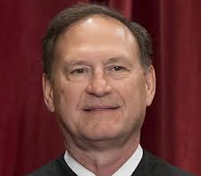
Did the Biden administration’s violate the 1st Amendment?
The 3 justices in the minority (Alito, Thomas, and Gorsuch) in the Missouri case suggested the Biden administration violated the 1st Amendment.
Alito wrote:
“[This is] one of the most important free speech cases to reach this Court in years . . . . [The Court} permits the successful campaign of coercion in this case to stand as an attractive model for future officials who want to control what the people say, hear, and think.”

Slide 23
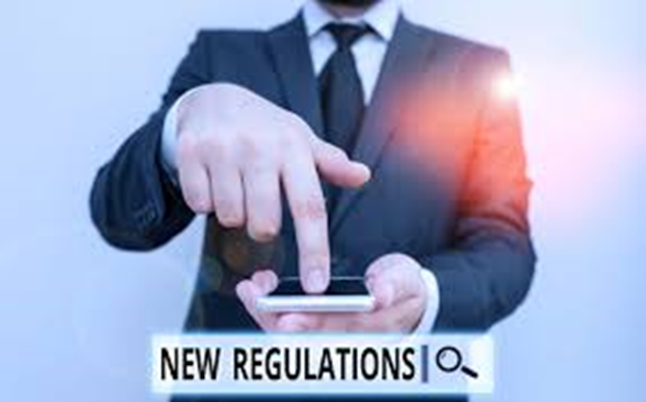
The “Politics” of Platform Content Moderation
Beyond the issue of the First Amendment, content moderation has become a partisan issue.
Republicans claim that the platforms unfairly censor conservative sources.
Acting on this belief, the Texas and Florida legislatures passed laws that prohibit the platforms from deleting political content or politicians.

Slide 24
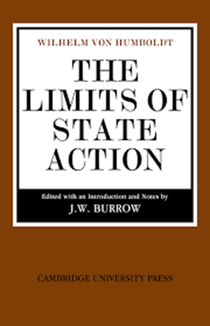
Can states dictate the platform’s content policies?
The cases are still pending, but the Supreme Court in 2024 sent challenges to the Florida and Texas laws back to a lower court with an opinion indicating the laws violate the platforms’ 1st Amendment rights.
Said the Court: “[The courts need to protect] those entities’ rights of speech, as courts have historically protected traditional media’s rights.”

Slide 25
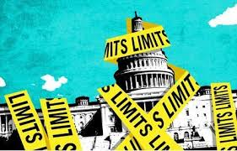
Where things stand - government
Government cannot remove social media content generated by Americans.
Government apparently cannot dictate the content policies of social media platforms
Government might be prohibited from asking social media companies to consider removing objectionable content.

Slide 26



Where things stand – the platforms
The platforms (apparently) have full power to remove and block sources of disinformation.
Are they willing to exercise that power?
Some platforms, including Facebook and YouTube, appear willing but only in extreme and clear-cut cases
Other platforms, including X (formerly Twitter), are unwilling – they have an “anything goes” policy.

Slide 27
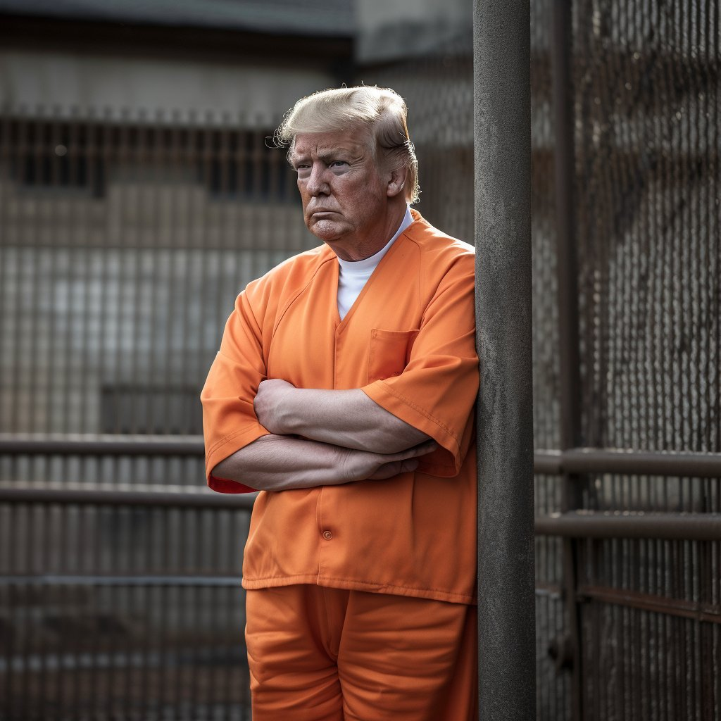
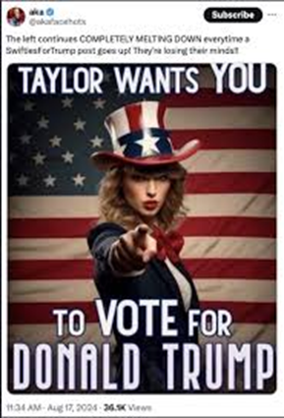
One thing is certain – the disinformation problem will get worse
Advances in Artificial Intelligence now allow the rapid creation of “deep fakes” – false images and voices.

Slide 28

The disinformation problem will get worse
AI has increased the power of Bots (software programs that can automatically generate messages)
One out of seven social media messages is now Bot (non-human) created.
Within a decade, eight of ten will be Bot created.
Technology is being weaponized by those who spread disinformation.

Slide 29

Will today’s 1st Amendment also be tomorrow’s?
That’s an open question.
The 1st Amendment is not fixed in meaning. The Supreme Court has allowed government to restrict speech.
EXAMPLE: When the United States emerged as a world power with its entry into World War I, the Court weighed the threat of free speech to national security.
In Schenck v. United States (1919), the Court held that the government could restrict speech that posed “a clear and present danger.”

Slide 30
The Balancing Standard
If the harms of disinformation reach the level where they threaten the nation’s sanity and unity, the Supreme Court might revisit its interpretation of the 1st Amendment.
In making that determination, the Court would apply a “balancing standard” - weighing the individual right of free speech against the general interests of society.
How much disinformation is too much disinformation? That’s the question we need to answer going forward.

Slide 31
Thank you

