Slide 1

Donald Trump &
Presidential Power
October 23, 2025
Tom Patterson

Slide 2
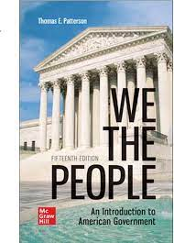
We the People, 2025
NUMBER ONE – the top-selling American Government text
Noted for Its Readability – a text that students actually like to read
Emphasis on Critical Thinking – turning students from passive readers to active ones
Balanced – there are two sides to American politics
Unparalleled Instructor Support—Connect, Smartbook, Videos, Podcasts, News Alerts, and more
To obtain a free instructor’s copy of We the People, please email polisci@mheducation.com

Slide 3
Donald Trump &
Presidential Power
October 23, 2025
Tom Patterson

Slide 4
Today’s Topics
1. Brief look at the Whig, Stewardship, and Institutional theories of presidential power
2. Examine the fit of President Trump’s policies with the Institutional Theory and the Unitary Executive Theory.
3. Discuss how upcoming Supreme Court rulings could affect our theory of presidential power.

Slide 5
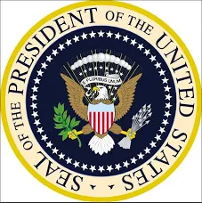
The Whig (Limited) Theory –
Early Presidency (roughly 1789-1932)
Prevailing theory (variously known as the Whig or Limited Presidency Theory) held that the presidency was primarily an administrative office.
The president’s chief responsibility was to oversee the executive departments to ensure they “faithfully” executed the laws of Congress.
There is no undefined residuum
of power which he can exercise
because it seems to him to be
in the public interest.”
President William Howard Taft (1909-1912)

Slide 6
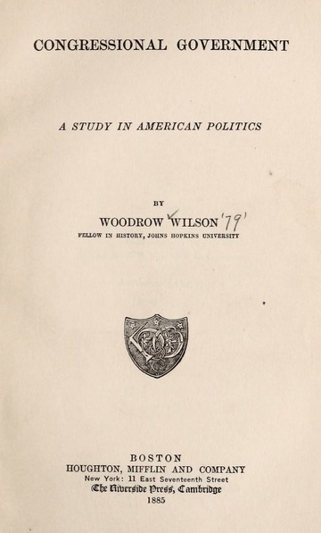
Congress in Whig Theory –
The Leading Institution
Aside from a few presidencies like Lincoln’s, Congress was the dominant institution during the nation’s early period, a point documented in 1888 by Woodrow Wilson while a political scientist at Princeton.

Slide 7
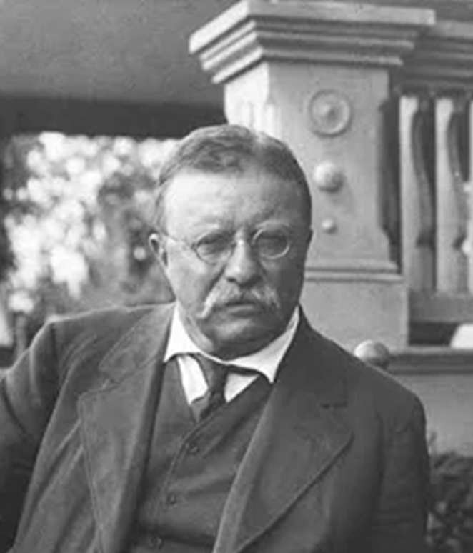
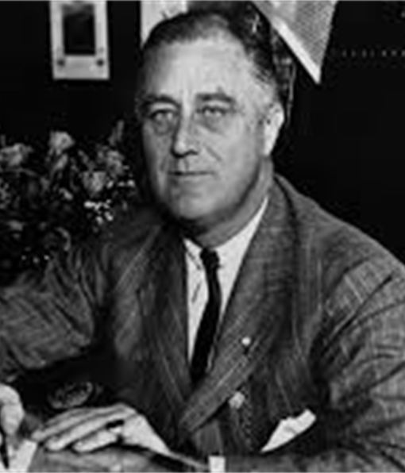
Stewardship (Strong) Theory of the Presidency
As Wilson was writing, America was changing – increasingly integrated economy and an expanding federal bureaucracy.
Theodore Roosevelt (1901-1908) saw the need for a new theory, arguing that the president can do anything not prohibited by the Constitution or the laws and should act energetically as “steward” of the people.
That theory came into full play with Franklin D. Roosevelt’s New Deal, accompanied by expansion of the executive branch, e.g.,
69 new federal agencies (e.g., Social Security Administration, FDIC, SEC, FCC) were created
Executive Office of the President (EOP) was created (Executive staff rose from 109 in 1932 to 21,428 in 1941).

Slide 8
FDR – Expanded Leadership Role
Executive Orders Issued in First Year in Office
Note: By comparison,
Theodore Roosevelt
issued only 29 EO’s
in first year.
Source: American Presidency Project, UC-Santa Barbara

Slide 9
What’s often understated about FDR’s presidency – his dependence on Congress
Note: What constitutes “major” is somewhat subjective, but I include, for example, the Emergency Banking Act and the Civilian Conservation Corps (CCC).

Slide 10
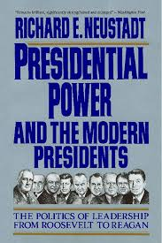
The Stewardship Theory –
Congress as a Co-Equal Branch of Government
Congress’s importance was the foundation of Richard Neustadt’s claim that presidential power is “the power to persuade.”
Neustadt saw the presidency as a personalized office, its power dependent on the persuasive skills of the occupant, particularly in dealing with Congress.

Slide 11
Institutional Presidency Theory
(aka, Unilateral Powers Theory or Unilateral Presidential Action Theory)
Noting a growing tendency of presidents to downplay legislative action in favor of executive action, political scientists William Howell and Terry Moe in the 1990s proposed an alternative theory of presidential power, one resting on the executive branch’s institutional features such as staffing and expertise.

Slide 12
Logic of the Institutional Presidency Theory
The growth of the institutional presidency provides organizational resources (staff, expertise) that have strengthened the president’s ability to act on their own.
Executive orders, memoranda, and regulatory authority gave presidents the tools to act on their own.
Determined to create a legacy, presidents act unilaterally whenever it advances their goals.

Slide 13
Going it alone –
Unilateral Presidential Directives

Slide 14
Going It Alone –
Bilateral and Multilateral Executive Agreements
Source: Congressional Research Service estimates

Slide 15
Going It Alone –
Use of Military Force

Slide 16
The President’s Institutional Advantage – example of use of military force
“It was been circumstances rather than design which has given the executive its great prominence . . . Circumstances [requiring] decisions of a kind Congress is ill-equipped to make . . . The President has the means at his disposal for prompt action: the Congress does not.”
Senator William Fulbright

Slide 17
The place of Congress in the
Institutional Presidency Theory
Occasionally indispensable (e.g., Obamacare)
But the Administrative State is largely in place, negating an ongoing need for Congress while creating opportunities for unilateral executive action (e.g., tightening or weakening environmental regulations).

Slide 18
Strategic Imperative of the
Institutional Presidency Theory
Exert executive authority but not to the point where it provokes counter action by Congress or the courts.
That still gives the president wide latitude – neither Congress nor the courts have an incentive or the capacity to routinely confront a president operating in the “gray area” of what’s allowed.

Slide 19
The
Trump
Presidency

Slide 20
First-Year Executive Orders
& Presidential Memorandums

Slide 21
Bills signed into law in the first 100 Days
More so than his post-war
predecessors, President Trump
has relied almost exclusively
on executive action, largely
foregoing the legislative option.
Source: History.com

Slide 22
Another Defining Feature of the Trump Presidency:
Legal Challenges to the Administration’s Executive Actions
Source: JustSecurity

Slide 23
Does the Trump Presidency fit with
Institutional Presidency Theory
Extreme version in its use of executive authority and neglect of legislative option
Deviating version in its willingness to pursue actions that knowingly will bring it into direct conflict with the judiciary.
In short: It’s hard to fit the Trump presidency into this theory.

Slide 24
An alternative possibility –
Unitary Executive Theory
Based on Article II of the U.S. Constitution, which vests “the executive power” in the President.
In its strong form, the Unitary Executive Theory holds:
The president has exclusive authority to control everyone and everything in executive branch.
Congress cannot interfere by, for example, creating independent agencies, granting authority to agency heads, restricting president’s removal power, requiring documents and reports from executive agencies.

Slide 25
The Fit of the Trump Presidency to the Unitary Executive Theory
A closer fit–
Theory implies no limit on exercise of executive authority
Trump’s actions include expansive claims of exclusive executive authority, e.g.,
“At will” firing of officials in legislatively protected “for cause” positions.
                Refusing to follow the steps required by the 1946 Administrative Procedures Act when issuing regulations.

Slide 26
Where the Unitary Executive Theory doesn’t fit -
In addition to claiming exclusive executive authority, which is part of the Unitary Theory, Trump has claimed authority in areas understood to constitutionally belong to Congress.

Slide 27
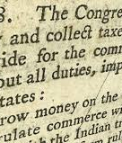
Case in Point
Article 1, Section 8 of the Constitution vests the spending power (appropriations) in the Congress.
Save for the power to veto spending bills at the time of enactment, President has no explicit or implied constitutional authority in this area.
Yet, the Administration has withheld more than $400 billion for hundreds of programs.
Trump claims presidents cannot spend more than Congress appropriates but can spend less.
If so, the president would effectively have an ex-post line-item spending veto. (Note: In Clinton v. City of New York (1998), the Supreme Court ruled the line-item veto to be unconstitutional.)

Slide 28
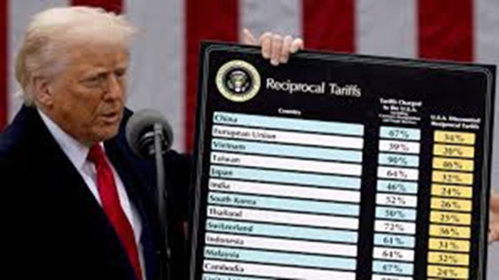
Another Case in point
Article 1, Section 8 of the Constitution grants Congress the power to “lay and collect” tariffs.
No constitutional provision grants the President authority in this area.
Yet, Trump has imposed a 10% tariff on all countries and additional "reciprocal tariffs" on most countries.
Note:Pursuant to its power, Congress in 1977 passed The International Emergency Economic Powers Act (IEEPA), which grants the U.S. President authority to imposed economic sanctions following a declared national emergency related to a severe threat to national security. The legislation contains no reference to tariffs. It is this law the Administration has cited as its tariff authority.

Slide 29
Trump’s Tariff Increase
Tariff rate when
Trump took office

Slide 30
Theories of the Presidency
Although some theories are hypothetical (the “strong” version of the United Executive Theory is not as yet supported in law), the usefulness of these theories is judged largely by their ability to describe the actual play of presidential power.
As such, whether Trump’s theory of presidential power will persist rests on the judiciary’s response.
What can we expect from the courts?

Slide 31
Lower Court Rulings on
Trump Administration Actions
Source: Adam Bonica and Maya Sen, “Common-Space Measures of Judicial Ideology by Federal Judges, 2025.

Slide 32
Explaining the lower-court rulings
Many of the Trump Administration’s actions violate statutes or constitutional precedents.
Lower courts are obliged to rule within the context of the law as established by statute and precedent.

Slide 33
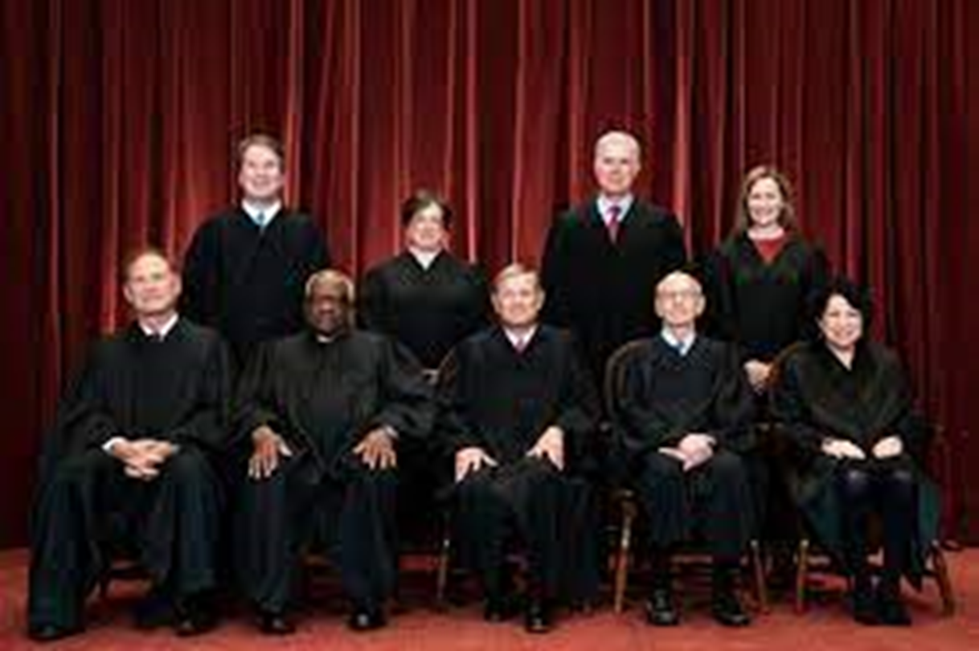
President Trump’s Strategy
The Administration expected many of its actions to be challenged in court.
The Administration is hoping that the Supreme Court – which does have the power to reinterpret the law—will side with its uses of presidential power.
Six of the justices are Republican appointees, three of whom are Trump appointees.

Slide 34
Supreme Court rulings on Trump Administration Actions
Source: Multiple sources

Slide 35
Nevertheless . . .
The cases have been decided on procedural grounds rather than the merits of the case.
Only now are the cases getting to the merits docket.
Three cases so far:
The challenge to the Trump tariffs (to be argued in November)
The challenge to the firing of an FTC commissioner (to be argued in December)
The challenge to the firing of a member of the Fed’s Board of Governors (to be argued in January)

Slide 36
Looking ahead
My guess –
Court will uphold the firing of FTC commissioner, thus overturning Humphreys Executor precedent and extending the Seila Law precedent
Court will find a way to insulate the Fed from “at will” removals
Court will decide the tariffs case on narrow grounds, rather than granting presidents broad unilateral taxing authority.
If that’s what happens and foretells subsequent rulings, then . . .

Slide 37
The next theory of presidential power will be
The Unitary Executive Theory, which grants the president exclusive authority over the executive branch.
In previous rulings, four justices have written favorably about UET - Clarence Thomas, Neil Gorsuch, Brett Kavanaugh, and Amy Coney Barrett.
John Roberts and Samuel Alito have been less explicit but inclined in that direction.

Slide 38
  Thank you
Questions, objections, your own take –

Slide 39
We the People, 2025
NUMBER ONE – the top-selling American Government text
Noted for Its Readability – a text that students actually like to read
Emphasis on Critical Thinking – turning students from passive readers to active ones
Balanced – there are two sides to American politics
Unparalleled Instructor Support—Connect, Smartbook, Videos, Podcasts, News Alerts, and more
To obtain a free instructor’s copy of We the People, please email polisci@mheducation.com

