Slide 1
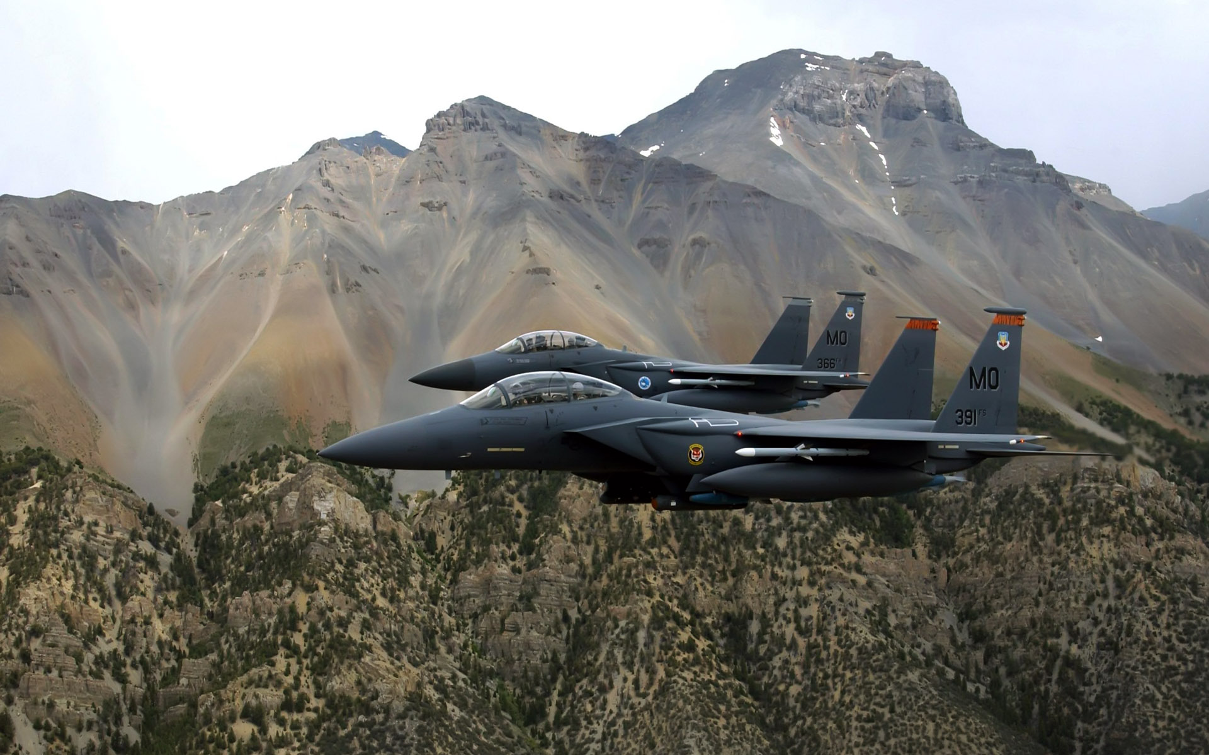
Presidents and Foreign Policy

Slide 2
The President’s constitutional powers in the foreign affairs
1. Chief diplomat
2. Commander in chief
Notes:
On the second point, emphasize the huge “knowledge” advantage available to the president. Executive branch and White House are swimming in policy and political experts, as opposed to the small staffs available to members of Congress.

Slide 3
Congress and War
The Constitution’s Article I grants Congress the power to
• declare War
• raise and support Armies
• provide and maintain a Navy;
• make Rules for the . . . land and naval forces
• provide for calling forth the Militia to … suppress Insurrections and repel Invasions
• provide for organizing, arming, and disciplining the Militia

Slide 4
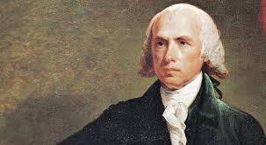
"The only case in which the Executive can enter on a war, undeclared by Congress, is when a state of war has been [initiated by] another [country].“ –
James Madison

Slide 5
Today’s session
1. The information and leadership advantage that the president has over Congress in the making of foreign policy
2. Presidents’ ability to act on their own in the area of foreign affairs
3. Presidents’ power over war

Slide 6
Presidential Advantages in Foreign Policy
1. control of information

Slide 7
Presidential Advantages in Foreign Policy
1. control of information
2. unitary authority in diplomatic relations

Slide 8
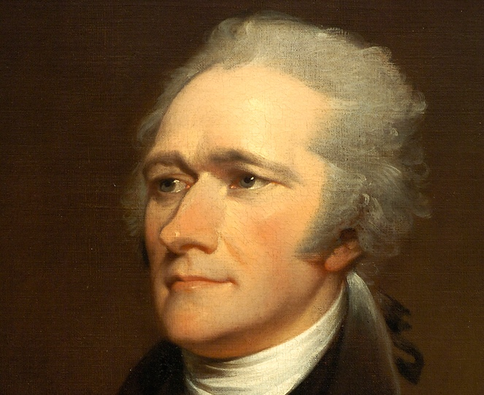
“the exercise
of power by
a single
hand.”
Alexander
Hamilton
"The only case in which the Executive can enter on a war, undeclared by Congress, is when a state of war has been [initiated by] another [country].“ –
James Madison

Slide 9
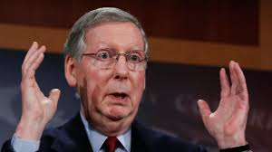
"We're in the process, all of us, of reading the Trans-Pacific partnership agreement.”
Mitch McConnell

Slide 10
executive agreement
A treaty-like agreement made by president that doesn’t require Senate ratification.

Slide 11
Executive Agreements and Treaties (1939-2013)
Source: State Department, 2014.

Slide 12
Military Actions (1946-2015)
percentage of military actions
Source: Rough estimates derived from Barbara Salazar Torreon, “Instances of Use of United States Armed Forces Abroad,
1798-2015,” Congressional Research Service, January 15, 2015. Excludes CIA operations and non-combat troop deployments.

Slide 13
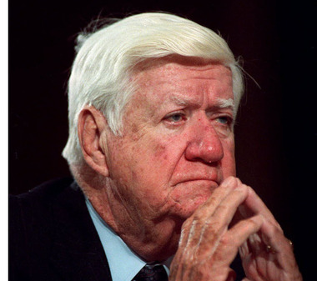
“We weren’t asked for advice . . . we were informed what was taking place.”
Thomas P. “Tip” O’Neill , Speaker of the House

Slide 14
Was the War a Mistake?
Source: For Vietnam, Gallup polls; for Iraq, Pew Research Center polls

Slide 15
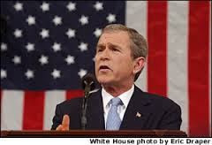
“axis of evil”

Slide 16
Preemptive War Doctrine
Doctrine holding that U.S. can attack a potentially threatening nation even before the threat materializes.

Slide 17
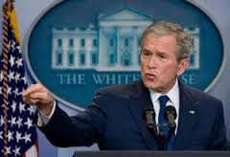
"The evidence indicates that Iraq is reconstituting its nuclear weapons program. . . . Satellite photographs reveal that Iraq is rebuilding facilities at sites that have been part of its nuclear program in the past."

Slide 18
Iraq War Resolution (2002)
Vote in House
Vote in Senate

Slide 19
Pre-Invasion News Coverage
Source: Estimated from Danny Hayes and Matt Guardino, “Whose Views Made News?” Political Communication
27 (2010), 73. Based on ABC, CBS, and NBC coverage, Aug 1, 2002-Mar 19, 2003.

Slide 20
Opinion of Iraq Invasion
Source: Gallup poll, March 24, 2003

Slide 21
Why Has Control of War Shifted to the President?
1) Congress’s reluctance to exercise its constitutional control over war?
OR:
2) Changes in the world that have tipped the balance in war decisions away from Congress and toward the president?

Slide 22
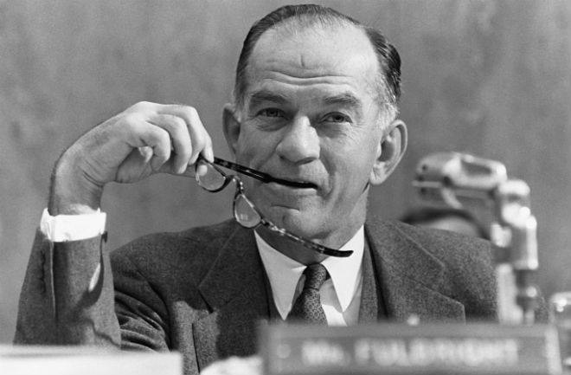
“It has been circumstance which has given the executive its great predominance . . . . An entire era of crisis in which urgent decisions have been required again and again, decisions of a kind that Congress is ill-equipped to make…The President has the means at his disposal for prompt action; the Congress does not.”
- William Fulbright

Slide 23
War Powers Act (1973)
1. Requires the president to inform Congress within 48 hours of the start of military action of the reasons for it.
2. Requires the president to stop offensive operations within 60 days unless Congress authorizes an extension.
3. Requires the president to withdraw U.S. troops within 30 days if Congress has not authorized an extension.

Slide 24
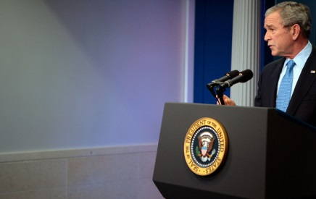
“While I appreciate receiving that support, my request for it did not . . . constitute any change in the long-standing positions of the executive branch on . . . the constitutionality of the War Powers Resolution.”

Slide 25
Summary
1. presidents’ constitutional authority in foreign affairs
>chief diplomat
>commander-in-chief
2. presidents’ foreign policy advantage over Congress
>access to policy-relevant information
>unitary authority in diplomatic relations
3. presidents’ opportunities to act on their own authority in foreign affairs

