Slide 1
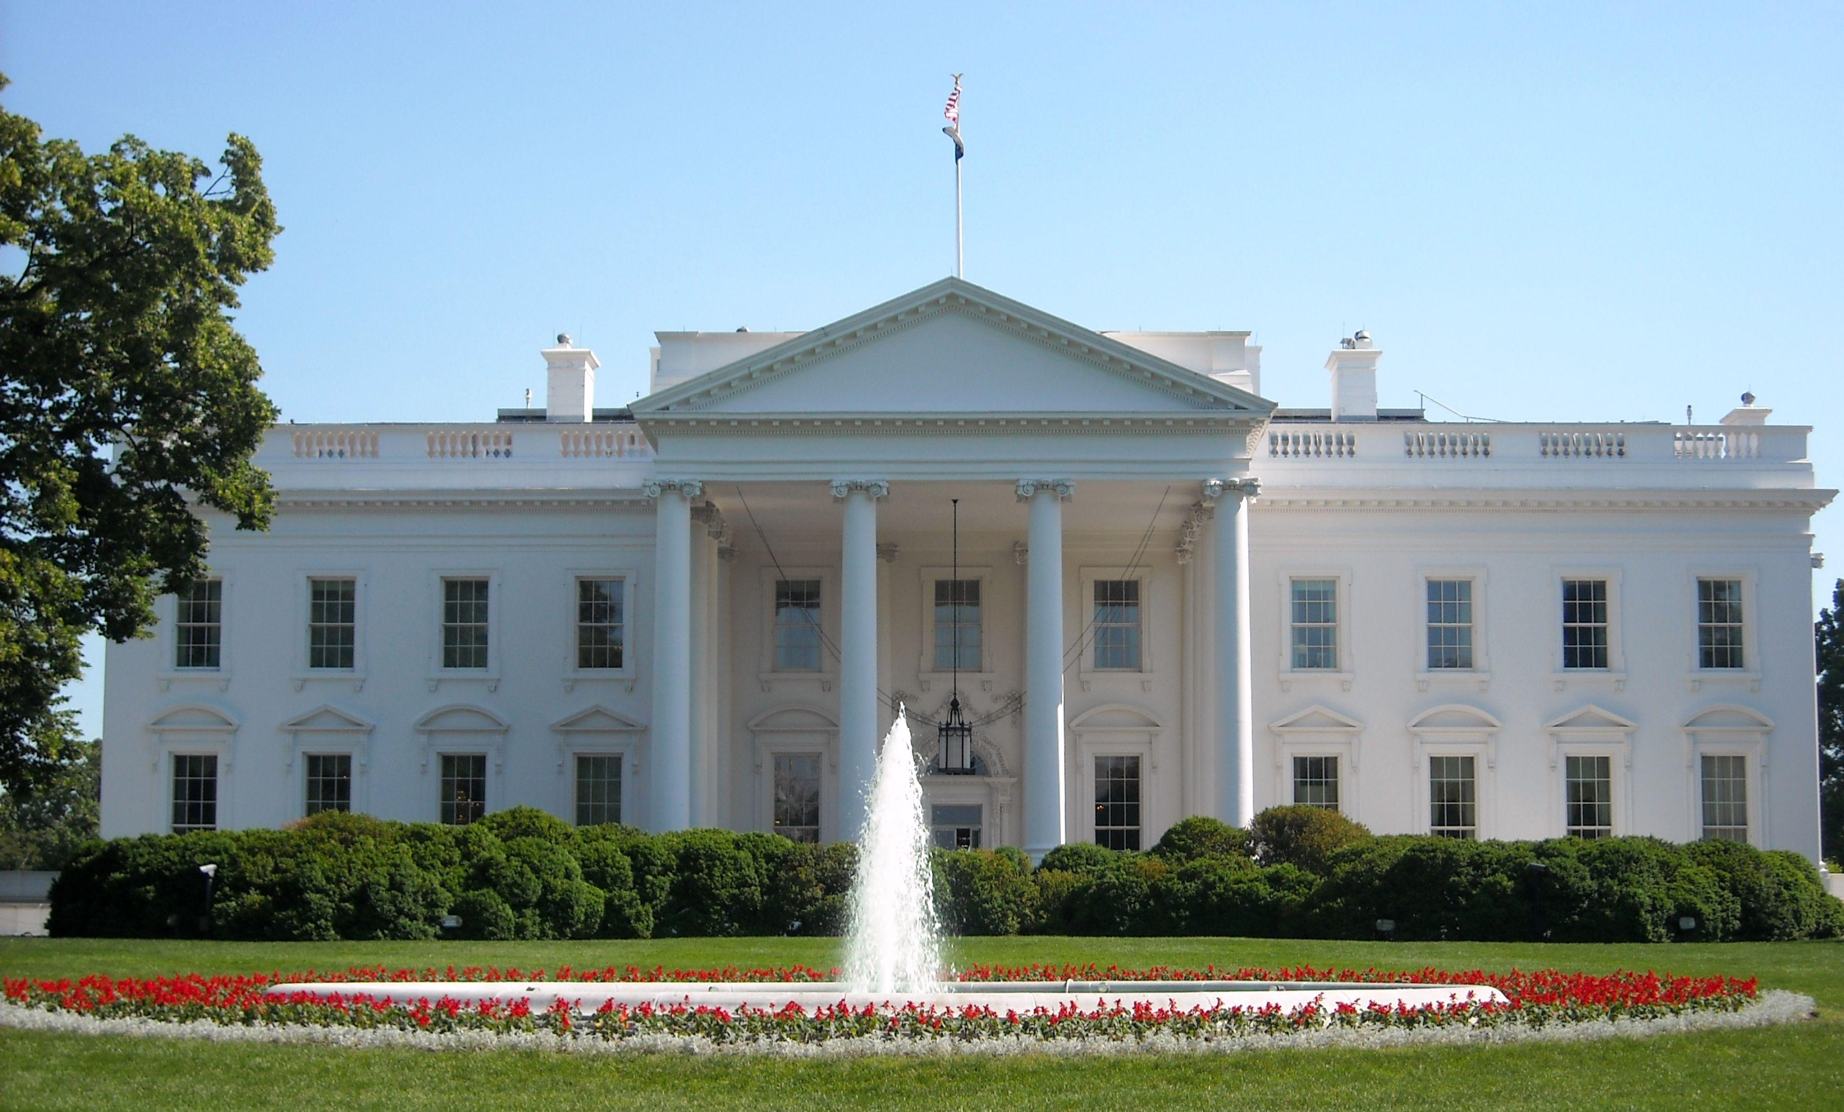
The Presidency & Domestic Policy
The President
& Domestic Politics

Slide 2
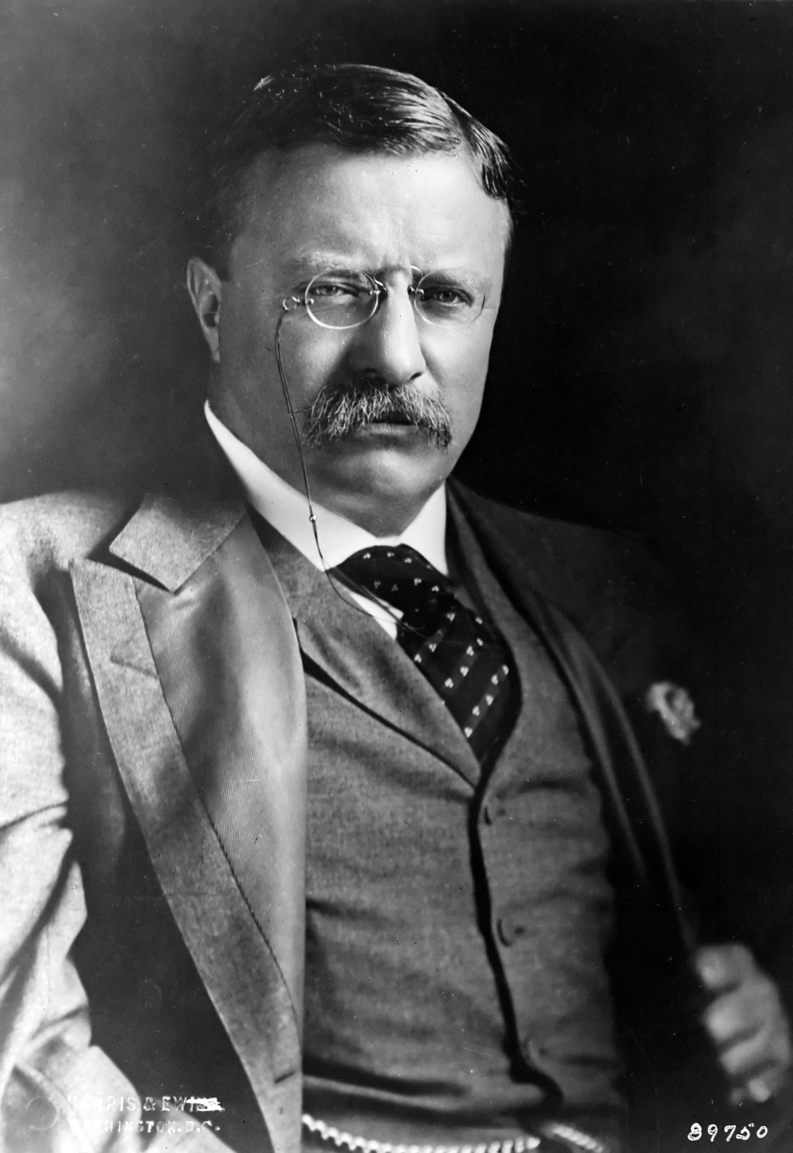
“Oh, if I only could be President and Congress, too, for just 10 minutes.”
Theodore Roosevelt

Slide 3
Today’s session
President’s constitutional powers in the domestic policy realm
How, and why, the president’s domestic policy role has expanded over time
Conditions affecting presidents’ ability to achieve their domestic policy goals

Slide 4
The President’s constitutional powers in the domestic realm
1. Chief executive—power to execute the laws
2. Legislative role—e.g., veto, State of the Union

Slide 5
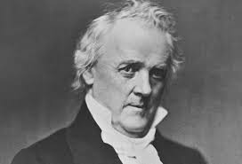
“My duty is to execute the laws . . . and not my individual opinions.”
James Buchanan

Slide 6
Enabling the president to exert more control over the bureaucracy
1. Budget and Accounting Act (1921)—Congress give the president through the executive budget greater power over agency budgets
2. Executive Office of President (1939)—Congress gives the president the staffing necessary to more fully oversee the activities of the federal agencies.

Slide 7
2010 Affordable Care Act
Title I Quality, affordable health care for all Americans
Title II The role of public programs
Title III Improving the quality and efficiency of health care
Title IV Preventing chronic disease and improving public health
Title V Health care workforce
Title VI Transparency and program integrity
Title VII Improving access to innovative medical therapies
Title VIII Community living assistance services and supports
Title IX Revenue provisions
Title X Reauthorization of the Indian Health Care Improvement Act

Slide 8
“The essence of decision is choice; and, to choose, it is first necessary to know.”
Ted Sorenson, presidential assistant

Slide 9
President’s informal advantages as legislative leader
National election—because of it, public looks to president for leadership on national issues, more so than individual Senate or House members. (foundation of “bully pulpit”)
Singular authority—unlike Congress, where authority divided—executive authority not shared. Constitution vests it entirely in president.

Slide 10
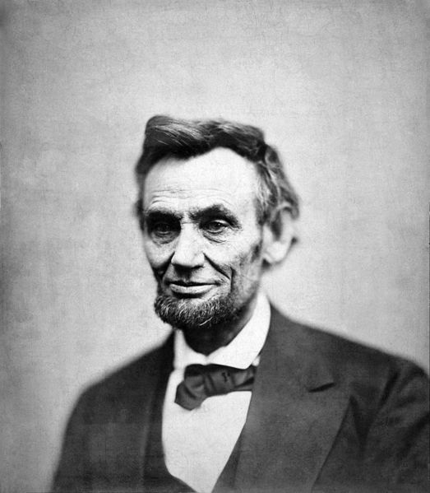
“Seven nays and one aye. The ayes have it.”
– Abraham Lincoln

Slide 11
“That’s not the way we do things here—you draft the bills, and we work them over.”
House Committee Chairman, comment addressed to President Dwight Eisenhower

Slide 12
What’s most important in presidential policy success?
Whether the president has just won election by a wide margin?
Whether the president is highly popular with the American public?
Whether the president’s party has a congressional majority?
Whether circumstances dictate policy action?

Slide 13
“Each decision is bound to hurt someone . . . [it] will satisfy one group but anger three others.”
– Top Aide to President Gerald Ford

Slide 14
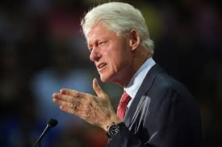
“[I had] no choice but to play the hand that history had dealt.”
– Bill Clinton

Slide 15
President Obama’s “Success Rate” in Congress, before & after 2010 election
Source: Congressional Quarterly Weekly Report, various dates

Slide 16
President Bush’s “Success Rate” in Congress, before & after 2006 election
Source: Congressional Quarterly Weekly Report, various dates

Slide 17
“In the end, the arithmetic is decisive.”
              Arthur Schlesinger, Jr., historian and presidential advisor

Slide 18
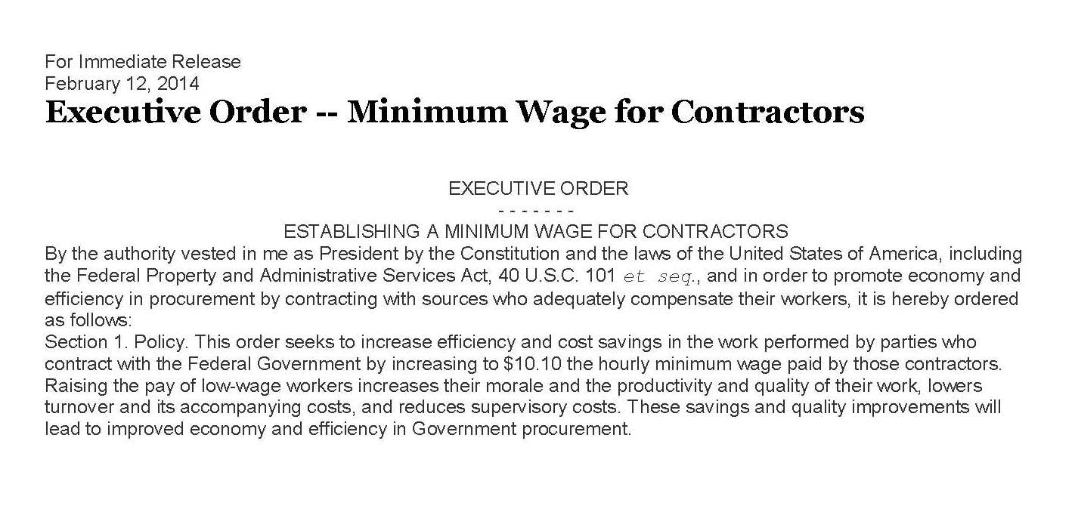
Executive orders are issued in context of existing law… presidents can direct how the law will be executed, as long as they do not violate any of its provisions.

Slide 19
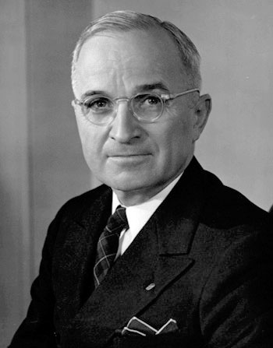
“The people can never understand why the president does not use his supposedly great power to make [Congress] behave.”
President Harry S. Truman

Slide 20
Case Study: Food Stamp Act
The Food Stamp Act of 1964
--part of Lyndon Johnson’s War on Poverty
But, unlike, many of other initiatives, it…
  did not have strong public support
  was opposed by business lobbies
  was opposed by farm lobby (which feared linking food with welfare would weaken support for farm subsidies)
Notes:
Why less support? Redistribution policy to benefit poor (not middle class)
(Unlike Medicare, which benefits all retirees)

Slide 21
Party Composition of
88th Congress (1963-64)
Number of seats

Slide 22
House Vote on Food Stamps Bill
If all House members had voted, how many votes needed for passage?
Notes:
The point: Johnson didn’t need any Republican votes to pass the Food Stamps bill—226 Democrats supported. If all 435 had voted, it would have passed with 218 votes. Johnson’s party was all he needed

Slide 23
Presidential “Success Rate” in Congress
Source: Congressional Quarterly Weekly Report, various dates

Slide 24
The 2009 Stimulus Bill (as enacted)
$787 billion stimulus package (formally called American Recovery and Reinvestment Act of 2009). Included, e.g.,
  >construction projects
  >extended unemployment benefits
  >assistance to state & local governments to enable them to retain their workers

Slide 25
House Vote on the 2009 Stimulus Bill

Slide 26
Senate Vote on the 2009 Stimulus Bill

Slide 27
2011 Stimulus Bill (as proposed)
$447 billion stimulus package (formally called the American Jobs Act), included
  Infrastructure projects (e.g., road construction)
  Extend unemployment benefits
  Payments to states and localities to retain teachers, police, firefighters

Slide 28
Party Composition of Congress, before and after 2010 election

Slide 29
Senate Cloture Vote* on 2011 Stimulus Bill
*For cloture (a vote to end a filibuster), 60 votes are needed

Slide 30
Summary
1. Presidents’ constitutional powers in domestic policy realm
2. Presidents’ advantages (relative to Congress) in initiating major policy proposals
3. Factors affecting presidents’ success in getting their proposals through Congress—particularly, the party composition of Congress

Slide 31
“The plain fact is that the United States does not have presidential system. It has a separated system.”
              Charles Jones,
              political scientist

