Slide 1
2022 Midterm Elections
Tom Patterson, author of We the People

Slide 2
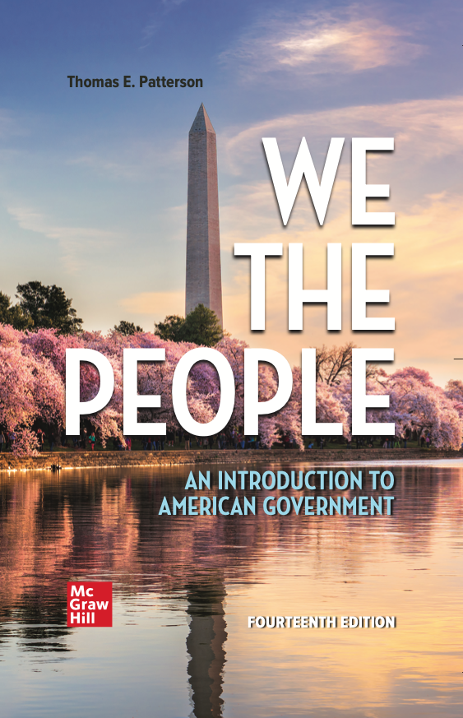
WE THE PEOPLE, 14e
NUMBER ONE in American Government
Accessibility through Readability
Critical Thinking Emphasis—Case Studies & Pedagogy
Even-handed approach with broad appeal
Unparalleled Instructor Support—24 Complimentary HarvardX/EdX Video Lectures
To obtain a free instructor’s copy of We the People, please contact Michael Gedatus at Michael.Gedatus@mheducation.com

Slide 3
2022 Midterm Elections
Tom Patterson, author of We the People

Slide 4
Overview
Midterm election tendencies
Projections for 2022
Developments that might alter projections
Implications if projections hold

Slide 5
The Midterm Tendency – House Elections

Slide 6
The Midterm Tendency – Senate Elections
18 of 25 midterms
marked by in-party losses

Slide 7
Theories of
Presidential Party’s Midterm Losses
Surge and Decline Theory
based on change in composition of voters from previous presidential election
Referendum Theory
focuses on the president’s popularity and performance

Slide 8
2022 House Elections

Slide 9
Surge and Decline Theory of Midterm Elections
Presidential election brings out a “surge” of voters who, compared with those who also vote in the midterm, are more responsive to the mood of moment and disproportionately back the winning presidential candidate and congressional candidates of his/her party.
In the midterm election, these voters stay home (“decline”), erasing the in-party’s advantage.

Slide 10
Estimating Surge and Decline
Self-defined independents:
1. Larger part of presidential electorate than midterm electorate
2. More responsive to mood of moment
Since 1980:
Each percentage point advantage that the presidential victor has among Independents is associated with a loss of 2.2 House seats in the subsequent midterm election.

Slide 11
Predicting 2022 from
Surge and Decline Theory
14-point advantage for Biden

Slide 12
Predicting 2022 from
Surge and Decline Theory
Biden’s 14-point
advantage in 2020
predicts Republican gain of 31 seats in 2022

Slide 13
Referendum Theory of Midterm Elections
After taking office, presidents make policy choices that tend to make more enemies than friends, leading to declining popularity that weakens appeal of president’s party in midterms.

Slide 14
Change in Presidential Approval Rating from First Year in Office to Second Year
Source: Gallup polls

Slide 15
Change in Presidential Approval Rating from First Year in Office to Second Year
Source: Gallup polls

Slide 16
Presidential Approval Rating and Out-Party Share of House Vote
Out-party
share of
House vote
Presidential approval rating

Slide 17
Presidential Approval Rating and Out-Party Share of House Vote
Biden’s approval rating
predicts that Republicans
will win 2022 House vote by
53-47 nationally
Out-party
share of
House vote
Presidential approval rating

Slide 18
Generic Two-Party Congressional Vote
Democratic
Republican
Source: Real Clear Politics, based on multiple polls

Slide 19
Out-Party Share of Midterm Two-Party Vote and Gain/Loss of House Seats
Out-party
gain/loss
House seats
Note: Based on 1972-2018 midterms

Slide 20
Out-Party Share of Two-Party Vote and Gain/Loss of House Seats
Out-party
gain/loss
House seats

Slide 21
Why Democrats Aren’t Likely to Lose
30 or More Seats
In past midterms, huge gains by out-party occurred when in-party had large House majority and was defending many seats.
2010 Example: Democrats had a 79-seat advantage in House, enabling GOP to gain huge number of seats when voters swung in its direction
Democrats currently have a 10-seat advantage, reducing likelihood of a Republican “wave” election, though not the likelihood of a Republican takeover.

Slide 22
2022 Senate Elections

Slide 23
2022 Senate races –
Cook Political Report Assessment

Slide 24
Toss-up and Leaning Races (Cook Political Report)
Toss up
Arizona – Mark Kelly (D)
Georgia – Raphael Warnock (D)
Nevada – Catherine Cortez Mastro (D)
Wisconsin – Ron Johnson (R)
North Carolina – open (currently R)
Pennsylvania – open (currently R)
Lean Democratic
New Hampshire – Maggie Hassan (D)
Lean Republican
Florida - Marco Rubio (R)
Ohio – open (currently R)

Slide 25
If Senate elections were held today (and if early polls can be trusted), the results would be . . .

Slide 26
A final factor to consider – “Enthusiasm Gap”
“Enthusiasm Gap” refers to the gap between the eagerness to vote of one party’s identifiers and the opposing party’s identifiers.
Enthusiastic voters are more likely to show up at the polls on Election Day.

Slide 27
Enthusiasm Gap in Recent Midterms
Source: Gallup polls

Slide 28
Enthusiasm Gap – 2022 Midterms
R+14
Source: NBC News poll, January 2022

Slide 29
“Unknown Knowns” that could impact outcome of 2022 Midterm Elections
Biden’s approval rating
Partisan Gerrymandering
Ballot Access laws

Slide 30
Biden’s Approval Rating

Slide 31
Biden Approval Rating
Source: Real Clear Politics, average of multiple polls

Slide 32
Increase in Biden Approval?
A sharp increase in Biden’s approval rating would improve Democrats’ chances.
But:
Federal Reserve projects high inflation and slowing economic growth for rest of 2022- both factors are associated with low approval ratings.
Biden’s approval rating has increased by only 1 percentage point during Ukrainian crisis. Unlike some crises, it hasn’t prompted a large “rally ‘round the flag” boost in presidential approval.
Unclear what could prompt a dramatic upswing

Slide 33
Biden’s Approval Rating Problem

Slide 34
Biden’s Approval Problem

Slide 35
Partisan Gerrymandering

Slide 36
Partisan Gerrymandering
In Rucho v. Common Cause (2019) the Supreme Court prohibited federal courts from ruling on partisan gerrymandering cases, saying:
  “Excessive partisanship in districting leads to results that reasonably seem unjust. But the fact that such gerrymandering is incompatible with democratic principles does not mean that the solution lies with the federal judiciary….”
But that’s not full story:
“Racial gerrymandering” remains unlawful [Cooper v. Harris (2017)]
Some state laws and constitutions place limits on gerrymandering, which can bring state courts into play.

Slide 37
Control of Redistricting
Source: FiveThirtyEight

Slide 38
Last time . . .
After 2010 census, Republicans also controlled redistricting of more House seats
Center for American Progress estimated the Republicans in 2012 picked up 19 additional House seats from their redistricting advantage.
Democrats won national House vote by 1.1 percentage points, but Republicans won control of House of Representatives by 234-201.

Slide 39
Why Republicans might not get as many extra seats this time
Democrats are showing less restraint this time. If they survive judicial scrutiny, New York Democrats’ redistricting map could result in pickup of 4 Democratic seats while Illinois Democrats’ map could add 2.
Democrats are challenging every Republican redistricting plan that’s vulnerable to legal challenge and already have had some success, e.g.
In Alabama, a federal district court struck down the Republican legislature’s redistricting plan on racial grounds.
State courts in Pennsylvania, Ohio, and North Carolina have taken control away from Republican-controlled legislature (collectively those states have 46 House seats).

Slide 40
The “Big Sort” – another reason the Republican gerrymandering yield could be smaller this time
The sorting of partisans – Democrats increasingly concentrated in urban areas and Republicans elsewhere – is reducing the number of seats that can effectively be gerrymandered

Slide 41
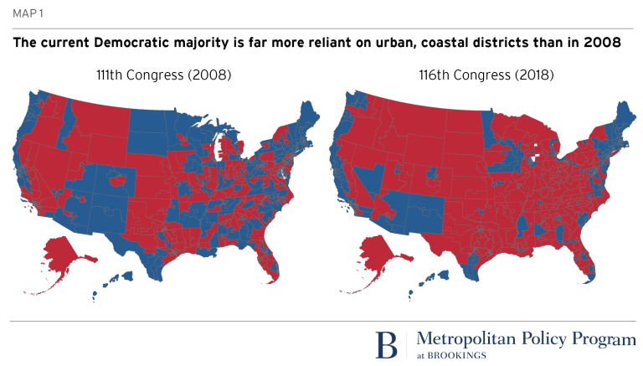
Geographical Distribution of House Seats –
2008 vs 2018
111th Congress (2009-2010) 116th Congress (2019-2020)

Slide 42
Gerrymandering plus geographical sorting - shrinking number of “competitive” House seats
The decline of competitive
House districts could “cap”
the number of House seats
picked up by the out-party
in midterm elections
Source: NY Times, Feb 7, 2022 for 1992, 2002, and 2002. The 2002 number estimated by author from multiple sources. A competitive
seat is defined as one in which the presidential candidates in prior election were within 5 percentage points of each other.

Slide 43
Senate races somewhat more competitive
Source: Cook Political Report, 2020 for House; 2020, 2018, 2016 for Senate

Slide 44
Indicator of
Declining Competitiveness of Senate Elections
Source: Pew Research Center

Slide 45
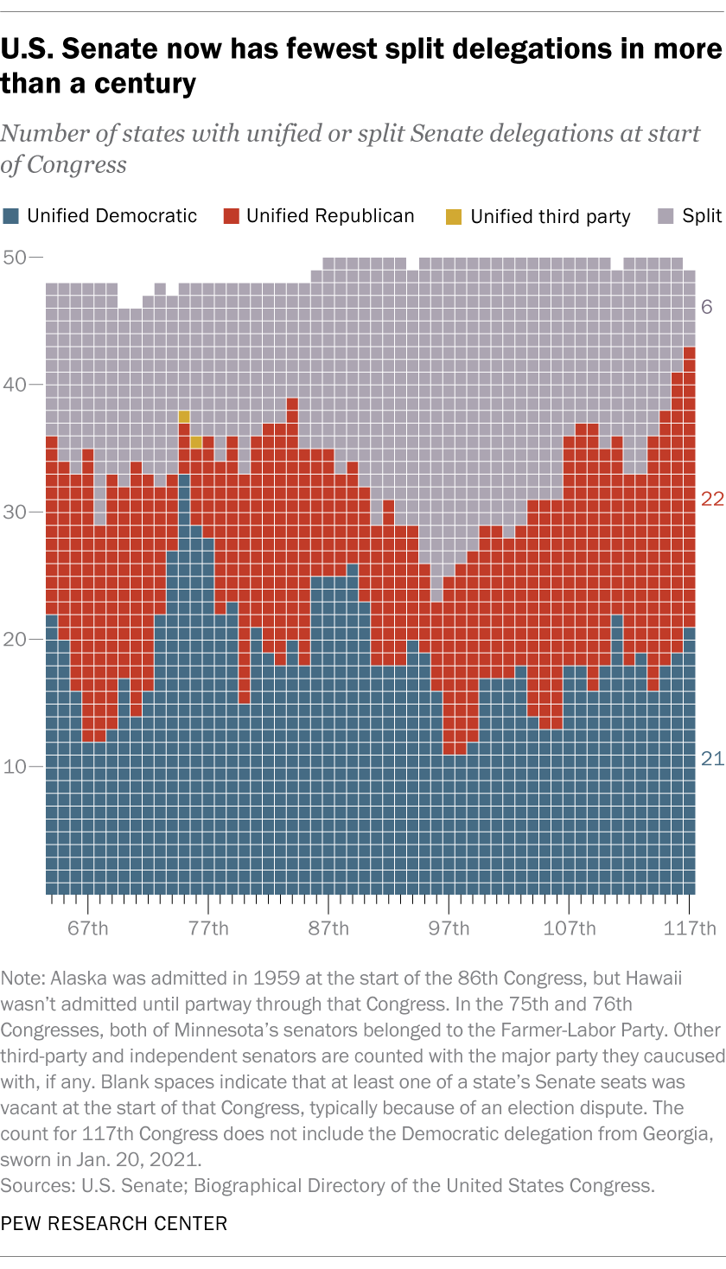
Declining Competitiveness -
Era of direct Senate elections (1914-2022)
Senate has fewest split delegations
in the entire period of direct Senate elections

Slide 46
Ballot Access

Slide 47
What we know . . .
On Republican side
Roughly 20 Republican-controlled states since the 2020 election have passed laws tightening ballot access –
several of these laws are under review in state and federal courts
On Democratic side
Nearly 20 states, most of them controlled by Democrats, have since 2016 instituted Automatic Voter Registration (AVR) in context of Motor Voter Act
Combined impact
Will make Republican states more solidly Republican control and Democratic states more solidly Democratic

Slide 48
What We Know –
Ballot access rules affect turnout rate
highest
State turnout
rate
lowest
lowest
highest
State rank in voting barriers
Source: For barriers: Scot Schranfruagal, et al, “Cost of Voting in the American States:2020,” Election Law Journal (cost index is based registration deadlines and restrictions; For turnout, US Census Bureau (based on percentage of vote-eligible citizens who voted).

Slide 49
If Republicans take control of Congress

Slide 50
Presidents’ Legislative Success
Source: CQ Voting Studies, 1952-2017

Slide 51
President Trump’s Legislative Success Rate
Source: CQ Vote Studies

Slide 52
President Obama’s Legislative Success Rate
Source: CQ, 2012

Slide 53
Looking ahead to 2024

Slide 54
Does the Midterm election predict outcome of next presidential election?

Slide 55
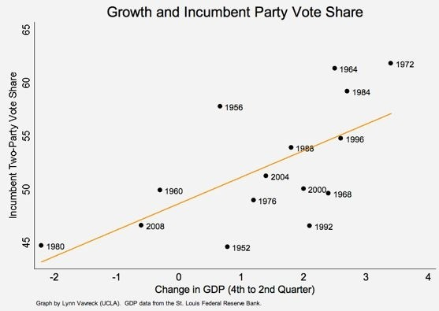
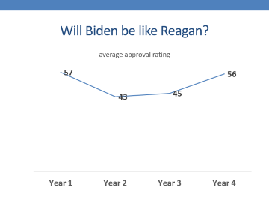
Democrats’ chances in 2024 likely hinge on economy -
GDP and incumbent-party share of presidential vote
Notes:
The data suggest that for every 1 percent growth in GDP from the fourth to the second quarter of an election year, an incumbent party can expect to pick up an additional 2.5 percentage points on Election Day. Two-and-a-half points in vote share may sound small, but consider that of the 16 elections in these graphs, five elections (1960, 1968, 1976, 2000, and 2004) were decided by this small (or smaller) a margin of victory.

Slide 56
Will Biden be like Reagan?

Slide 57
Or will Biden be like Carter?

Slide 58
If the presidential election were held today, would you vote for . . . ?
Source: Fox News poll, March 2022

Slide 59
Thank You
Questions, Observations, Objections?

Slide 60
WE THE PEOPLE, 14e
NUMBER ONE in American Government
Accessibility through Readability
Critical Thinking Emphasis—Case Studies & Pedagogy
Even-handed approach with broad appeal
Unparalleled Instructor Support—24 Complimentary HarvardX/EdX Video Lectures
To obtain a free instructor’s copy of We the People, please contact Michael Gedatus at Michael.Gedatus@mheducation.com

Slide 61
Additional Slides

Slide 62
Average In-Party Performance since 2006

Slide 63
Projecting 2024 Congressional Elections – seats gained by party of presidential winner

Slide 64
House Members by Population Density
number of House members
Source: FairVote, 2017.

Slide 65
Is there a redistricting effect that benefits out-party? Apparently not . . .

