Slide 1
2022 Midterm Elections
Tom Patterson, author of We the People

Slide 2
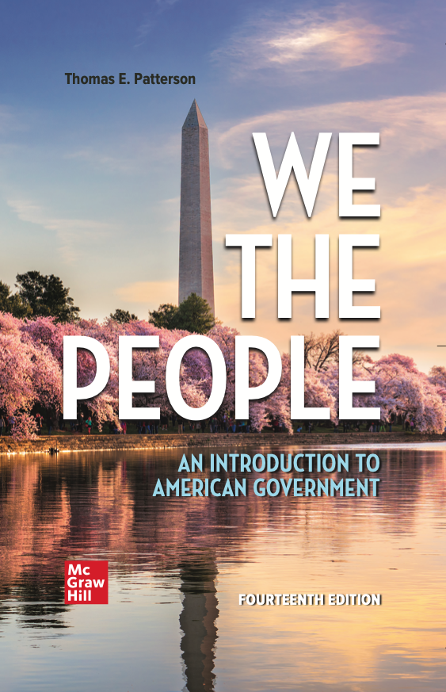
WE THE PEOPLE, 14e
NUMBER ONE in American Government
Accessibility through Readability
Critical Thinking Emphasis—Case Studies & Pedagogy
Even-handed approach with broad appeal
Unparalleled Instructor Support—24 Complimentary HarvardX/EdX Video Lectures
To obtain a free instructor’s copy of We the People, please enter your name and affiliation in the Chat Room.

Slide 3
2022 Midterm Elections
Tom Patterson, author of We the People

Slide 4
Overview
Vote tendencies in midterm elections
Factors unique to the 2022 midterms that could reinforce or disrupt the tendencies.

Slide 5
The Midterm Tendency – House Elections

Slide 6
The Midterm Tendency – Senate Elections
18 of 25 midterms
marked by in-party losses

Slide 7
2022 House Elections

Slide 8
Theories of
Presidential Party’s Midterm House Losses
Surge and Decline Theory
based on change in composition of voters from presidential election to the midterm
Referendum Theory
focuses on the president’s popularity and performance

Slide 9
Surge and Decline Theory of Midterm Elections
Presidential election brings out a “surge” of voters who, compared with those who also vote in the midterm, are more responsive to the mood of moment and disproportionately back the winning presidential candidate and congressional candidates of his/her party.
In the midterm election, these voters stay home (“decline”), erasing the in-party’s advantage.

Slide 10
Estimating Surge and Decline
Self-defined independents:
1. Larger part of presidential electorate than midterm electorate
2. More responsive to mood of moment
Since 1980:
Each percentage point advantage that the presidential victor has among Independents is associated with a loss of 2.2 House seats in the subsequent midterm election.

Slide 11
Predicting 2022 from
Surge and Decline Theory
Biden’s 14-point
advantage in 2020
predicts Republican gain of 31 seats in 2022

Slide 12
Referendum Theory of Midterm Elections
After taking office, presidents typically make more enemies than friends because of their policies and national conditions, which leads to declining popularity that weakens appeal of president’s party in midterms.

Slide 13
Change in Presidential Approval Rating from First Year in Office to Second Year
Source: Gallup polls

Slide 14
Change in Presidential Approval Rating from First Year in Office to Second Year
Source: Gallup polls

Slide 15
Presidential Approval Rating and Out-Party Share of House Vote
Out-party
share of
House vote
Presidential approval rating

Slide 16
Presidential Approval Rating and Out-Party Share of House Vote
Biden’s approval rating
predicts that Republicans
will win 2022 House vote by
52-48 nationally
Out-party
share of
House vote
Presidential approval rating

Slide 17
Out-Party Share of Midterm Two-Party Vote and Gain/Loss of House Seats
Out-party
gain/loss
House seats
Note: Based on 1972-2018 midterms

Slide 18
Out-Party Share of Two-Party Vote and Gain/Loss of House Seats
Out-party
gain/loss
House seats

Slide 19
Post-War Era Overview
In the 5 midterms in this period when the president’s approval rating has been near or above 60 percent, the in-party has either gained House seats or lost a minor number.
In the 8 midterms in this period where the president’s approval has been below 50 percent, the in-party has lost at least 26 House seats except Obama 2014 (13 seats)
Source: James Campbell, The 2022 House Midterm by the Numbers, Real Clear Politics,’
July 5, 2022.

Slide 20
Biden’s Approval Rating Problem
Source: NPR/PBS NewsHour/Marist poll, October, 2022

Slide 21
Why 2022 Might Not Fit the Model
A midterm election is typically a referendum-like response to the in-party.
What’s unusual is that the 2022 midterm is also a referendum on the out-party.
Donald Trump is not on the ballot but, he looms over the election – his persistent claim that the election was stolen and his active involvement in GOP primaries.
The Dobbs decision and the perception that the Supreme Court is pursuing a Republican agenda..

Slide 22
Biden, Trump, and the Supreme Court
Sources: For Biden, CNN, Oct 22; Trump, FiveThirtyEight, Oct 2022; for Supreme Court, Gallup poll, Sep 2022

Slide 23
Generic Two-Party Congressional Vote
Republican
Democratic
Source: Real Clear Politics, based on multiple polls

Slide 24
Another Reason Forecasting Models Are Likely to Overestimate Republican Party Performance
In past midterms, huge gains by out-party occurred when in-party had large House majority and was defending many seats.
2010 Example: Democrats had a 79-seat advantage in House, enabling GOP to gain huge number of seats when voters swung in its direction
Democrats currently have a 10-seat advantage, reducing likelihood of a Republican “wave” election.

Slide 25
2022 Senate Elections

Slide 26
2022 Senate races –
Politico’s Current Forecast

Slide 27
Toss-up and Leaning Races (Politico)
Lean Democratic
Arizona – Mark Kelly (D)
Colorado – Bennet (D)
New Hampshire – Maggie Hassan (D)
Toss up
Georgia – Raphael Warnock (D)
Nevada – Catherine Cortez Mastro (D)
Wisconsin – Ron Johnson (R)
Pennsylvania – open (currently R)
Lean Republican
Florida - Marco Rubio (R)
North Carolina – open (currently R)
Ohio – open (currently R)

Slide 28
If Senate elections had been held in March (and if polls were predictive), the results would have been. . .

Slide 29
If Senate elections were held today (and if polls are predictive), the results would be. . .

Slide 30
What happened between March and October?
Dobbs
Rise in Biden’s approval rating
Vulnerable Republican candidates in races that Republicans were favored to win (and could still win) – Walker in Georgia, Oz in Pennsylvania, Vance in Ohio, Masters in Arizona, Budd in NC – all of whom were backed by Trump in the GOP primary
    Has Trump put Republicans in the position they held in 2010 and 2012 when 4 flawed Tea-Party backed Senate candidates (Sharron Angle-NV, Christine O’Donnell, DE, Todd Akin, MO, Richard Mourdock-IN) cost them control of the Senate?

Slide 31
However . . .
Polls in recent elections have tended to underestimate the Republican vote
Republicans have gained ground recently in most Senate races
The “luck” factor

Slide 32
“Luck factor” example
In 1980, Republicans won control of the Senate for the first time in three decades.
7 Senate seats flipped from one party to the other by a margin of 52-48 percent or less.
All 7 Senate seats were won by the Republican candidate.

Slide 33
2022 House and Senate Elections

Slide 34
A factor affecting all candidates –
The “Enthusiasm Gap”
“Enthusiasm Gap” refers to the gap between the eagerness to vote of one party’s identifiers compared with the opposing party’s identifiers.
Enthusiasm Gap is used as an indicator of likely turnout in the midterms – whether it will favor one party or the other

Slide 35
Enthusiasm Gap in Recent Midterms
Source: Gallup polls

Slide 36
Enthusiasm Gap - 2022
Survey: Morning Consult-Politico polls

Slide 37
The Money Gap
Source: Estimated from OpenSecrets analysis of federal campaign disclosures filed through Sept. 20, 2022.

Slide 38
Known Unknowns in 2022 Midterms
Popularized by Defense Secretary Donald Rumsfeld . . .
Known unknowns refer to factors we recognize but don’t fully comprehend
In contrast with . . .
Unknown knowns, which are things that you think you know but turn out to be different.

Slide 39
“Known Unknowns” in the
2022 Midterm Elections
Reapportionment and Redistricting
Ballot Access laws

Slide 40
“Known Unknowns” in the
2022 Midterm Elections
Reapportionment and Redistricting
Ballot Access laws

Slide 41
Reapportionment
7 House seats shifted between states. Republican-controlled states gained 5 of them. Texas picked up two seats while Florida, Montana, and North Carolina each picked up one.
Based simply on those numbers, Republicans should have a net gain of 3 seats from the shift.
But it could be 2 seats in that 3 of the states t hat lost seats have a Republican controlled legislature – Ohio, Pennsylvania, and West Virginia.

Slide 42
Redistricting – Who Decided?
Source: FiveThirtyEight

Slide 43
Last time . . .
After 2010 census, Republicans also controlled redistricting of more House seats
Center for American Progress estimated the Republicans in 2012 picked up 19 additional House seats through gerrymandering.
Democrats won national House vote by 1.1 percentage points, but Republicans won control of House of Representatives by 234-201.

Slide 44
The “Big Sort” –
Why Republican gerrymandering will yield fewer seats this time
The sorting of partisans – Democrats increasingly concentrated in urban areas and Republicans elsewhere – is reducing the number of seats that can effectively be gerrymandered

Slide 45
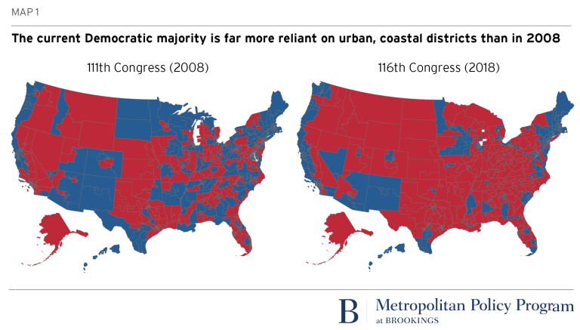
Geographical Distribution of House Seats –
2008 vs 2018
111th Congress (2009-2010) 116th Congress (2019-2020)

Slide 46
House Members by Population Density
number of House members
Source: FairVote, 2017.

Slide 47
Sophisticated gerrymandering plus geographical sorting - shrinking number of “competitive” House seats
The decline of competitive
House districts could “cap”
the number of House seats
picked up by the out-party
in midterm elections
Source: NY Times, Feb 7, 2022 for 1992, 2002, and 2002. The 2002 number estimated by author from multiple sources. A competitive
seat is defined as one in which the presidential candidates in prior election were within 5 percentage points of each other.

Slide 48
Cumulative Effect of Redistricting –
Competitiveness in Context of 2020 Vote
Source: Brennan Center for Justice, New York University

Slide 49
Why those numbers are less favorable to Democrats than it might appear
The “lean Biden” districts on average are more competitive than the “lean Trump” districts.
In other words, Republicans might have the better chance of picking up most of the “lean” districts.
Trump “ran behind” Republican congressional candidates in 2020 – Biden outpolled Trump by 4.4 percent points of the popular vote compared to Democratic House candidates outpolling their Republican rivals by 3.1 percent.
In other words, if district competitiveness had been declined by congressional vote rather than presidential vote, the numbers would have been more favorable to Republicans.

Slide 50
The Courts
Court decisions have also worked against Democrats’ goal of keeping the House.
In NY and Maryland, state court threw out redistricting plans that strongly favored Democratic candidates.
In Wisconsin, state court left largely in place a redistricting plan from the last census that favors Republicans.
In Ohio, state court allowed a pro-GOP gerrymander to remain in place for the 2022 midterms.
In Alabama, Louisiana, and Georgia, federal courts blocked the creation of three majority Black districts.
If all these had gone in Democrats’ favor, they would likely have picked up an additional 10-12 House seats

Slide 51
Courts & Election Commissions – a Republican edge
According to the Brennan Center’s analysis, the courts and redistricting commissions created two-thirds of all competitive Biden districts nationwide and 9 of 11 of the most competitive.
Without these districts, the Republican path to a winning control of the House would be far more difficult.

Slide 52
Ballot Access

Slide 53
What we know . . .
On Republican side
Roughly 20 Republican-controlled states since the 2020 election have passed laws tightening ballot access –
some of these laws are under review in state and federal courts but the cases will not be decided before the midterm

Slide 54
The chief target of the Republican laws – imposing limits on mail-in and absentee balloting
Source: 2020 exit polls

Slide 55
What We Know –
Ballot access rules affect turnout rate
highest
State turnout
rate
lowest
lowest
highest
State rank in voting barriers
Source: For barriers: Scot Schranfruagal, et al, “Cost of Voting in the American States:2020,” Election Law Journal (cost index is based registration deadlines and restrictions; For turnout, US Census Bureau (based on percentage of vote-eligible citizens who voted).

Slide 56
If Republicans take control of Congress

Slide 57
Biden’s Agenda Will Tank –
Presidents’ Legislative Success
Source: CQ Voting Studies, 1952-2017

Slide 58
President Trump’s Legislative Success Rate
Source: CQ Vote Studies

Slide 59
Looking ahead to 2024

Slide 60
Does the Midterm election predict outcome of next presidential election?

Slide 61
Will Biden be like Reagan?

Slide 62
Or will Biden be like Carter?

Slide 63
If the presidential election were held today, would you vote for . . . ?
Source: ABC News/The Washington Post, September 2022.

Slide 64
Thank You
Questions, Observations, Objections?

Slide 65
WE THE PEOPLE, 14e
NUMBER ONE in American Government
Accessibility through Readability
Critical Thinking Emphasis—Case Studies & Pedagogy
Even-handed approach with broad appeal
Unparalleled Instructor Support—24 Complimentary HarvardX/EdX Video Lectures
To obtain a free instructor’s copy of We the People, please enter your name and affiliation in the Chat Room.

