Slide 1
Party Polarization - in the Nation and the classroom
Tom Patterson
April 20, 2023

Slide 2
The Making of a Polarized Nation

Slide 3
The gradual realignment that fueled today’s polarized politics
Race – 1964 Civil Rights Act, plus
Cultural issues – late 1960s and 1970s
Scope of federal programs – 1970s-1990s

Slide 4
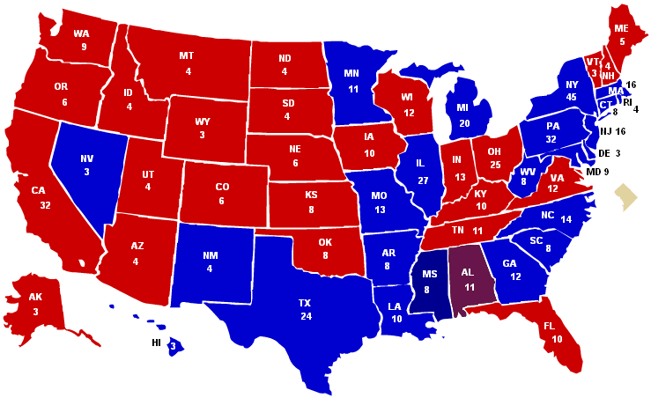
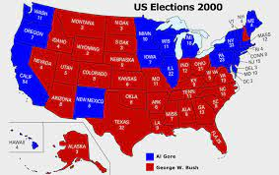
Partisan Change
1960 Election
Pre-realignment
2000 Election
Post-realignment

Slide 5
Key Aspect of the Realignment –
Reinforcing Issues
Going back in time – earlier sources of moderation in the American political system
Pluralism
Cross-cutting identities
Incrementalism
The new reality –
Overlapping and therefore reinforcing issues & identities – a seedbed for polarization

Slide 6
Correlation between religious attendance and party identification (NES surveys)
Rise of religion in U.S. politics

Slide 7
One More Aspect of the Change –
Intra-Party Takeover of the GOP
Throughout most of this period of change, Republican Party was dominated by its Establishment Wing (reflected in presidential nominations of Bush 1 and 2, McCain, Romney)
War on the Establishment Wing
Rise & institutionalization of the Tea Party (2009-2012)
Nomination of Trump in 2016

Slide 8
View of Congress in 2015
(Republicans are in control House & Senate)
Source: Pew Research Center poll, 2015

Slide 9
Republicans’ View of Their Party and Candidate Preference in 2016 Primaries
Republican Primary Voters’ View of Their Party
Vote Choice of Republicans Who Feel Party Has Betrayed Them
Source: 2016 primary exit polls where question was asked. Percentages include those
who indicated an opinion/preference.

Slide 10
Cumulative Effect –
Today’s parties
Democratic Party: A product of its 1930s-1960s transformation – the party of economic security programs, civil rights, cultural liberalism. Reductively, the federal party.
Republican Party: A product of its more recent transformation – the party of small government (economic sphere) & cultural conservatism. Reductively, the states-rights party.
Our parties are as far apart as at nearly any time in their history.

Slide 11
The Partisan Divide –
Issue Polarization Example
Source: Gallup polls

Slide 12
The partisan divide – affective polarization example
Source: CBS News poll, February, 2021

Slide 13
The partisan divide – perceptual polarization (alternative realities) example
Source: Gallup polls

Slide 14
A Hardening of the Division –
Why We Shouldn’t Expect Short-term Change
The increasing number of uncompetitive states & districts as a result of gerrymandering and the “Big Sort” – primary elections are increasingly decisive and favor candidates from the wing of the party.
Political leaders who have no qualms about playing to our divisions.
A media system that also plays to the divides and derives financial gain from doing so.

Slide 15
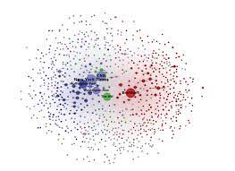
Today’s Media System –
Two Networks, Two Versions of Reality
Outlets on the partisan side are fewer and overwhelmingly conservative in orientation
Traditional
Partisan
Source: Benkler, et al, Network Propaganda (New York: Oxford University Press, 2018)

Slide 16
Partisan Sorting:
Cable News Audience
Source: Pew Research Center poll, 2019

Slide 17
Social Media
Partisan Echo Chambers
Sharing on Twitter of media-created Information about Covid
Democrats – less than 1% of shared messages that originated with partisan media
Republicans – nearly 50% of their shared messages originated with partisan media
Source: Sebastian Blum, Master’s thesis, Harvard University, 2022.

Slide 18
How and When might polarization subside

Slide 19
A feature of today’s politics that’s historically unusual and a barrier to reducing polarization
Intense Party Competition–
The two parties our closely matched, which is rare in the history of our parties.

Slide 20
Closely Matched Parties – presidency

Slide 21
Closely Matched Parties:
Average Margin of House Majority
Notes:
If I had charted the party percentages in House and Senate, you’d see similar results

Slide 22
Closely Matched Parties:
Average Margin of Senate Majority
Notes:
If I had charted the party percentages in the House and Senate, you’d see similar results

Slide 23
Why Close Competition Fosters Polarization
Historically, when closely matched, each party is dedicated to undermining the other party in hope of winning the next election:
  “The single most important thing we want to achieve is for President Obama to be a one-term president,” said Republican Senate leader Mitch McConnell in 2009.
  “Dead on arrival,” said Democratic House Speaker Nancy Pelosi in 2019 on Trump’s legislative agenda.

Slide 24
Historically, when one party has been much stronger than the other, they have acted differently
  The stronger party has focused on governing. It isn’t worried about losing the next election.
  The weaker party has moved closer to the stronger party and avoided demonizing it in hopes of drawing away enough of its supporters to become competitive.
  Our polarization likely won’t end until one or the other party achieves an unassailable majority position.

Slide 25
Could that party be the Republicans?
Among the reasons:
Greater support than the Democrats at the state and local levels
Recently have begun to cut into Democrats’ advantage with the nation’s two fastest-growing demographic groups – Hispanics and Asian Americans.

Slide 26
Party control of state offices

Slide 27
Could that party be the Democrats?
Among the reasons:
Since 2004, young voters have strongly supported the Democratic Party in presidential and midterm elections

Slide 28
Youth Vote (ages 18-29)
Source: Exit polls, 2000-2020

Slide 29
The cumulative effect of Democratic gains among young adults
Source: 2020 exit polls, based on 2-party vote only

Slide 30
Addressing Party Polarization in the Classroom

Slide 31
Polarization in the classroom – unwanted outcomes
Unwanted outcomes include:
Name-calling and worse
Spiral of Silence – those in minority shut down
Close-mindedness – from hearing only the like- minded

Slide 32
Some things I do
Rules –
civility
deliberation, not debate
Empower those who believe that speaking up might work against them

Slide 33
A typical result when I poll my students on their political ideology

Slide 34
Americans’ Political Ideology
Source: Gallup poll, 2021.

Slide 35
Talking about Misinformation
My students see misinformation as a problem but believe that the problem is centered on the other side of the partisan divide, not their side.
I try to open their minds a bit by suggesting that it’s a problem affecting all of us.

Slide 36
Examples of factual claims from 2020
Donald Trump faked having Covid-19 in order to win sympathy votes
Joe Biden is mentally impaired
Dr. Anthony Fauci funded a lab in Wuhan to develop the coronavirus
If reelected, Donald Trump planned to eliminate social security and Medicare
Kamala Harris was not born in United States
CDC manipulated numbers to exaggerate fatalities from Covid-19
President Trump went to the hospital while president after suffering a stroke
Vote counting machines overcounted the Biden vote

Slide 37
None are true, but each is believed by tens of millions of Americans
Source: Indiana University’s Observatory on Social Media survey, November 2020

Slide 38
Confirmation Bias
Our psychological tendency to interpret claims in ways that align with our preexisting beliefs and biases.

Slide 39
Confirmation Bias affects Republicans & Democrats alike - accepting false claims that align with one’s partisanship
Source: Indiana University’s Observatory on Social Media survey, November 2020

Slide 40
A final example – approaching polarization through an analytic lens
My goal here is to try to get them to understand the other side rather than judge it.

Slide 41
COVID-19
Biggest health threat of past century
Note: COVID-19 death rate is period before vaccine became widely availabe

Slide 42
Public health was not the only issue – economic downturn was the other
Source: U.S. Department of Labor

Slide 43
Responses to the COVID-19 Pandemic
U.S. has a federal system of government in which power is constitutionally divided between the national government and the state governments.
One of the constitutional powers reserved to the state governments is public health.
State governors have more authority than the president over public health mandates.

Slide 44
Governors’ Response –
Restrictions on Social Gatherings
Same pattern held for mandates on masks and restrictions on business activity
Source: Christopher Adolph, et al, “Pandemic Politics: Timing State-Level Social Distancing Responses to COVID-19,” Journal of Health Politics, Policy and Law, August 2020, pp. 1-17.

Slide 45
Covid Vaccination Rates
Note: Based on those who are fully vaccinated. The rankings vary only slightly if based on single dose only

Slide 46
Covid Deaths (as of 4/16/2021)
States with:
Republican governor 159/100,000
Democratic governor 126/100,000
Source: Derived by author from New York Times Covid data base. Excludes the 6 states at epicenter of first
wave of COVID when protective measures were not in place.

Slide 47
Economic dimension (jobs lost)
Source: Carsey School of Public Policy, University of New Hampshire

Slide 48
Thank you
Open to your response to any of the above, and please share with us your suggestions for handling polarization in the classroom.

Slide 49
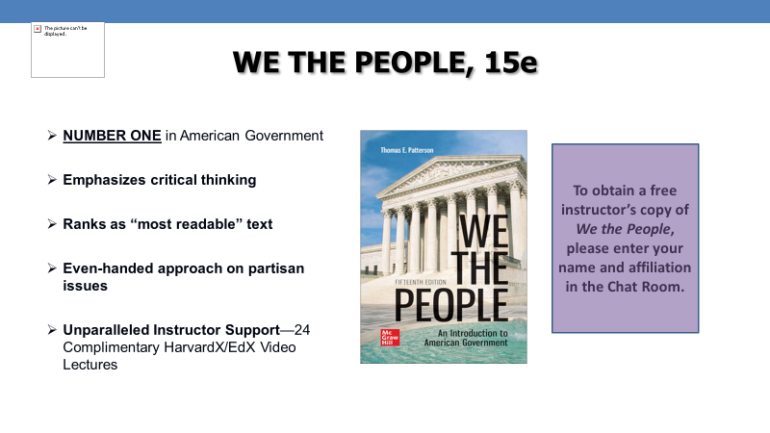
To obtain a copy, contact Michael Gedatus Michael.Gedatus@mheducation.com

