Slide 1
Presidential nominating system from competence to popularity (1787-2024)
TCCTA Conference, March 2024
Thomas Patterson

Slide 2
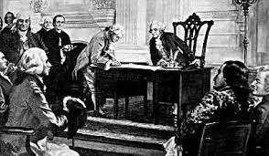
The Framer’s Intent -
The Electoral College
Framers knew what they wanted in a president – experience, judgment, character
Hamilton, Federalist No. 68
The electors would have the “information” and “discernment” –
to choose candidates “endowed with the requisite qualifications”
to reject candidates with “talents for low intrigue, and the little arts of popularity.”

Slide 3
Presidential Qualification –
First System (Framers)
Weight given to:
C = Competence (defined as potential nominees being judged on their preparation for the presidential office)
P = Popularity (defined as potential nominees being judged on their level of popular support)
C P

Slide 4
The First Reform –
Convention System (1832-1900)
Jacksonian Democracy–
- tying electoral votes to the popular vote outcome in each state
- giving control of nomination to the national party convention where the delegates were controlled by state leaders.

Slide 5
By the late 1800s –
“popularity” was becoming more important
Convention delegates increasingly valued a potential candidate’s electability rather than suitability for the presidency.
“Gentleman, let there be no
mistake. I would make a
very good president, but a
very bad candidate.”
James Bryce, The American Commonwealth

Slide 6
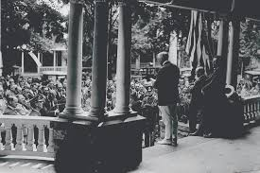
And yet -
Candidates typically didn’t campaign, believing it beneath the dignity of the office
.
In 1896, William McKinley campaigned
from the front porch of his Ohio home.

Slide 7
Prior Experience –
Presidential Nominees (1836-1900)

Slide 8
Presidential Qualification – late 1800s (increased emphasis on popularity)
Weight given to:
C = Competence (defined as potential nominees being judged on their preparation for the presidential office)
P = Popularity (defined as potential nominees being judged on their level of popular support)
C P

Slide 9
The Second Reform –
Mixed System (1904-1968)
Progressive Movement
1901- Florida enacts first presidential primary, some states follow
BUT - most states continue to pick their convention delegates through the party organizations

Slide 10
Presidential Primaries –
Early Period (1904-1944)
Although their names were sometimes on the primary ballot, leading candidates usually did not actively campaign, nor was the outcome a reliable predictor of the nominee.

Slide 11
Pre-WW2 Example –
1936 Republican Primaries

Slide 12
After World War II
World War II had a “democratizing” effect on America.
Among the consequences was an increased tendency for presidential hopefuls to actively contest the primaries.

Slide 13
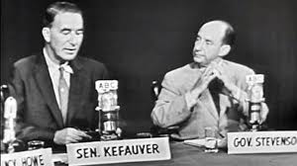
The 1952 Democratic Nomination
Senator Estes Kefauver (TN) won 12 of the 15 Democratic primaries.
Nevertheless, the Democratic National Convention chose instead Governor Adlai Stevenson (IL) who had not contested a single primary.
Stevenson nominated
on 3rd ballot:
Stevenson 618
Kefauver 276
Other 335

Slide 14
Delegate Selection Process –
Mixed System (1948-1968)
Note: In parenthesis is number of states holding a primary. Chart based on average for the two parties. They varied slightly in how many primaries they held.

Slide 15
Prior Experience –
Presidential Nominees (1904 -1956)
The parties primarily nominated candidates
with executive experience, usually governors

Slide 16
Presidential Qualification –
1904-1956 (popularity increasing important)
Weight given to:
C = Competence (defined as potential nominees being judged on their preparation for the presidential office)
P = Popularity (defined as potential nominees being judged on their level of popular support)
C P

Slide 17
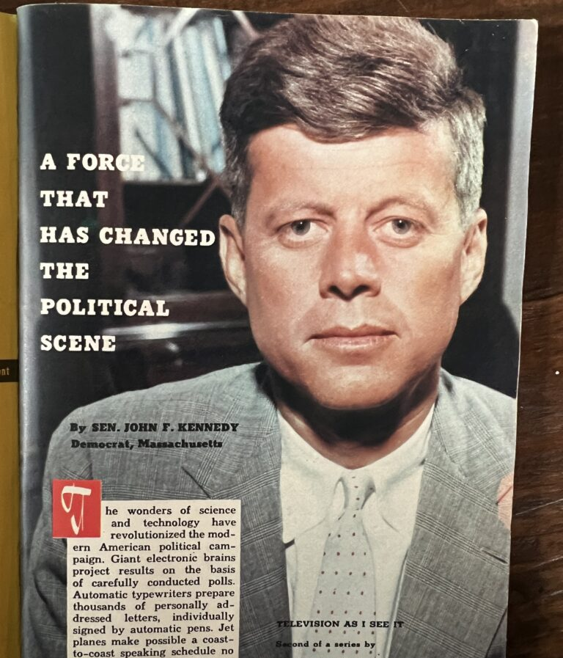
The Television Age
John F. Kennedy writing in TV Guide, 1959
Television, he wrote, is “revolutionary” in that it reveals a candidate’s character in ways that allow voters to draw “uncannily correct” judgments about the candidate’s preparation for the presidency.
Because of that, he argued, party leader dare not “run rough-shod over the voters’ wishes by picking a candidate in the traditional ‘smoke-filled room.’ “
Derived from John Dickerson, Theodore H. White Lecture, Harvard Kennedy School, February 6, 2024.

Slide 18

Conceptually, it was a paradigm shift
Kennedy was arguing that the primary qualification for a president was–
Not preparation for office, but public approval
What Hamilton derided as “the little arts of popularity”

Slide 19
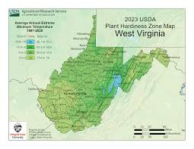
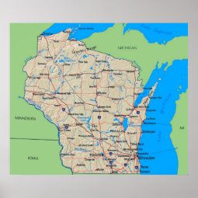
Kennedy’s Primary Election Strategy – 1960
Wisconsin
West Virginia
Kennedy 57%
Humphrey 43%
Kennedy 57%
Humphrey 43%
Kennedy 61%
Humphrey 39%
Kennedy’s leading challenger was Minnesota’s Hubert Humphrey. Kennedy
picked the Wisconsin primary to demonstrate he could win in Humphrey’s neighboring
state and picked heavily Protestant West Virginia to demonstrate that his Catholic
religion would not be an obstacle to victory in the general election.

Slide 20
Presidential Qualification –
1960s
Weight given to:
C = Competence (defined as potential nominees being judged on their preparation for the presidential office)
P = Popularity (defined as potential nominees being judged on their level of popular support)
C P

Slide 21
Turning Point –
1968 Democratic Primaries
Number of states contested/won
  Eugene McCarthy 12/6
  Robert Kennedy 7/4
  Hubert Humphrey 0/0
  DEMOCRATIC NOMINEE: Humphrey was nominated on first ballot of the Democratic convention
  Delegate vote: Humphrey 1,760
  McCarthy 601
  McGovern 147
  Others 101

Slide 22
McGovern-Fraser Commission – changing the rules
When Humphrey lost the 1968 election to Richard Nixon, the Democratic Party decided to change the rules to let the voters pick the nominees
Democrats required states to –
choose their convention in delegates in primaries or open caucuses
use proportional representation in allocating their delegates (except a candidate had to get 15% or more of the vote to get a share)
Republicans then –
adopted the same rules except states had option of using the unit rule to allocate delegates

Slide 23
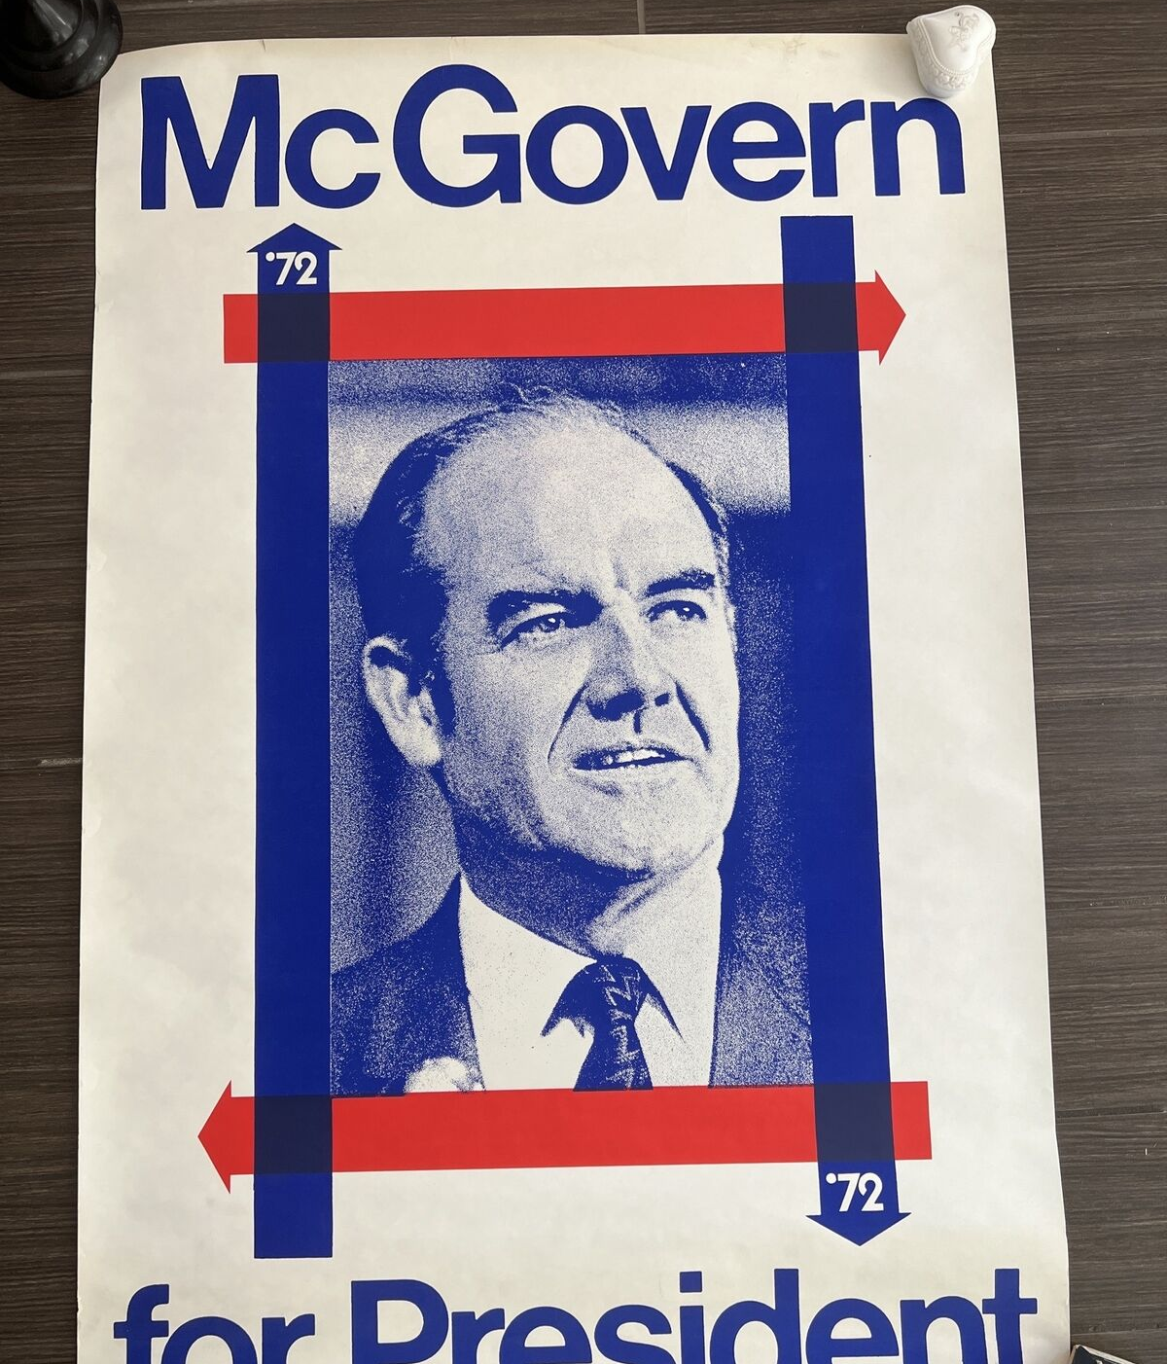
1972 –
First Contest With New Rules
George McGovern (one of the rule makers) wins the Democratic nomination over Hubert Humphrey.
McGovern started campaigning months before his major rivals, and, unlike them, contested every state.
More than the others, McGovern recognized the implications of the new rules.

Slide 24
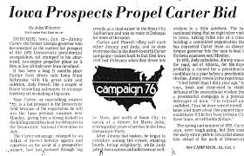
Unintended Consequence of New Rules –
The News Media as Power Broker
“The Great Mentioner”
Russell Baker, New York Times
Media exposure is required for a candidate to rise in the polls.
Absent a high poll standing, or upward movement in the polls, it’s difficult for a candidate to raise money and attract additional support.

Slide 25
Media Amplify the Popularity Factor
Polls & primary outcomes as the media’s benchmarks – top candidates get disproportionate coverage
“Horserace journalism” – the horserace gets more coverage than the candidates’ policy issues and their qualifications for office

Slide 26
News Coverage and 1972 Nominating Process Reform
Source: Thomas E. Patterson, Out of Order

Slide 27
“No Time for Losers” –
Time & Newsweek’s Coverage in the week following Jimmy Carter’s victory in New Hampshire primary
The outcome of NH’s primary:
Carter 28.6%
Udall 22.9%
Harris 10.8%
Shriver 8.2%
Source: Thomas E. Patterson, Out of Order

Slide 28
Presidential Qualification –
1970s (strong shift to popularity)
Weight given to:
C = Competence (defined as potential nominees being judged on their preparation for the presidential office)
P = Popularity (defined as potential nominees being judged on their level of popular support)
C P

Slide 29
1976 & 1980
A Flaw in the System
The McGovern-Fraser Commission hadn’t counted on the large influx of candidates under the new rules or how the composition of the field could work to the advantage of a candidate with a political position different from that of the other leading contenders.
1976 – Jimmy Carter (more to the center than other leading Democrats)
1980 – Ronald Reagan (more to the right than other leading Republicans)

Slide 30
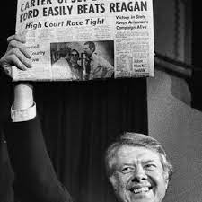
The advantage of being the outlying candidate -
1976 New Hampshire Democratic Primary
Contenders included 4 “major” traditional Democrats – Bayh, Harris, Shriver, Udall – and one “major” non-traditional Democrat – Carter
In a poll based on paired-comparisons, Carter lost by a wide margin to each of the traditional Democrats. Yet, they divided the vote, enabling Carter to win.
The outcome of NH’s primary:
Carter 28.6%
Udall 22.9%
Harris 10.8%
Shriver 8.2%

Slide 31
Modifying the Rules - Superdelegates
To reduce the likelihood of an outlier winning nomination and to give officeholders a larger say in the selection of their party’s nominee, the parties created superdelegates – delegates not chosen by primary voters but picked because they held party office
In 1984, Democrats modified the system by creating unbound superdelegates (about 15% of total delegates).
The intent was not unlike that of the Framers – grant power to those (current officeholders & party leaders) best positioned to judge the candidates
Republicans then also adopted superdelegates (7%) but they’re bound on 1st ballot to vote for the winner of their state’s contest.

Slide 32
Presidential Qualification –
1980s (giving somewhat more weight to qualifications)
Weight given to:
C = Competence (defined as potential nominees being judged on their preparation for the presidential office)
P = Popularity (defined as potential nominees being judged on their level of popular support)
C P

Slide 33
Tipping the Balance –
Superdelegates and 2008 Democratic Nomination

Slide 34
Standing the Framers on Their Head –
The 2016 Republican primaries
When Donald Trump won in New Hampshire (with 35% of the vote) and followed that with a win in South Carolina (with 32% of the vote), “Establishment” Republicans mobilized to block his path to the nomination.
What Establishment Republicans didn’t recognize was that the Tea Party Movement was more than a revolt against Democrats – it was also a revolt against the GOP’s Establishment wing.

Slide 35
Republicans’ Opinion of Their Party and Candidate Preference in 2016 Primaries –
Eliminating the Establishment’s Voice in the Nomination
Republican primary voters
Vote choice of Republicans who felt betrayed by their party
Source: 2016 primary exit polls where question was asked. Percentages include those
who indicated an opinion/preference.

Slide 36
Presidential Qualification –
2016 Republican Nomination (determined almost entirely by voters with almost no role for officeholders)
Weight given to:
C = Competence (defined as potential nominees being judged on their preparation for the presidential office)
P = Popularity (defined as potential nominees being judged on their level of popular support)
C P

Slide 37
The Media’s Role in the 2016 Rise of Donald Trump
Source: Media Tenor data, Jun 16, 2015-Nov 8, 2016. Based on coverage average for Los Angeles Times, New York Times, Wall Street Journal, Washington Post, USA Today, and main newscasts of ABC, CBS, CNN, Fox, and NBC.

Slide 38
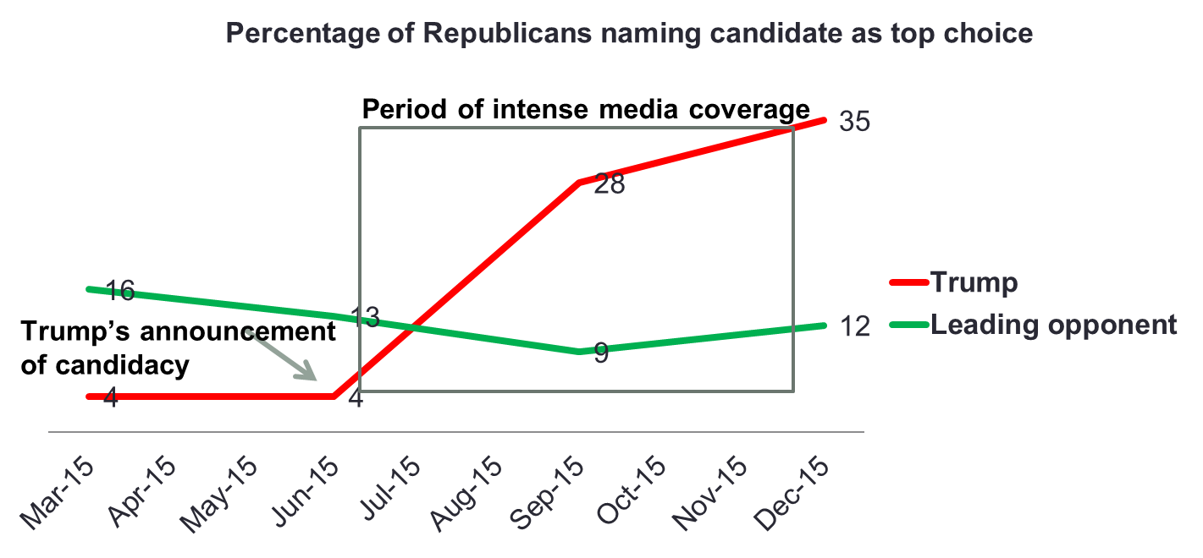
Standing in the Polls –
Invisible Primary

Slide 39
Who Wins the Nomination?
Placing first in Iowa/New Hampshire
Note: Based on non-incumbent races 1980-2020

Slide 40
Who Wins the Nomination?
Leading in last national poll before Iowa
Note: Based on non-incumbent races since 1980
Notes:
Poll losers, Hart 1988; Dean 2004; Clinton 2008

Slide 41
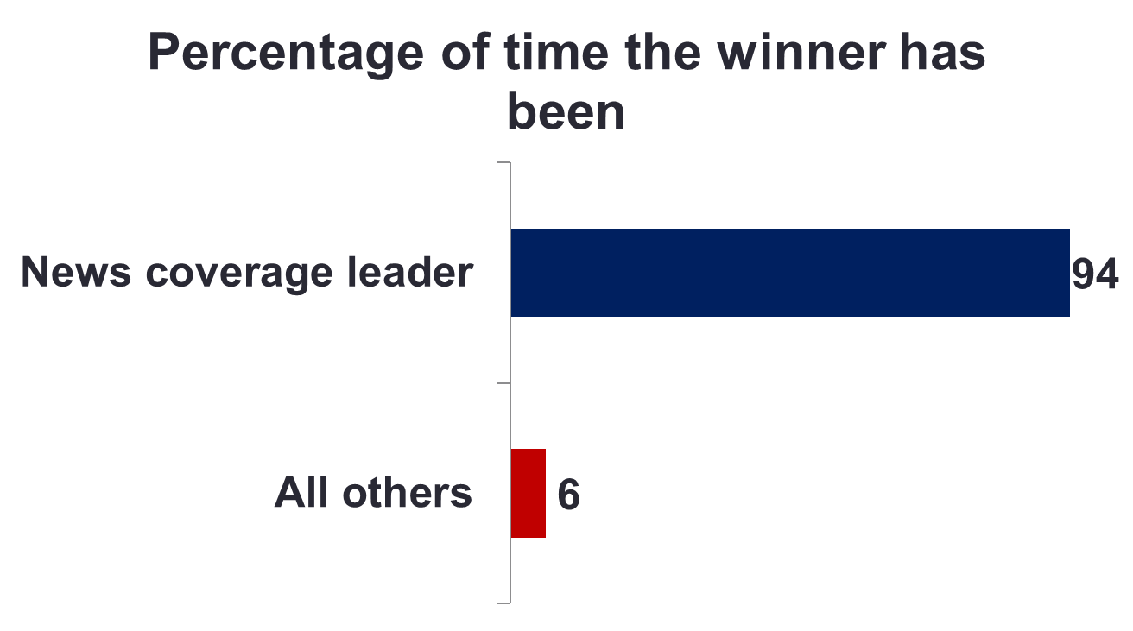
Who Wins the Nomination?
Receiving the most news coverage before Iowa
Note: Based on non-incumbent races since 1980
Notes:
Media losers Dean in 2004, Hillary in 2008

Slide 42
The Great Mismatch of the Modern Campaign
“Campaigns are about gaining power. Governing is about using it.”
We fool ourselves if we think the skills required for one are the skills required for the other.
“Gentleman, let there be no
mistake. I would make a
very good president, but a
very bad candidate.”
James Bryce, The American Commonwealth
Derived from John Dickerson, Theodore H. White Lecture, Harvard Kennedy School, February 6, 2024.

Slide 43
Prior Experience –
Presidential Nominees (1960-2020)
With television, the news
became increasingly about
national politics, directing
public attention toward
senators and away from
governors.

Slide 44
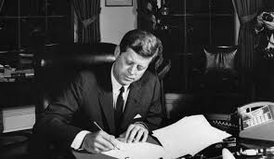
The Last Word –
John F. Kennedy
“I wish I had spent more time learning how to be president instead of learning how to become president.”
Source: John Dickerson, Theodore H. White Lecture, Harvard Kennedy School, February 6, 2024.

Slide 45
Thank
You

