Slide 1
2022 Midterm Elections
Tom Patterson
TCCTA March 4, 2022

Slide 2
Overview
Midterm election tendencies
Projections for 2022
Developments that could alter projections
Implications if projections hold

Slide 3
The Midterm Tendency – House Elections

Slide 4
The Midterm Tendency – Senate Elections
18 of 25 midterms
marked by in-party losses

Slide 5
Theories of
Presidential Party’s Midterm Losses
Surge and Decline Theory
based on change in composition of voters from previous presidential election
Referendum Theory
focuses on the president’s popularity and performance

Slide 6
Surge and Decline Theory of Midterm Elections
Presidential election brings out a “surge” of voters who, compared with those who also vote in the midterm, are more responsive to the mood of moment and disproportionately back the winning presidential candidate and congressional candidates of his/her party.
In the midterm election, these voters stay home (“decline”), erasing the in-party’s advantage.

Slide 7
Surge and Decline
Presidential Election
Midterm Election
Note: Hypothetical distribution for illustrative purposes.

Slide 8
Estimating Surge and Decline
Self-defined independents:
1. Larger part of presidential electorate than midterm electorate
2. More responsive to mood of moment
Using Independents as presidential election surge indicator, since 1980:
Each percentage point advantage among Independents of presidential winner is associated with a loss of 2.2 House seats in the subsequent midterm election.

Slide 9
Predicting 2022 from
Surge and Decline Theory
Source: 2020 exit polls

Slide 10
Predicting 2022 from
Surge and Decline Theory
Biden’s 14-point
advantage in 2020
predicts Republican gain of 31 seats in 2022

Slide 11
Referendum Theory of Midterm Elections
After taking office, presidents make policy choices that tend to make more enemies than friends, leading to declining popularity that weakens appeal of president’s party in midterms.

Slide 12
Change in Presidential Approval Rating from First Year in Office to Second Year
Source: Gallup polls

Slide 13
Change in Presidential Approval Rating from First Year in Office to Second Year
Source: Gallup polls

Slide 14
Presidential Approval Rating and Out-Party Share of House Vote
Out-party
share of
House vote
Presidential approval rating

Slide 15
Presidential Approval Rating and Out-Party Share of House Vote
Biden’s approval rating
predicts that Republicans
will win 2022 House vote by
53-47 nationally
Out-party
share of
House vote
Presidential approval rating

Slide 16
Generic Two-Party Congressional Vote
(“If upcoming November election were held today, would you vote for Democratic or Republican candidate for House of Representatives?)
Democratic
Republican
Source: Real Clear Politics, based on multiple polls

Slide 17
Out-Party Share of Midterm Two-Party Vote and Gain/Loss of House Seats
Out-party
gain/loss
House seats
Note: Based on 1972-2018 midterms

Slide 18
Out-Party Share of Two-Party Vote and Gain/Loss of House Seats
Out-party
gain/loss
House seats

Slide 19
Why Democrats Aren’t Likely to Lose
30 or More Seats
In past midterms, huge gains by out-party occurred when in-party had large House majority and was defending many seats.
2010 Example: Democrats had a 79 seat advantage in House, enabling GOP to gain huge number of seats when voters swung in its direction
Democrats currently have a 10 seat advantage, reducing likelihood of a Republican “wave” election, though not the likelihood of a Republican takeover.

Slide 20
2022 Senate races –
Cook Political Report Assessment

Slide 21
Toss-up and Leaning Races (Cook Political Report)
Toss up
Arizona – Mark Kelly (D)
Georgia – Raphael Warnock (D)
Nevada – Catherine Cortez Mastro (D)
Wisconsin – Ron Johnson (R)
North Carolina – open (currently R)
Pennsylvania – open (currently R)
Lean Democratic
New Hampshire – Maggie Hassan (D)
Lean Republican
Florida - Marco Rubio (R)
Ohio – open (currently R)

Slide 22
If Senate elections were held today (and if early polls can be trusted), the results would be . . .

Slide 23
A final factor to consider – “Enthusiasm Gap”
“Enthusiasm Gap” refers to the gap between the eagerness to vote of one party’s identifiers and the opposing party’s identifiers.
Enthusiastic voters are more likely to show up at the polls on Election Day.

Slide 24
Enthusiasm Gap in Recent Midterms
Source: Gallup polls

Slide 25
Enthusiasm Gap – 2022 Midterms
Source: NBC News poll, January 2022

Slide 26
“Unknown Knowns” that could impact outcome of 2022 Midterm Elections
Biden’s approval rating
Partisan Gerrymandering
Ballot Access laws

Slide 27
Biden’s Approval Rating

Slide 28
Biden Approval Rating
Source: Real Clear Politics, average of multiple polls

Slide 29
Increase in Biden Approval?
A sharp increase in Biden’s approval rating could improve Democrats’ chances.
But:
Federal Reserve projects high inflation and slowing economic growth for rest of 2022- both factors are associated with low approval ratings.
Biden’s approval rating has been flat through Ukrainian crisis. Unlike previous such crises, it hasn’t prompted a “rally ‘round the flag” boost in President’s approval rating.
Unclear what could prompt a dramatic upswing

Slide 30
Biden’s Approval Rating Problem

Slide 31
Partisan Gerrymandering

Slide 32
Partisan Gerrymandering
In Rucho v. Common Cause (2019) the Supreme Court prohibited federal courts from ruling on partisan gerrymandering cases, saying:
  “Excessive partisanship in districting leads to results that reasonably seem unjust. But the fact that such gerrymandering is incompatible with democratic principles does not mean that the solution lies with the federal judiciary….”
But that’s not full story:
“Racial gerrymandering” remains unlawful [Cooper v. Harris (2017)]
Some state laws and constitutions place limits on gerrymandering, which brings state courts into play.

Slide 33
Control of Redistricting
Source: FiveThirtyEight

Slide 34
Last time . . .
After 2010 census, Republicans also controlled redistricting of more House seats
Center for American Progress estimated the Republicans in 2012 picked up 19 additional House seats from their redistricting advantage.
Democrats won national House vote by 1.1 percentage points, but Republicans won control of House of Representatives by 234-201.

Slide 35
Why Republicans might not get as many extra seats this time
Democrats are showing less restraint this time. If they survive judicial scrutiny, New York Democrats’ redistricting map could result in pickup of 4 Democratic seats while Illinois Democrats’ map could add 2.
Democrats are challenging every Republican redistricting plan that’s vulnerable to legal challenge and already have had some success, e.g.
In Alabama, a federal district court struck down the Republican legislature’s redistricting plan on racial grounds.
State courts in Pennsylvania, Ohio, and North Carolina have taken control away from Republican-controlled legislature (collectively those states have 46 House seats).

Slide 36
The “Big Sort” – another reason the Republican gerrymandering yield could be smaller this time
The sorting of partisans – Democrats increasingly concentrated in urban areas and Republicans elsewhere – is reducing the number of seats that can effectively be gerrymandered

Slide 37
House Members by Population Density
number of House members
Source: FairVote, 2017.

Slide 38
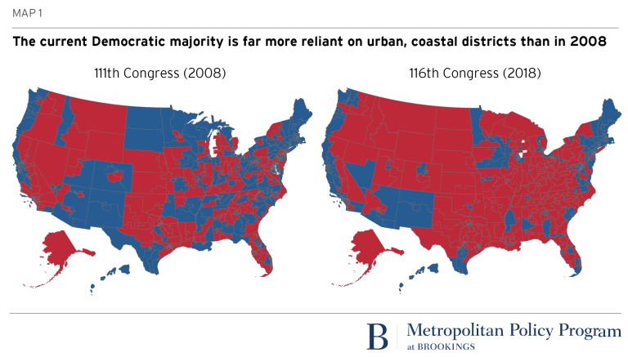
Geographical Distribution of House Seats –
2008 vs 2018
111th Congress (2009-2010) 116th Congress (2019-2020)

Slide 39
Gerrymandering plus geographical sorting - shrinking number of “competitive” House seats
The decline of competitive
House districts could “cap”
the number of House seats
picked up by the out-party
in midterm elections
Source: NY Times, Feb 7, 2022 for 1992, 2002, and 2002. The 2002 number estimated by author from multiple sources. A competitive
seat is defined as one in which the presidential candidates in prior election were within 5 percentage points of each other.

Slide 40
Senate races somewhat more competitive
Source: Cook Political Report, 2020 for House; 2020, 2018, 2016 for Senate

Slide 41
Indicator of
Declining Competitiveness of Senate Elections
Source: Pew Research Center

Slide 42
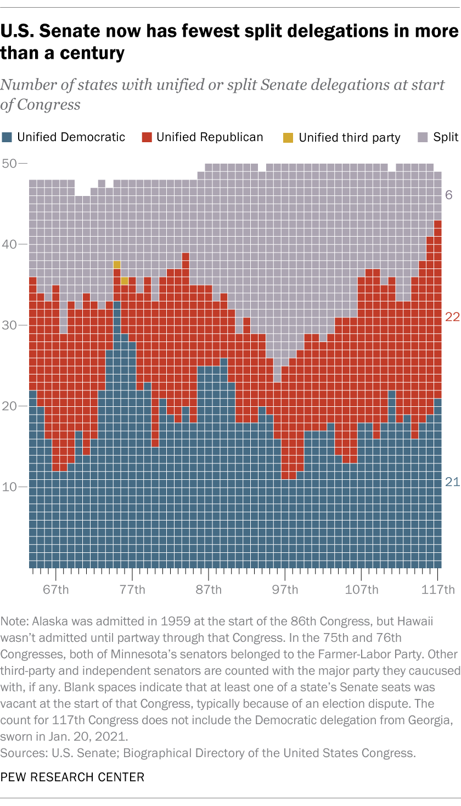
Declining Competitiveness -
Era of direct Senate elections (1914-2022)
Senate has fewest split delegations
in the entire period of direct Senate elections

Slide 43
Ballot Access

Slide 44
What we know . . .
On Republican side
Roughly 20 Republican-controlled states since the 2020 election have passed laws tightening ballot access –
several of these laws are under review in state and federal courts
On Democratic side
Nearly 20 states, most of them controlled by Democrats, have since 2016 instituted Automatic Voter Registration (AVR) in context of Motor Voter Act
Combined impact
Will make Republican states more solidly Republican control and Democratic states more solidly Democratic

Slide 45
What We Do Know –
Ballot access rules affect turnout rate
highest
State turnout
rate
lowest
lowest
highest
State rank in voting barriers
Source: For barriers: Scot Schranfruagal, et al, “Cost of Voting in the American States:2020,” Election Law Journal (cost index is based registration deadlines and restrictions; For turnout, US Census Bureau (based on percentage of vote-eligible citizens who voted).

Slide 46
If Republicans take control of Congress

Slide 47
Implications for Biden’s Agenda
Source: New York Times analysis, as of early 2022

Slide 48
Implications for Biden’s Agenda
Source: New York Times analysis, as of early 2022

Slide 49
Presidents’ Legislative Success
Source: CQ Voting Studies, 1952-2017

Slide 50
President Trump’s Legislative Success Rate
Source: CQ Vote Studies

Slide 51
President Obama’s Legislative Success Rate
Source: CQ, 2012

Slide 52
Looking ahead to 2024

Slide 53
Does the Midterm election predict outcome of next presidential election?

Slide 54
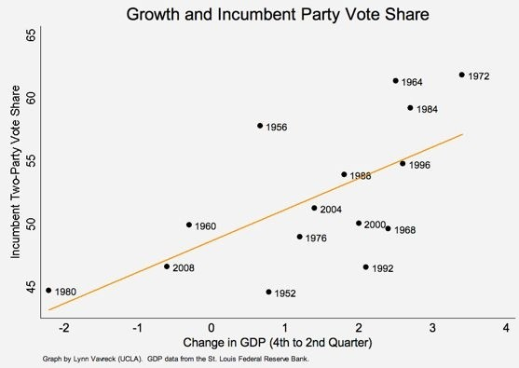
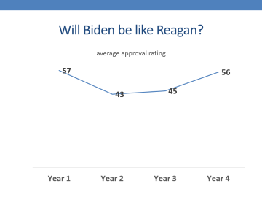
Democrats’ chances in 2024 likely hinge on economy -
GDP and incumbent-party share of presidential vote
Notes:
The data suggest that for every 1 percent growth in GDP from the fourth to the second quarter of an election year, an incumbent party can expect to pick up an additional 2.5 percentage points on Election Day. Two-and-a-half points in vote share may sound small, but consider that of the 16 elections in these graphs, five elections (1960, 1968, 1976, 2000, and 2004) were decided by this small (or smaller) a margin of victory.

Slide 55
Will Biden be like Reagan?

Slide 56
Or will Biden be like Carter?

Slide 57
2024 Congressional Elections – seats gained by party of presidential winner

Slide 58
Thank You
Questions, Observations, Objections?

Slide 59
Average In-Party Performance since 2006

