Slide 1
Red or Blue -
Which Way Is America Heading?
Tom Patterson
TCCTA
February 19, 2021

Slide 2
Nature of Recent Party Politics
Party Polarization–
the ever-widening divide between Republicans and Democrats that began in the 1980s

Slide 3


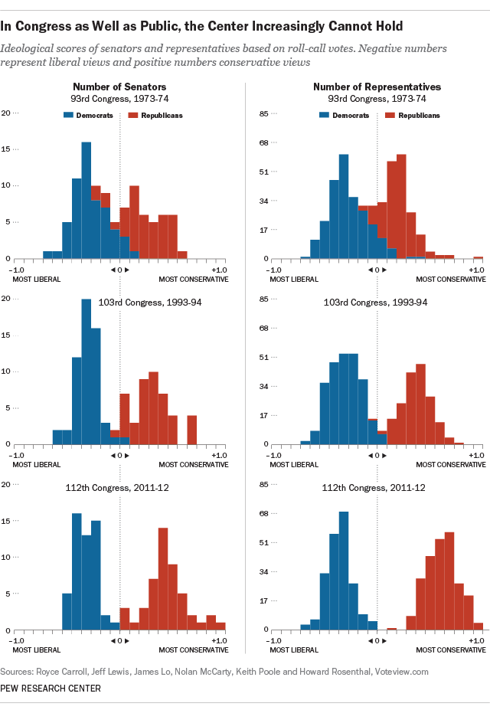
What the party divide in Congress once looked like – 1973-74
Partisan overlap
Source: Keith Poole and Howard Rosenthal research (NOMINATE scores)
Notes:
…It also made inter-party ideological overlap the key to forging the necessary compromises for passing legislation.

Slide 4
What the party divide in Congress looks like today`
Senators
House members
Source: Keith Poole and Howard Rosenthal research (NOMINATE scores). Data are from 112th Congress, which
ss virtually what it looks like now

Slide 5
Party Polarization
Conservative
Source: Derived from Pew Research Center’s poll naalysis

Slide 6
Polarization –
How Americans see those in the other party
Source: CBS News poll, February, 2021

Slide 7
Nature of Recent Party Politics
Intense Party Competition–
the highly competitive nature of Republican and Democratic Party competition in recent elections

Slide 8
Closely Matched Parties – presidency

Slide 9
Closely Matched Parties:
Average Margin of House Majority
Notes:
If I had charted the party percentages in House and Senate, you’d see similar results

Slide 10
Closely Matched Parties:
Average Margin of Senate Majority
Notes:
If I had charted the party percentages in the House and Senate, you’d see similar results

Slide 11
What History Tells Us about
Close Party Competition
Dedicated to winning the next election, closely matched parties have focused on damaging the other party:
  “The single most important thing we want to achieve is for President Obama to be a one-term president,” said Republican Senate leader Mitch McConnell in 2009.
  “Dead on arrival” are the words Democratic House Speaker Nancy Pelosi used in 2019 in response to Trump legislative proposals.

Slide 12
Historically, when one party has been much stronger than the other, they have behaved differently
  The stronger party has focused on governing. It isn’t worried about losing the next election.
  The weaker party has moved closer to the stronger party and avoided demonizing it in hopes of drawing away enough of its supporters to become competitive.
  To break out of our crippling polarization, it will likely require one of our parties to become dominant.
  Is there anything about 2020 election to suggest that might happen?

Slide 13
What 2020
revealed about
the Democratic Party

Slide 14
Biden’s Victory
Restored Democrats’ “Blue Wall” –
Pennsylvania, Michigan, Wisconsin
Penetrated Republican hold on southern tier – Arizona, Georgia
Won comfortably by some indicators
Popular vote margin: 81 million to 74 million
Electoral vote margin: 306 to 232

Slide 15
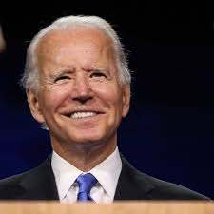
But Biden’s victory might not foreshadow a period of Democratic dominance
Biden’s personal history connected him to key voting blocs
Catholics – went by 4 points to Trump in 2016, by 5 points to Biden in 2020 – a 9-point swing in Democrats’ favor
White working-class men - went by 31 points to Trump in 2016, by 23 points in 2020 – an 8-point swing in Democrats’ favor
Catholics and white working-class men are large voting blocs in Pennsylvania and Wisconsin, which Biden won narrowly and wouldn’t have won if they’d voted as they did in 2016.
Source: 2020 exit polls, based on 2-party vote only

Slide 16
Another reason Biden’s victory might not be predictive – it could be argued that, rather than Biden winning, Trump “lost”
A fourth of all voters said
their vote was “against” a
candidate rather than “for”
a candidate – they gave
Biden a net gain of 8 percentage points -
more than twice his margin of victory
Source: 2015 and 2020 exit polls, based on 2-party vote only

Slide 17
Another look at Trump’s unpopularity and how it helped Biden in 2020

Slide 18
What 2020
revealed about
the Republican Party

Slide 19
Republican Victories
Projected to lose House seats, Republicans cut into the Democratic majority in the House by fourteen seats.
Republicans maintained domination at state level –
23 states are Republican controlled
12 have mixed GOP/Democratic control
15 are Democratic controlled

Slide 20
Why state control matters
Redistricting after 2020 census
Republicans are better positioned to gerrymander House seats
GOP in same position after 2010 census and picked up estimated 20 additional seats through gerrymandering
  In 2012 House races, Republicans lost national popular vote 49-51 percent but won 52 percent of House seats

Slide 21
Why state control matters
States enact most of the laws governing ballot access
    Since 2003, more than 30 states, all but one controlled at the time by Republicans, have enacted Voter ID laws, the strictest of which require a government-issued photo ID, such as a driver’s license or passport
Since the 2020 election, Republican legislators in 28 states have introduced bills to curtail mail-in and early voting, which they see as helping Democratic candidates
Source: Brennan Center for Justice report, Jan 28, 2021.

Slide 22
Republicans’ Geographical Advantage in Senate
Senate is apportioned by state - less populated states tend to be Republican.
The 25 least populous states have only 16 percent of US population but have 50 percent of Senate seats
Of the 50 Senate seats of 25 least populous states, 32 are held by Republicans

Slide 23
Republicans’ Geographical Senate Advantage

Slide 24
GOP’s geographical advantage extends to presidential elections through electoral college

Slide 25
YET Democrats lost three of those elections (2000, 2004, 2016) and nearly lost in 2020
Although Trump lost the national popular vote by 7 million votes, a shift of less than 45,000 votes in three states would have given Trump a second term:
      Arizona (11 electoral votes), Biden won by 10,500 votes 0.03%
      Georgia (16 electoral votes), Biden by 11,800 votes 0.02%
      Wisconsin (10 electoral votes), Biden by 20,700 votes 0.06%
      Shift would have resulted in a 269-269 electoral vote tie, which would have placed election in the House where the vote would have been by state. House Republicans had a majority in 26 states.

Slide 26
Republicans’ Problem
Demographic Change –
virtually no population shift favors the Republicans

Slide 27
Youth Vote (ages 18-29)
Source: Exit polls, 2000-2020

Slide 28
Cumulative effect of shift toward Democratic Party among young adults
Source: 2020 exit polls, based on 2-party vote only

Slide 29
Age-
Georgia Senate Run-Off Election
Warnock, Loeffler
vote was virtually
identical
Source: 2020 exit polls,

Slide 30
The Making of the Last Democratic Majority

Slide 31
Race, Ethnicity & the Vote
BUT – White voters have dropped from 77% to 66% of electorate, while Black/Hispanic voters have increased from 19% to 27%.
Source: Exit polls, 2000-2020 for vote percentages. Census Bureau data for percentage of electorate.

Slide 32
Asian-American Vote
Democratic nominee
Republican nominee
Source: Exit polls, 1992-2020

Slide 33
Vote of college educated
As percentage of voting electorate, college educated have been gradually increasing whereas non-college educated (who tend to vote Republican) have been decreasing
Source: 2000-2020 exit polls, based on 2-party vote only

Slide 34
Democratic advantage from secular trend
Source: Estimates derived from multiple sources.

Slide 35
2020 Presidential Vote by
Religious Orientation
Source: 2020 exit polls

Slide 36
Another advantage for Democrats- positioning of the two parties
Source: Compiled by author from multiple recent polls. Percentages are the difference between the average opinion of independents and the average opinion of Republicans and of Democrats.

Slide 37
Why positioning matters in a 2-party system –
Independents hold balance of power
Democrats were
38 percent of voters,
Republicans 36 percent,
Independents 26 percent

Slide 38
A Looming Risk for GOP – a growing factional divide
Source: Gallup poll, February 2021

Slide 39
A disastrous possibility for Republicans – break-up into two parties
Source: CBS News poll, February, 2021

Slide 40
Historically, breakups have been disastrous for the party
1860 Democrats split between Douglas and Breckenridge enabling Republican (Lincoln) to win presidency with 40 percent of vote. Democrats also lost 39 House/8 Senate seats
1912 Republicans split between Taft and Roosevelt enabling Democrat (Wilson) to win with 42 percent of vote. Republicans also lost 29 House/7 Senate seats
      2024 If Republicans split, Democrats would sweep election

Slide 41
Republican Safety Valve?
Primary Elections: Since 1912, primary elections have allowed party factions to fight it out within the party, as opposed to breaking from the party
    2022 – two dozen Republican House and Senate races already appear likely to pit “establishment” Republican incumbents against “Trump” Republican challengers
The Risk: Some of the Republican nominees might be too bizarre or extreme to win general election, as happened in 2010 Senate races in Nevada, Colorado, and Delaware.

Slide 42
The Cost of Factionalism –
Republican Slippage in Since November–
Source: Gallup Polls

Slide 43
Trend in GOP’s favorability resembles that when Nixon resigned as president in 1973
By 1974, Gallup poll found that on 24 per cent of respondents identified themselves as Republicans - the lowest level to that point in history of Gallup poll.
1974 midterm elections: Democrats gained 4 Senate seats and 49 House seats.
Political scientist Carll Everett Ladd said America now had “a party and a half system.”
Could 2022 be a repeat?

Slide 44
What could go wrong for Democrats?
1. A failed economic recovery from COVID-19 –
    Historically, a bad economy has been electorally harmful to in-party

Slide 45
In-Party Losses in House Races since World War II

Slide 46
What could go wrong for Democrats?
2. Loss of its positioning advantage
a. An increase in belief that Democrats are too liberal (“socialists”) could erode the party’s advantage with independents.
Perception of Democrats as too liberal may have fueled late swing toward Trump in 2020. It was his closing argument, and he won nearly three-fifths of late deciding voters.
Can Democrats establish themselves, in fact and in voters’ minds, as a moderate party?

Slide 47
Image of Democratic Party
2000
2020
Source: Gallup poll, 2000, 2020

Slide 48
Thank You

