Slide 1
Harris, not Biden
Dynamics of the 2024 presidential election
Webinar – October 28, 2024
Tom Patterson, Harvard University

Slide 2
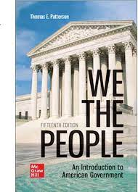
We the People, 15e
NUMBER ONE – the top-selling American Government text
Noted for Its Readability – a text that students actually like to read
Emphasis on Critical Thinking – turning students from passive readers to active ones
Balanced – there are two sides to American politics
Unparalleled Instructor Support—Connect, Smartbook, Videos, Podcasts, News Alerts, and more
To obtain a free instructor’s copy of We the People, please email polisci@mheducation.com

Slide 3
Harris, not Biden
The difference a candidate makes
McGraw-Hill Symposium
Tom Patterson, Harvard University

Slide 4
A Campaign With Few Precedents
Tightest race in polling history
First three-time Republican presidential nominee
Highest stakes in memory – the country’s direction could hinge on the outcome
First time a presumptive nominee has quit the campaign in mid-stream –
  Today’s Focus: How the switch from Biden to Harris affected the race

Slide 5
Presidential Race, by Month
Biden drops out
on July 21
Source: 538 aggregate of polls

Slide 6
But can the polls be trusted?–
Here’s the record for 2000-2020

Slide 7
Accounting for the 3 percent error in in the 2016 and 2020 polls
2016 – undercount of non-college-educated voters
2020 – undercount of Trump’s most hardcore supporters
Pollsters have built those corrections into their models
But – we won’t know if they fixed the problem until votes are cast.
The reality?
Harris could be slightly ahead nationally (if problem fixed)
Trump could be ahead (if the polling problem persists)
Harris could have an even bigger lead (if pollsters overcorrected)

Slide 8
A second unknown - Turnout
Source: New York Times/Siena College poll, October 25, 2024

Slide 9
The better turnout predictor – “Enthusiasm Level”
“Enthusiasm” is measured by asking respondents whether they are “more enthusiastic than usual” in casting their vote.
It turns out to be a better predictor of actual turnout than asking people whether they intend to vote.

Slide 10
Enthusiasm Level, 2008-2020
In each of
these elections,
actual turnout
was higher for
the party that
had the higher
pre-election
enthusiasm
Level.
D+17
R+11
R+2
D+7
Source: Gallup polls

Slide 11
Enthusiasm Level – 2024
Source: Galup poll, August 29, 2024

Slide 12
Enthusiasm Level – Biden vs. Harris
Biden as Democratic nominee
(March 2024 poll)
Harris as Democratic nominee
(August 2024 poll)
The Unknown:
Gallup hasn’t
asked this
question since
August and it’s
unknown whether
Republicans have
closed the gap.
The Known (maybe):
Democrats
reportedly have
the better
“ground game.”:
R+4
Source: Gallup polls, March and August, 2024

Slide 13
Early Voting (as of Oct 25)
Although Democrats
have the edge nationally and in most states, the margin is smaller than in 2020, when, nationally,
they had nearly a 2:1 edge.

Slide 14
Key Voting Blocs

Slide 15
“The Gender Gap” the difference in the voting preference of women and men
Source: Politico, August, 2024

Slide 16
“The Gender Gap” the difference in the voting preference of men and women
Source: Exit polls, 2004-2020; for 2024, New York Times/Siena College poll, October 25, 2024

Slide 17
Women & Men, 2024
Trump vs. Biden
Trump v. Harris
Source: New York Times/Sienna College polls, June and October 2024

Slide 18
Black, Hispanic & White Voters
Over this period, White voters have dropped from 77% to 66% of the electorate, while Black/Hispanic voters have increased from 19% to 27%.
Source: Exit polls, 2000-2020 for vote percentages. Census Bureau data for percentage of electorate.

Slide 19
The Black Vote, 2020 and 2024 –
Sources: Exit polls, 2020: New York Times/Siena College poll, October 25, 2024.

Slide 20
The Hispanic Vote, 2020 and 2024
Source: Exit polls, Newsweek, October 4, 2024.

Slide 21
The White Vote
Democrats have not carried the White vote since 1964 and lost by a record margin in 2016 – Trump’s first presidential campaign.
But, there are two white votes – that of working-class whites (defined as those without a college degree) and that of college-educated whites.

Slide 22
White Working-Class Voters, 2020 and 2024
If this margin holds,
it would be the widest
in history of polling
Source: Exit polls, 2020: New York Times/Sienna College poll, 2024.

Slide 23
White College-Educated Voters, 2012-2020
Source: New York Times, October 2024.

Slide 24
White College-Educated Voters with 2024 added
Source: 2024 data from New York Times/Siena College poll, October 2024.

Slide 25
White College-Educated Voters
Trump vs. Biden
Trump vs. Harris
Source: New York Times/Sienna College polls, June and October 2024

Slide 26
Suburban Voters, 2024
Trump vs. Biden
(June 2024)
Trump vs. Harris
(Sept 2024)
Source: New York Times/Sienna College polls, June and September 2024

Slide 27
Party Identifiers
Trump vs. Biden (June 2024)
Trump v. Harris (Oct 2024)
Source: New York Times/Siena College polls, June & October, 25 2024

Slide 28
Independents –
A decisive voice when partisans vote the party line
D+14
Source: Exit polls, 2020

Slide 29
Independents
Trump vs. Biden
(June 2024)
Trump v. Harris
(Oct 2024)
Less than two
weeks out
from the
Election, 13
percent are
undecided or
leaning to a
third-party
alternative.
Source: New York Times/Siena College polls, June & October 25, 2024

Slide 30
Young Voters (ages 18-29)
The last time a political party captured the youth vote in a lengthy series of elections was in the Great Depression era. It was the basis for a nearly four- decade period of Democratic Party dominance.
Source: Exit polls, 2000-2020

Slide 31
The cumulative effect of Democratic among young adults, 2020 election
D+14
R+4
Source: 2020 exit polls, based on 2-party vote only

Slide 32
Young voters, 2024
Source: New York Times/Sienna College poll, October 25, 2024

Slide 33
Key voting bloc 2024: Young Voters
Trump vs. Biden
Trump vs. Harris
Source: Harvard IOP/Harris polls, March and September 2024

Slide 34
2024 Vote Preference by Age
Cumulatively, the young voters who began trending Democratic in 2004 constitute about 40 percent of the electorate. Those who came of voting age in 200 or earlier makeup roughly 60 percent.
Source: New York Times/Sienna College poll, October 25, 2024

Slide 35
The Battleground States
The path to the 270 electoral votes needed to win the presidency

Slide 36
Battleground States When Biden Still in Race
Source: Based on polls taken in Spring of 2024

Slide 37
Battleground States Now
All states are within sampling error
Source: 538. Oct 27, 2024

Slide 38
Can the Battleground Polls Be Trusted?
Polling accuracy, 2016 and 2020
Source: 538, 2024.

Slide 39
Nebraska? Battleground State?
Maine and Nebraska are the only two states that don’t use unit rule for electoral votes.
The two states award 2 electoral votes to the statewide winner and award one electoral vote per House district to the district winner.
This arrangement has made Nebraska’s 2nd District a battleground. It’s the state’s only district where Democrats have a chance of victory.

Slide 40
How Nebraska’s 2nd District Could Decide the Election
If Harris holds the expected Democratic states, plus Wisconsin, Michigan, and Pennsylvania, she would have 269 electoral votes.
A win in Nebraska’s 2nd District would then give here exactly the 270 electoral votes needed to win the presidency,
In that scenario, if Trump wins the 2nd District, they would be tied at 269 electoral votes. In that case, the election would be decided by the House of Representatives (the one elected in 2024, not 2022) with each state having one vote.

Slide 41
Who’s ahead in Nebraska’s 2nd District?
Harris+9
Source: New York Times/Siena College poll, September 22-24, 2024

Slide 42
Thank you
Questions, observations, objections –

Slide 43
We the People, 15e
To obtain a free instructor’s copy of We the People, please email polisci@mheducation.com

Slide 44
The following slides were not presented but may be of interest.

Slide 45
Control of Congress

Slide 46
Even if Harris is up by 3 percent, it might not be enough - GOP’s electoral college advantage

Slide 47
The House Races

Slide 48
Generic House Ballot, 2024
Source: FiveThirtyEight, October, 2024

Slide 49
2024 Senate Races
Of the 34 seats up in 2024 –
Democrats are defending 23 seats (nearly half of their Senate majority)
Republicans are defending 11 seats (less than a fourth of their current members)
To gain control of the Senate, Republicans need a net gain of 2 seats or only 1 seat if they win the presidency in 2024.

Slide 50
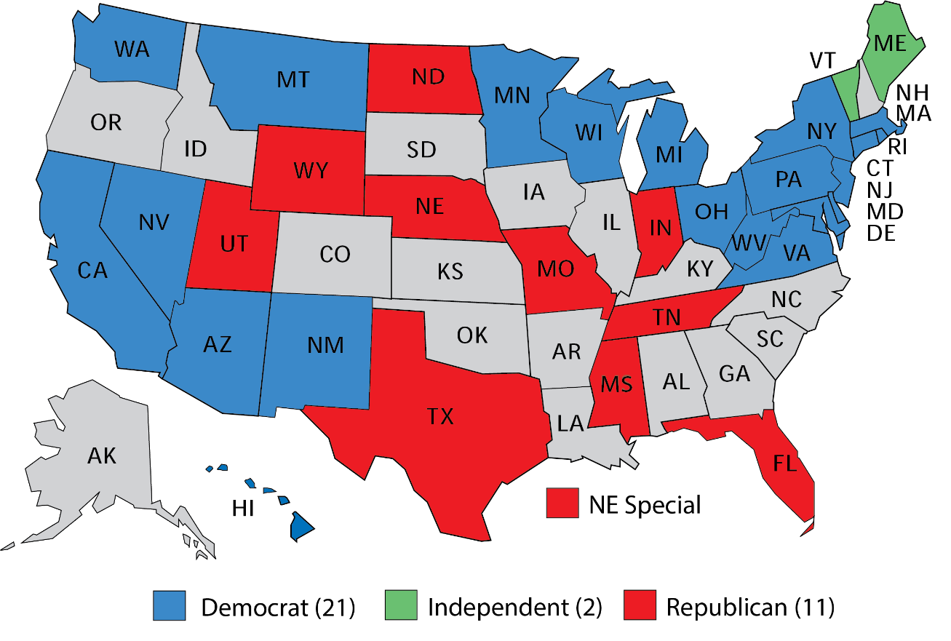
2024 Senate Races –
Democrats are defending 23 seats, Republicans 11 seats

Slide 51
The Senate Seats Most Likely to Flip in 2024
Source: Vulnerable seats based on combined assessments of Cook Political Report, 538, and CNN.

Slide 52
The Senate races that will decide Senate Control
(rating based on most recent polls)
Democratic-controlled seats
West Virginia Manchin has retired, Republican pickup
Montana (+3D) – Tester is slightly behind
Arizona – open seat, Democrat has slight lead
Ohio – Brown is in a toss up
Nevada – Rosen has slight lead
Wisconsin – Baldwin has slight lead
Michigan – open seat, toss up
Pennsylvania – Casey has slight lead
Republican-controlled seats
Texas – Cruz has slight lead
Senate is 51-49 Democratic now. Democrats only chance of retaining control is a 50-50 Senate combined with a presidential win. Republicans likely to gain control with at least 51 seats.

