Slide 1
Politics & COVID-19
McGraw Hill Webinar, April 2021
Thomas Patterson

Slide 2
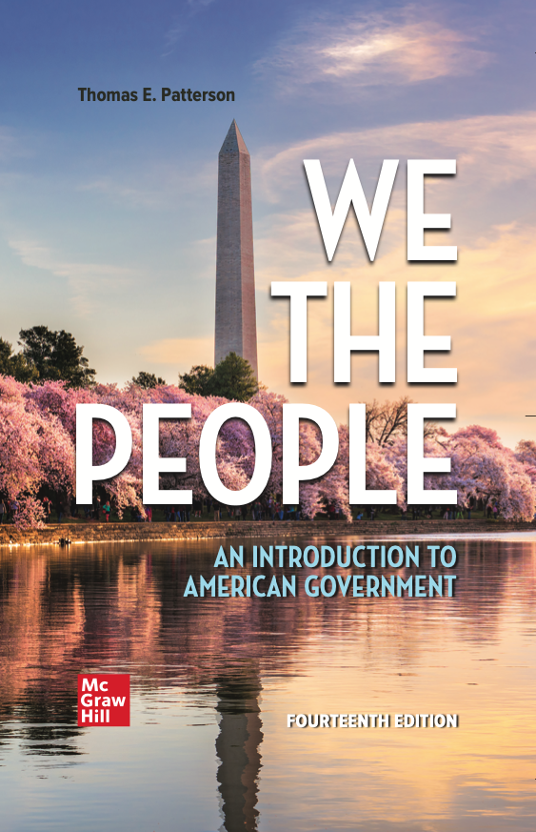
WE THE PEOPLE, 14e
NUMBER ONE in American Government
Accessibility through Readability
Critical Thinking Emphasis—Case Studies & Pedagogy
Even-handed approach with broad appeal
Unparalleled Instructor Support—24 Complimentary HarvardX/EdX Video Lectures
AVAILABLE FOR SUMMER & FALL 2021 CLASSES!

Slide 3
Politics & COVID-19
McGraw Hill Webinar, April 2021
Thomas Patterson

Slide 4
COVID-19
The biggest public health failure in our history
The United States should have been a world leader in reducing fatalities from Covid-19
Per capita, US has the most ICU units and hospital beds
Yet on deaths per capita, US ranks 165th out of the world’s 177 countries for which there are data
If US had EU death rate - 91,031 fewer deaths
If US had Canada’s death rate - 358, 583 fewer deaths
Source: Johns Hopkins/World Bank data set.

Slide 5
Public health was not the only major issue – economic impact was the other
Source: U.S. Department of Labor

Slide 6
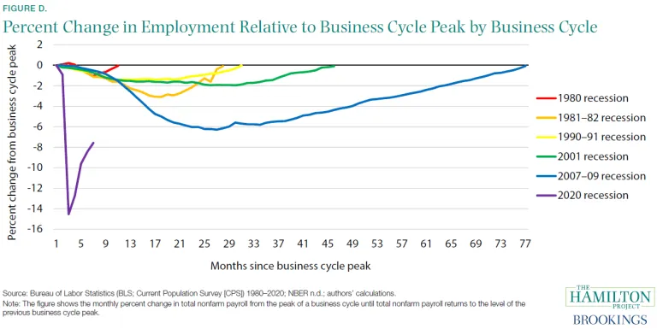
Economic shock was more rapid and severe than other recent economic downturns
Covid

Slide 7
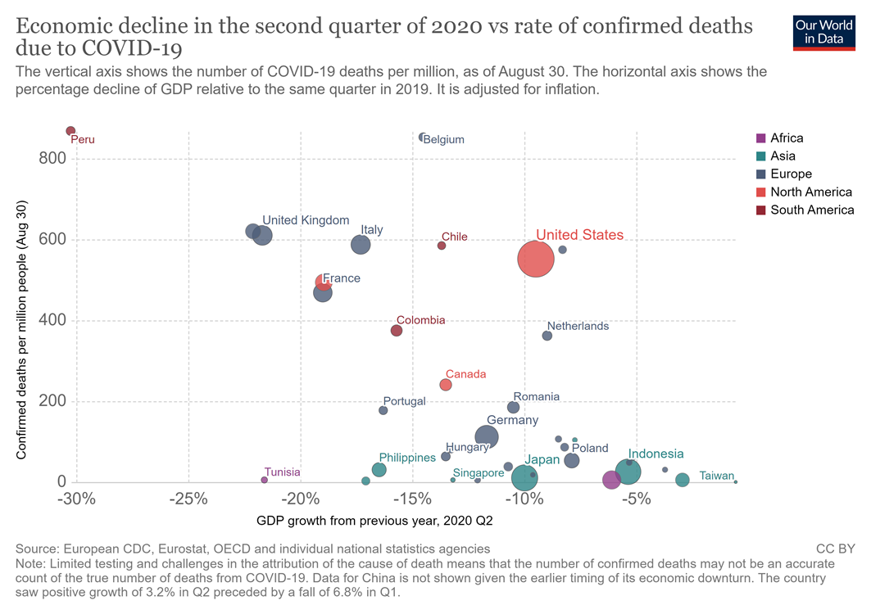
Globally, no trade off between Covid & economy – the lower the death rate, the stronger the economic performance
Confirmed deaths per million
people.
(Aug. 30)
US is an outlier. If it
fit the global pattern,
It should have had:
Fewer deaths,
OR
2) Deeper recession
“Which countries have protected both health and the economy
in the pandemic?”
Joe Hasell, Sept. 2020
GDP growth, 2020 Q2 (from previous year)

Slide 8
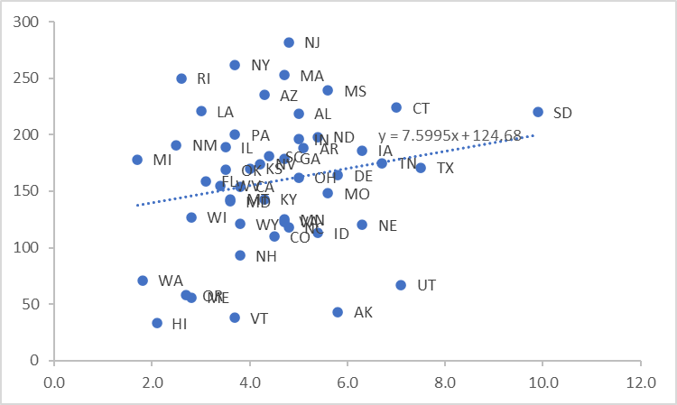

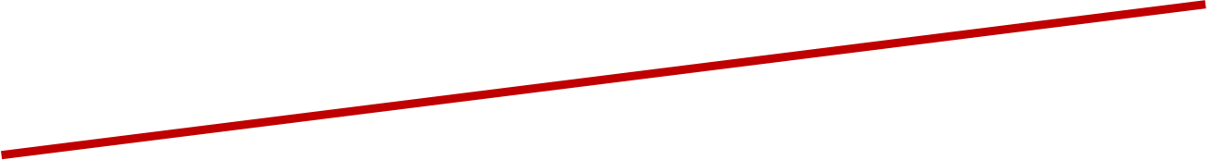
The 50 States –
Trade-off between deaths and economic impact?
Percentage increase in GDP, 4Q, 2020

Slide 9
Was federalism an advantage or disadvantage in responding to Covid?
Source: Johns Hopkins/World Bank data set.

Slide 10
What mattered nationally was clarity of signaling by major leaders
Harvard/Cornell leadership study:
Consensus: When major leaders were communicating a consistent message on Covid threat, damage to public health and the economy was lower.
Conflict: When major leaders were at odds over severity, damage to both was higher.

Slide 11
The American Case – Conflicting Messages
Donald Trump and other major leaders downplayed the Covid threat
TRUMP: “America will again, and soon, be open for business — very soon — a lot sooner than three or four months that somebody was suggesting. A lot sooner.” (3/23/2020)
TRUMP: [On CDC’s mask advisory] “It’s going to be, really, a voluntary thing. You can do it. You don’t have to do it. I’m choosing not to do it.” (4/3/2020)
Andrew Cuomo and other major leaders highlighted the threat:
CUOMO: “This virus . . . is powerful. It's more dangerous than we expected." (3/3/2020)
CUOMO: “We're doing . . . aggressive testing and strong social distancing protocols.” (3/14/2020)

Slide 12
Party Polarization: Messaging & Cue Taking
The conflicting messaging divided along party lines, with Republican leaders downplaying the health threat relative to Democratic leaders.
Party polarization:
heightened our tendency to take cues from our party’s leaders and like-minded media.
heightened confirmation bias – our tendency to hear what we want to hear when faced with conflicting messages.

Slide 13
Donald Trump’s Handling of Pandemic
Source: ABC News/Ispos poll, April 2020

Slide 14
Partisan Response (Reported Mask Wearing)
Source: Gallup polls, April-June 2020..

Slide 15
Partisan Response
Would you feel comfortable attending a crowded party?
Source: Pew Research Center poll, June 2020

Slide 16
News Media Signaling
Trump-related Covid Coverage
Source: Thomas Patterson, analysis of Media Tenor data, March 1-November 3, 2020.

Slide 17
Trump-related Economic Coverage
Source: Thomas Patterson, analysis of Media Tenor data, March 1-November 3, 2020.

Slide 18
Conservative talk shows were aligned with Trump on Covid threat
“Healthy people, generally, 99 percent recover very fast, even if they contract it. . . Put it in perspective: 26 people were shot in Chicago alone over the weekend. I doubt you heard about it. You notice there’s no widespread hysteria about violence in Chicago.”
Sean Hannity
“It’s no worse than the common cold, folks,”
Rush Limbaugh
“It’s a great time to fly.”
Laura Ingraham

Slide 19
Conservative talk-show viewers/listeners perception of pandemic
Source: Pew Research Center survey, September 2020.

Slide 20
Covid Misinformation and Media Exposure
Level of misinformation
Level of exposure – low to high
Source; Kathleen Hall Jamieson, “The Relation between Media Consumption and Misinformation at the Outset of the SARS-CoV-2 Pandemic in the US,” Harvard Kennedy School
Misinformation Journal, April 2020.

Slide 21
Where Federalism Comes In
Trump’s power
bully pulpit
could restrict travel into country
could have directed mask wearing/social distancing for federal employees and when on federal property
Governors’ power
constitutionally, public health policy is largely reserved for states
governors have public health emergency powers – can order statewide mask wearing, social distancing, closings, curfews, etc

Slide 22
Journal of Health Politics Study
Examined how quickly states imposed preventive measures, using five predictor variables:
        Governor’s political party
        Population density of state
        Level of Covid in neighboring states
        Level of Covid within the state
        Level of state’s economic prosperity
Best predictor:
Governor’s political party
  \
.

Slide 23
Governors’ Response –
Restrictions on Social Gatherings
Source: Christopher Adolph, et al, “Pandemic Politics: Timing State-Level Social Distancing Responses to COVID-19,” Journal of Health Politics, Policy and Law, August 2020, pp. 1-17.

Slide 24
Governors’ Response –
Order to close non-essential businesses
The study also found that
Republican governors were
lower to:
close schools
restrict restaurant operations
issue stay-at-home orders
Source: Christopher Adolph, et al, “Pandemic Politics: Timing State-Level Social Distancing Responses to COVID-19,” Journal of Health Politics, Policy and Law, August 2020, pp. 1-17.

Slide 25
Covid deaths over time
NY, NJ, PA, CT, & RI
account for high number
Source: Thomas Patterson, based on CDC date

Slide 26
Covid Deaths (as of 4/16/2021)
States with:
Republican governor 162/100,000
Democratic governor 154/100,000
Excluding states (NY, NJ, MA, PA, CT, RI) at the epicenter of first wave of COVID:
Republican governor 159/100,000
Democratic governor 126/100,000
Source: Derived by author from New York Times Covid data base.

Slide 27
Covid Vaccination Rates
Note: Based on those who are fully vaccinated. The rankings vary only slightly if based on single dose only

Slide 28
Vaccine or No Vaccine, by Partisanship
Source: Quinnipiac poll, April 2020

Slide 29
Economic dimension (jobs)
Source: Carsey School of Public Policy, University of New Hampshire

Slide 30
Economic dimension (GDP, Q1-Q2, 2020)
Source: US Bureau of Economic Analysis

Slide 31
Economic dimension (GDP, Q4, 2020)
Source: US Bureau of Economic Analysis

Slide 32
The 50 States –
Trade-off between deaths and economic impact
Percentage increase in GDP, 4Q, 2020

Slide 33
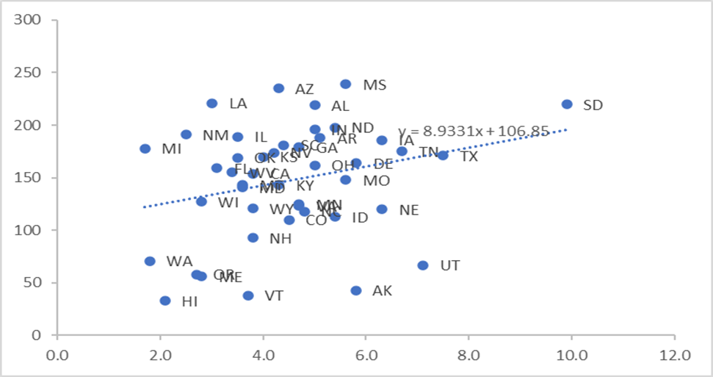
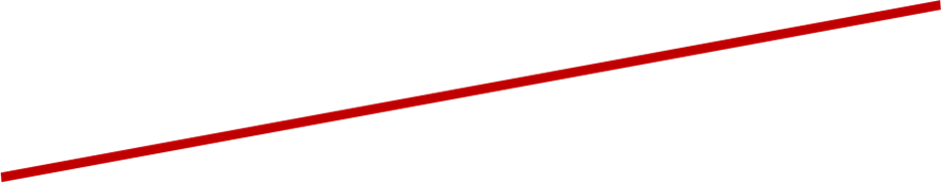
The States (less NY, NJ, MA, RI, CT, PA) –
Trade-off between deaths and economic impact
Percentage increase in GDP, 4Q, 2020

Slide 34
Thank you
Questions, Objections, Comments

Slide 35
WE THE PEOPLE, 14e
NUMBER ONE in American Government
Accessibility through Readability
Critical Thinking Emphasis—Case Studies & Pedagogy
Even-handed approach with broad appeal
Unparalleled Instructor Support—24 Complimentary HarvardX/EdX Video Lectures
AVAILABLE FOR SUMMER & FALL 2021 CLASSES!

Slide 36
Adjusted for Age, Ratio of Death Rates Higher for Minorities except Asian Americans
Source: APM Research Lab

Slide 37
Contrary to a common belief, Covid death rate was not necessarily higher in more densely population areas
The ten counties with highest death rates all had populations under 10,000
Jerauld, South Dakota
Gove, Kansas
Foard, Texas
Iron, Wisconsin
Galax, Virginia
Buffalo, South Dakota
Dickey, North Dakota
Emporia, Virginia
Hancock, Georgia
Gregory, South Dakota
Source: CDC, February, 2021

Slide 38
Hannity-Carlson Study
Study examined two audiences -
Audience for Sean Hannity, who downplayed the threat
Audience for Tucker Carlson, who said threat was serious
Survey finding:
On average, Carlson audience members changed protective behavior much earlier than did Hannity audience members
Epidemiological/audience ratings finding:
U.S. counties with higher audience ratings for Hannity had higher average death and hospitalization rates than other counties.
Source: Leonardo Bursztyn, Aakaash Rao, Christopher Roth, and David Yanagizawa-Drott, “Misinformation During a Pandemic, University of Chicago, September 2020.

Slide 39
Trump v. Governors
State-by-state polls were conducted.
All governors but one
(Kemp of Georgia) had higher
approval ratings than Trump.
Source: Survey Monkey state-by-state polls, May 2020

