Slide 1
America’s Misinformation crisis
Tom Patterson
“Once a country tolerates dishonesty, then everything else falls apart.”
- columnist David Brooks
McGraw Hill Webinar, April 7, 2022

Slide 2
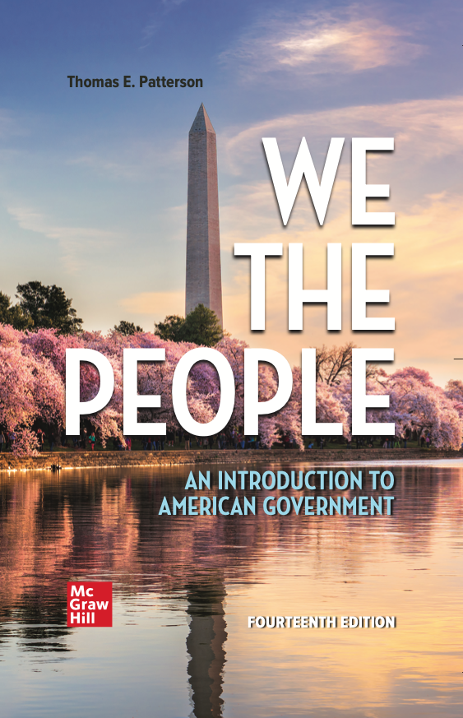
WE THE PEOPLE, 14e
NUMBER ONE in American Government
Accessibility through Readability
Critical Thinking Emphasis—Case Studies & Pedagogy
Even-handed approach with broad appeal
Unparalleled Instructor Support—24 Complimentary HarvardX/EdX Video Lectures
To obtain a free instructor’s copy of We the People, please enter your name and affiliation in the Chat Room.

Slide 3
America’s Misinformation crisis
Tom Patterson
“Once a country tolerates dishonesty, then everything else falls apart.”
- columnist David Brooks
McGraw Hill Webinar, April 7, 2022

Slide 4
Today’s Session
Rise in Misinformation
Explain the rise, including role of party polarization and media change
What we can do to deflate it

Slide 5
Definitions
Misinformation:
False information that is held or spread, regardless of intent.
Disinformation:
False information that is spread with intent to deceive.

Slide 6
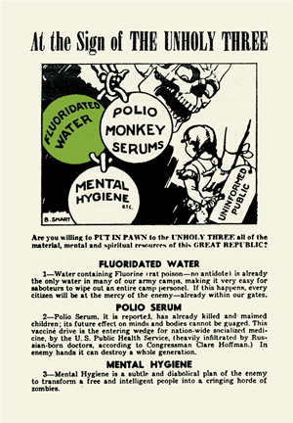
Disinformation is not new

Slide 7
But conditions have changed that make misinformation a much larger problem
Demand Side: Although human psychology hasn’t changed, party polarization has heightened demand for misinformation & increased our vulnerability to it
Supply Side: Rise of partisan and social media and breakdown of norms against deception have sharply increased supply of misinformation
Notes:
Obviously, news media primarily function on supply side. But understanding of interaction between supply and demand-side dynamics is critical for thinking about potential policy responses.

Slide 8
COVID-19
The biggest public health failure in our history
US death rate 295/100,000
Canadian death rate 99/100,000
If US had Canada’s death rate, more than 600,000 deceased Americans would be alive today
Why did we perform so poorly?
Source: Johns Hopkins/World Bank data

Slide 9
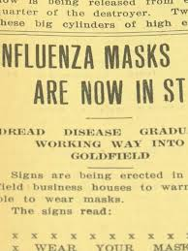
It wasn’t for reason of medical science or facilities
Per capita, U.S. has world’s largest number of ICU & hospital beds
Since the 1918 Spanish flu, masking and social distancing have been the first line of defense against an outbreak of an airborne virus. Mask wearing cuts infection rate in half, combined with social distancing it’s a four-fold decrease.
US had one of earliest supplies of reliable Covid vaccines

Slide 10
It was a compliance problem – mask wearing three months into pandemic
Source: Pew Research Center poll, June 2020

Slide 11
It was a compliance problem
Sources: U.S. Centers for Disease Control; Public Health Agency of Canada

Slide 12
America’s Misinformation Problem

Slide 13
Americans Hold a Lot of False Beliefs
Based on responses
to 28 factual
questions
Source: IPSOS Survey, 2017
Notes:
IPSOS 2017 index based on answers from over 50,000 people to 28 questions on various topics: immigration levels, crime rates, teenage pregnancy, obesity levels, how happy people are, unemployment rates, smartphone ownership, etc.

Slide 14
Examples of recent factual claims
Donald Trump faked having Covid-19 in order to win sympathy votes
Joe Biden is mentally impaired
Dr. Anthony Fauci funded a lab in Wuhan to develop the coronavirus
If reelected, Donald Trump planned to eliminate social security and Medicare
Kamala Harris was not born in United States
CDC manipulated numbers to exaggerate number of dead from Covid-19
President Trump went to the hospital while president after suffering a stroke
Vote counting machines overcounted the Biden vote

Slide 15
None are true, but each is believed by tens of millions of Americans
Source: Indiana University’s Observatory on Social Media survey, November 2020

Slide 16
Explaining Rise in Misinformation
Party Polarization

Slide 17
Our partisan divide – ideological polarization
Conservative
Source: Derived from Pew Research Center’s polls

Slide 18
Our partisan divide – affective polarization
Source: CBS News poll, February, 2021

Slide 19
Why Polarization Matters
Party polarization heightens:
Cue-taking (heuristic “shortcuts”)– Our tendency to accept at face value claims made by our party leaders and by like-minded media sources and reject those coming from other side.
Confirmation Bias: Our psychological tendency to interpret claims in ways that confirm our preexisting partisan beliefs and biases.
Motivated Reasoning: Our biases lead us to conclusions based on their desirability (whether they fit with what we would prefer) rather than on what the evidence would indicate.

Slide 20
Heuristic: Cue Taking Example
Source: Washington Post/ABC News polls, 2013 and 2017.

Slide 21
Another Heuristic - “Familiarity”
Why Repetition Matters
Accurate Claim
False Claim
Source: Gordon Pennycook, presentation at Fake News Conference, Harvard, February 17, 2017.

Slide 22
Confirmation Bias example
Of the 34 election presidential debates . . .
Source: Multiple polls, estimated for some on incomplete data
Notes:
The two exceptions are one of the Clinton-Bush debates and one of the Clinton-Dole debates

Slide 23
motivated reasoning example –
Kahan, et al Yale study-
In first experiment, subjects were given a somewhat difficult math test involving quantities of skin cream. Subjects with higher math skill, regardless of ideology, were more likely than those of lower skill to get the right answer.
In follow-up experiment, subjects were given similarly difficult math tests involving effect of gun control on level of community violence. Liberals with high math skill scored high only when solution showed that gun control reduced violence. Conservatives with high math skill scored high only when solution showed that it didn’t.

Slide 24
Governors as Cue-Givers -
Covid-Based Restrictions on Social Gatherings
Study also found Democratic governors were quicker
to close schools, issue stay-at-home orders, close
non-essential businesses & issue mask mandates
Source: Christopher Adolph, et al, “Pandemic Politics: Timing State-Level Social Distancing Responses to COVID-19,” Journal of Health Politics, Policy and Law, August 2020, pp. 1-17.

Slide 25
Partisan responses to Covid in first months
Would you feel comfortable attending a crowded party?
Would you feel comfortable eating out in a restaurant?
Source: Pew Research Center poll, June 2020

Slide 26
Partisan Response to Covid in First Months
Source: Gallup polls, 2020

Slide 27
Confirmation Bias affects Republicans & Democrats alike - accepting false claims that align with one’s partisanship
Source: Indiana University’s Observatory on Social Media survey, November 2020

Slide 28
Explaining Our Misinformation Crises
Changes in Media System

Slide 29
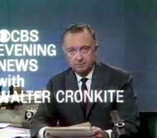
The Old “Low Choice” System
Low Choice – In most media markets, consumers seeking national news had local newspaper and a network newscast (ABC, CBS, NBC) as their only options.
Media effects:
1. An “information commons”
2. Rising level of information
3. “Depolarization”

Slide 30
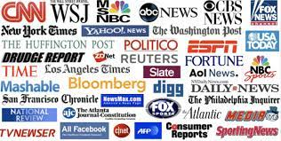
Today “High Choice” System
Traditional news outlets
Cable news and talk shows – CNN, Fox, and MSNBC
Talk radio – ten-fold increase following elimination of Fairness Doctrine, weekly audience is roughly 40 million listeners
Internet – news outlets (eg, HuffPost, Breitbart), bloggers, social media activists

Slide 31
Our Media System
Traditional (fact verifying) outlets, such as CBS News, and the Chicago Tribune, that have norms and editing procedures designed to reduce factual reporting errors and correct them when they occur.
Partisan (bias confirming) outlets, such as Fox and Breitbart, that tell their audience what they expect/want to hear.
These are dominant tendencies. Some traditional outlets have a bias-confirming component (eg, opinion page of traditional newspapers) and some partisan outlets have a fact-verifying component (eg, Fox’s Special Report with Bret Baier).

Slide 32
Fact Verifying Does Not Mean Unbiased
CBS Evening News – 2020 Election
Fox Special Report w/Brett Baier – 2020 Election
Source: Thomas E. Patterson, “A Tale of Two Elections,” Shorenstein Center, Harvard University, December 17, 2020

Slide 33
Fact Verifying Does Not Mean Unbiased
CBS Evening News –2020 Election
Fox Special Report-Brett Baier – 2020 Election
Source: Thomas Patterson, analysis of Media Tenor data, March 1-November 3, 2020

Slide 34
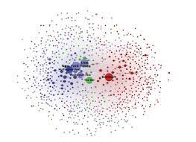
Another feature of our media system – strong links only among like types of media
Outlets on the partisan side are fewer and overwhelmingly conservative in orientation
Traditional
Partisan
Source: Benkler, et al, Network Propaganda (New York: Oxford University Press, 2018)

Slide 35
Ideological Asymmetry-
Information Sharing by Party Identification
Information sharing about Covid on Twitter
Democrats relied heavily to traditional media rather than partisan media when sharing a piece of content through Twitter – ratio was 163 to 1
Republicans tilted only slightly to traditional media as opposed to partisan media – ratio was 1.16 to 1
Source: Sebastian Blum, Master’s thesis, Harvard University, 2022.

Slide 36
BUT – Republicans and Democrats are alike in type of content they share/like
Source: David Rand, et al, “Shared Partisanship Dramatically Increases Social Tie Formation in a Twitter Field Experiment,”
Proceedings of the National Academy of Sciences, 2021.

Slide 37
Another Tendency – Sorting on Partisan Media:
Source: Pew Research Center poll, 2019

Slide 38
Political Blogosphere – much smaller audience but far more partisan
Over 90 percent
of links on political
blogs/websites link
to sites that cater
to the same beliefs.

Slide 39
Media Effects - Misinformation

Slide 40
Sources of Misinformation –
Partisan Media
Partisan talk shows/websites are filled with disinformation
        Based on a study of more than four million media messages, Yochai Benchler et al concluded that partisan media are distinctive for their “disinformation, lies, and half-truths.”
Sources: Benchler, et al, Network Propaganda; New York Times, November 13, 2020 (based on MIT’s RadioSpeak data)

Slide 41
Most Conservative Talk Shows
Were Dismissive of the Covid Threat
“It’s no worse than the common cold, folks,”
Rush Limbaugh
“It’s a great time to fly.”
Laura Ingraham
“Healthy people, generally, 99 percent recover very fast, even if they contract it. . . Put it in perspective: 26 people were shot in Chicago alone over the weekend. I doubt you heard about it. You notice there’s no widespread hysteria about violence in Chicago.”
Sean Hannity

Slide 42
Conservative talk-show viewers/listeners perception of pandemic
Source: Pew Research Center survey, September 2020.

Slide 43
Covid Misinformation and Media Exposure
Level of misinformation
Level of exposure – low to high
Source; Kathleen Hall Jamieson, “The Relation between Media Consumption and Misinformation at the Outset of the SARS-CoV-2 Pandemic in the US,” Harvard Kennedy School Misinformation Journal, April 2020.

Slide 44
Vaccination Rate by News Outlet

Slide 45
Sean Hannity-Tucker Carlson Study
Study examined two audiences -
Audience for Hannity, who downplayed the threat
Audience for Carlson, who said threat was serious
Survey finding:
On average, Carlson audience members adopted protective behavior much earlier than Hannity audience members
Epidemiological finding:
U.S. counties with higher audience ratings for Hannity had higher death and hospitalization rates than other counties.
Source: Leonardo Bursztyn, Aakaash Rao, Christopher Roth, and David Yanagizawa-Drott, “Misinformation During a Pandemic, University of Chicago, September 2020.

Slide 46
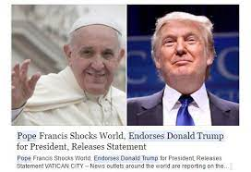
Bloggers & Malicious Actors – primary source of “fake news”

Slide 47
The Power of Fake to Attract Our Attention
On average, fake stories travel
six times faster on social media
than true stories
Source: Soroush Vosoughi, Deb Roy, and Sinan Aral, “The spread of true and false news online,” Science 369 (2018): 1146-1151.

Slide 48
“Super Spreaders” of Fake News
Extreme liberals and extreme conservatives are far more likely than other citizens to share fake news stories.
Source: Toby Hopp, et al, Why Do People Share Ideologically Extreme, False, and Misleading Content on Social Media? Human Communication Research (2020).

Slide 49
Traditional media are fact checkers but also a leading source of misinformation
    “News organizations play a major role in propagating hoaxes, false claims, questionable rumors, and dubious viral content.”
    Craig Silverman, et al, “Lies, Damn Lies and Viral Content,” Columbia University, February 10, 2015.
Although traditional news outlets don’t ordinarily twist the facts, they report the words of political leaders who do shade the truth – over 80 percent of false claims are disseminated without mention that they’re inaccurate.

Slide 50
The News Media and Trump’s Tweets
A NY Times fact check found that a third of Trump’s tweets contained a significant falsehood.
How did Americans learn of Trump’s tweets?
1% directly from his Twitter feed
99% directly or indirectly through the media
Sources: Fact check, https://www.nytimes.com/2020/06/03/us/politics/trump-twitter-fact-check.html; tweet exposure, http://www.newsweek.com/trump-tweets-one-percent-mainstream-media-769207

Slide 51
Deception and Political Leaders
Deception at the highest levels of government is not new – e.g., Pentagon Papers
But the norm against deception by political leaders has weakened
Deception is now endemic at the highest levels of our politics
  “[Misinformation is highest for issues “on which elites prominently and persistently [make] incorrect claims.”
      Josh Pasek, et, Journal of Communication, 2015.

Slide 52
Fixing Our Misinformation Problem

Slide 53
Fixing our problem
1. We could hold political leaders to account for deception
BUT: We don’t detect it when our side’s leaders do it, and we don’t value truth enough to base our vote on it.
2. We could get our information from reliable sources
BUT: Many of us prefer sources that tell us what we want to believe – there’s growing demand for confirming information.
3. We could hold ourselves to a higher standard
BUT: Confirmation bias is ingrained – we don’t know when we’re wrong and tend to reject conflicting information.

Slide 54
Fixing our problem
4. Fact checking – studies don’t show it to be all that effective and might contribute to spread of misinformation in some instances
5. Media literacy & Civics courses – short half life to lessons learned
6. Platform intervention (removing false claims, delisting serial abusers, noting that a story is suspect) – somewhat promising but more research on efficacy is needed.

Slide 55
Fixing our problem
Would Biden administration Ukraine strategy of preempting disinformation by calling it out in advance?
The problem: It only works when recipients are inclined to believe it (cue-taking, confirmation bias, and motivated reasoning aligned with messenger and message).
Condition not met in our domestic politics

Slide 56
Root of the problem
Incentives encourage disinformation/misinformation
Polarization makes us accepting of false claims about opposing side and encourages leaders to make false/deceptive claims
Polarization is both a cause and effect of partisan media – there’s a demand for information, true or false, harmful to other side
To break the hold of misinformation, polarization would likely need to ease
    – if history is a guide, it will only happen when one of the two parties becomes much stronger than the other

Slide 57
Thank you –
Questions, Observations, Objections

Slide 58
WE THE PEOPLE, 14e
NUMBER ONE in American Government
Accessibility through Readability
Critical Thinking Emphasis—Case Studies & Pedagogy
Even-handed approach with broad appeal
Unparalleled Instructor Support—24 Complimentary HarvardX/EdX Video Lectures
To obtain a free instructor’s copy of We the People, please enter your name and affiliation in the Chat Room.

