Slide 2
America’s Misinformation crisis
Tom Patterson
“Once a country tolerates dishonesty, then everything else falls apart.”
- columnist David Brooks
McGraw Hill Webinar, May 13, 2021

Slide 3
Definitions
Misinformation:
False information that is held or spread, regardless of intent.
Disinformation:
False information that is spread with the intent to mislead.

Slide 4
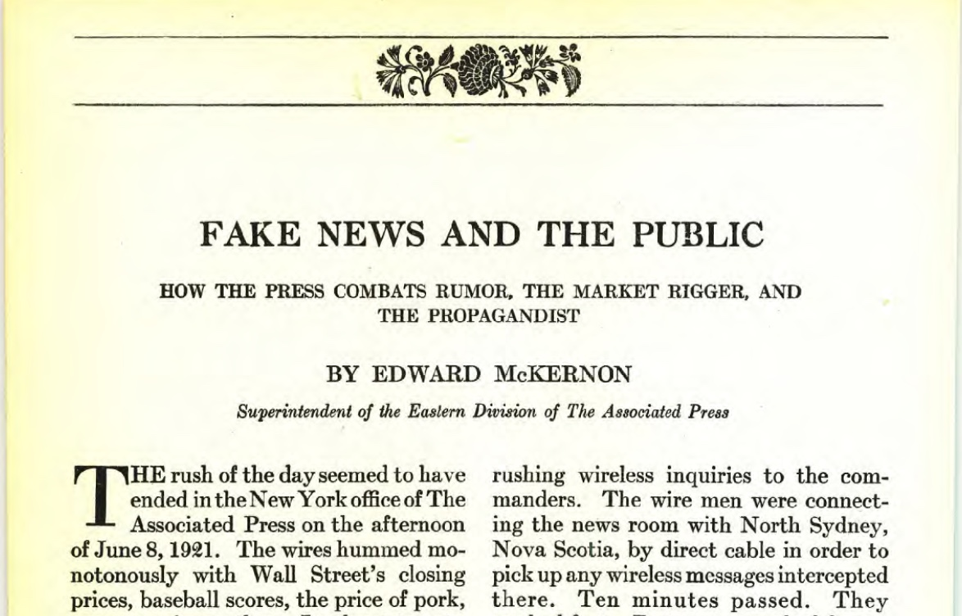
An Old Problem
Harper’s, October 1925
Notes:
During WWI, multiple countries produced false videos of supposed war crimes by the other side in order to rally their domestic publics. These could be incredibly realistic.

Slide 5
But conditions have changed
Demand Side: Although human psychology hasn’t changed, party polarization has heightened demand for misinformation & our response to it
Supply-side: Rise of partisan and social media and breakdown of norms against lying have resulted in a dramatic increase in the supply of misinformation
Notes:
Obviously, news media primarily function on supply side. But understanding of interaction between supply and demand-side dynamics is critical for thinking about potential policy responses.

Slide 6
Level of Public Misinformation (Estimated)
Note: Ballpark estimates by author based on opinion poll questions.

Slide 7
Americans Hold a Lot of False Beliefs
Based on responses
to 28 factual
questions
Source: IPSOS Survey, 2017
Notes:
IPSOS 2017 index based on answers from over 50,000 people to 28 questions on various topics: immigration levels, crime rates, teenage pregnancy, obesity levels, how happy people are, unemployment rates, smartphone ownership, etc.

Slide 8
Examples of recent factual claims
Donald Trump faked having Covid-19 in order to win sympathy votes
Joe Biden is mentally impaired
Dr. Anthony Fauci funded a lab in Wuhan to develop the coronavirus
If reelected, Donald Trump planned to eliminate social security and Medicare
Kamala Harris was not born in United States
CDC manipulated numbers to exaggerate number of dead from Covid-19
President Trump went to the hospital last year after suffering a stroke
Vote counting machines overcounted the Biden vote

Slide 9
None are true, but each is believed by tens of millions of Americans
Source: Indiana University’s Observatory on Social Media survey, November 2020

Slide 10
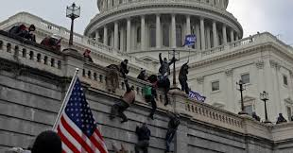
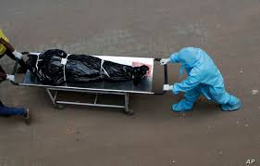
Impact of Misinformation
Assault on Capitol
585,000 deaths from Covid

Slide 11
The events were fueled by misinformation – millions of Americans refused to accept the facts
Sources: Gallup poll, May 2020, for Covid; Fox News poll, Dec 2020, for election

Slide 12
COVID 19c–
Misinformation led to biggest public health failure in our history
The United States should have been a world leader in reducing fatalities from Covid-19
Per capita, US has the most ICU units and hospital beds
Yet on deaths per capita, US ranks 165th out of the world’s 177 countries for which there are data
If US had EU death rate – roughly 100,000 fewer deaths
If US had Canada’s death rate – roughly 350,000 fewer deaths
Source: Johns Hopkins/World Bank data set.

Slide 13
Explaining the Rise of Misinformation
Party Polarization

Slide 14
The widening partisan divide
Conservative
Source: Derived from Pew Research Center’s poll naalysis

Slide 15
Perception of those in other party
Source: CBS News poll, February, 2021

Slide 16
Why Polarization Matters
Party polarization heightens:
Cue-taking – Our tendency to accept at face value claims made by our party leaders and by like-minded media sources
Confirmation Bias: Our psychological tendency to interpret claims in ways that fit our partisan beliefs and biases.

Slide 17
Confirmation Bias –
Accepting false claims that align with one’s partisanship
Source: Indiana University’s Observatory on Social Media survey, November 2020

Slide 18
Explaining Our Misinformation Crises
Changes in Media System

Slide 19
The “Old” Low-Choice Media System
(pre-1980)

Slide 20
Consequences of Low-Choice System
1. An “information commons”
2. Rising level of information
3. “Depolarization”

Slide 21
Today’s High-Choice System:
Elimination of Fairness Doctrine
Fairness Doctrine required broadcast licensees to treat opposing sides “fairly” and to include public affairs programming –
In 1987, the Fairness Doctrine was eliminated, giving station owners freedom to air programming of their choosing.
Resulting developments:
    Reduction in number of stations that aired news on hour
    Increase in number of stations carrying partisan talk shows

Slide 22
Effect of Eliminating Fairness Doctrine:
Size of Weekly Political “Talk Show” Audience
Notes:
Arbitron ratings

Slide 23
Audience Share of Partisan Talk Shows
(weekly Arbitron ratings)
Source: Arbitron, March 2021

Slide 24
The High Choice Media System–
Emergence of Cable TV
Notes:
Average # channels: 1980: 14; 2016: 2016

Slide 25
Partisan News Comes to Cable
Fox (1996) – Rubert Murdoch starts Fox News as a conservative alternative, hiring Republican political consultant Roger Ailes to run it
MSNBC (2005) – Started in 1996 as a competitor to CNN, shifted in 2005 to become liberal alternative to Fox
CNN (2013) – Changes format by adding liberal-leaning talk shows to its lineup

Slide 26
Partisan Sorting:
Cable News Audience
Source: Pew Research Center poll, 2019

Slide 27
The High Choice System –
Internet
Source: Feedspot, 2021

Slide 28
Blogs as Echo Chambers
Nearly all political blogs and websites are ideological and unwelcoming to those who hold diverse opinions.
Over 90 percent of links on political blogs/websites link to sites that cater to the same beliefs.

Slide 29
The High Choice System –
Social Media
Source: David Rand, et al, “Shared Partisanship Dramatically Increases Social Tie Formation in a Twitter Field Experiment,”
Proceedings of the National Academy of Sciences, 2021.

Slide 30
High Choice System vs. Low-Choice System
Why the change matters

Slide 31
Sources of Misinformation –
Partisan Media
Partisan talk shows/websites are filled with disinformation
        Based on a study of more than four million media messages, Yochai Benchler et al concluded that partisan media are distinctive for their “disinformation, lies, and half-truths.”
Sources: Benchler, et al, Network Propaganda; New York Times, November 13, 2020 (based on MIT’s RadioSpeak data)

Slide 32
Talk Shows and Disinformation –
Covid 19 Example
“It’s no worse than the common cold, folks,”
Rush Limbaugh
“It’s a great time to fly.”
Laura Ingraham
“Healthy people, generally, 99 percent recover very fast, even if they contract it. . . Put it in perspective: 26 people were shot in Chicago alone over the weekend. You notice there’s no widespread hysteria about violence in Chicago.”
Sean Hannity

Slide 33
Conservative talk-show viewers/listeners perception of pandemic
Source: Pew Research Center survey, September 2020.

Slide 34
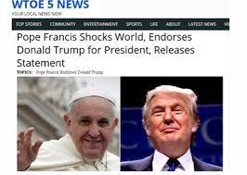
Sources of Misinformation –
Social Media
Foreign actors, most notably Russia
Domestic actors, which far outnumber foreign actors

Slide 35
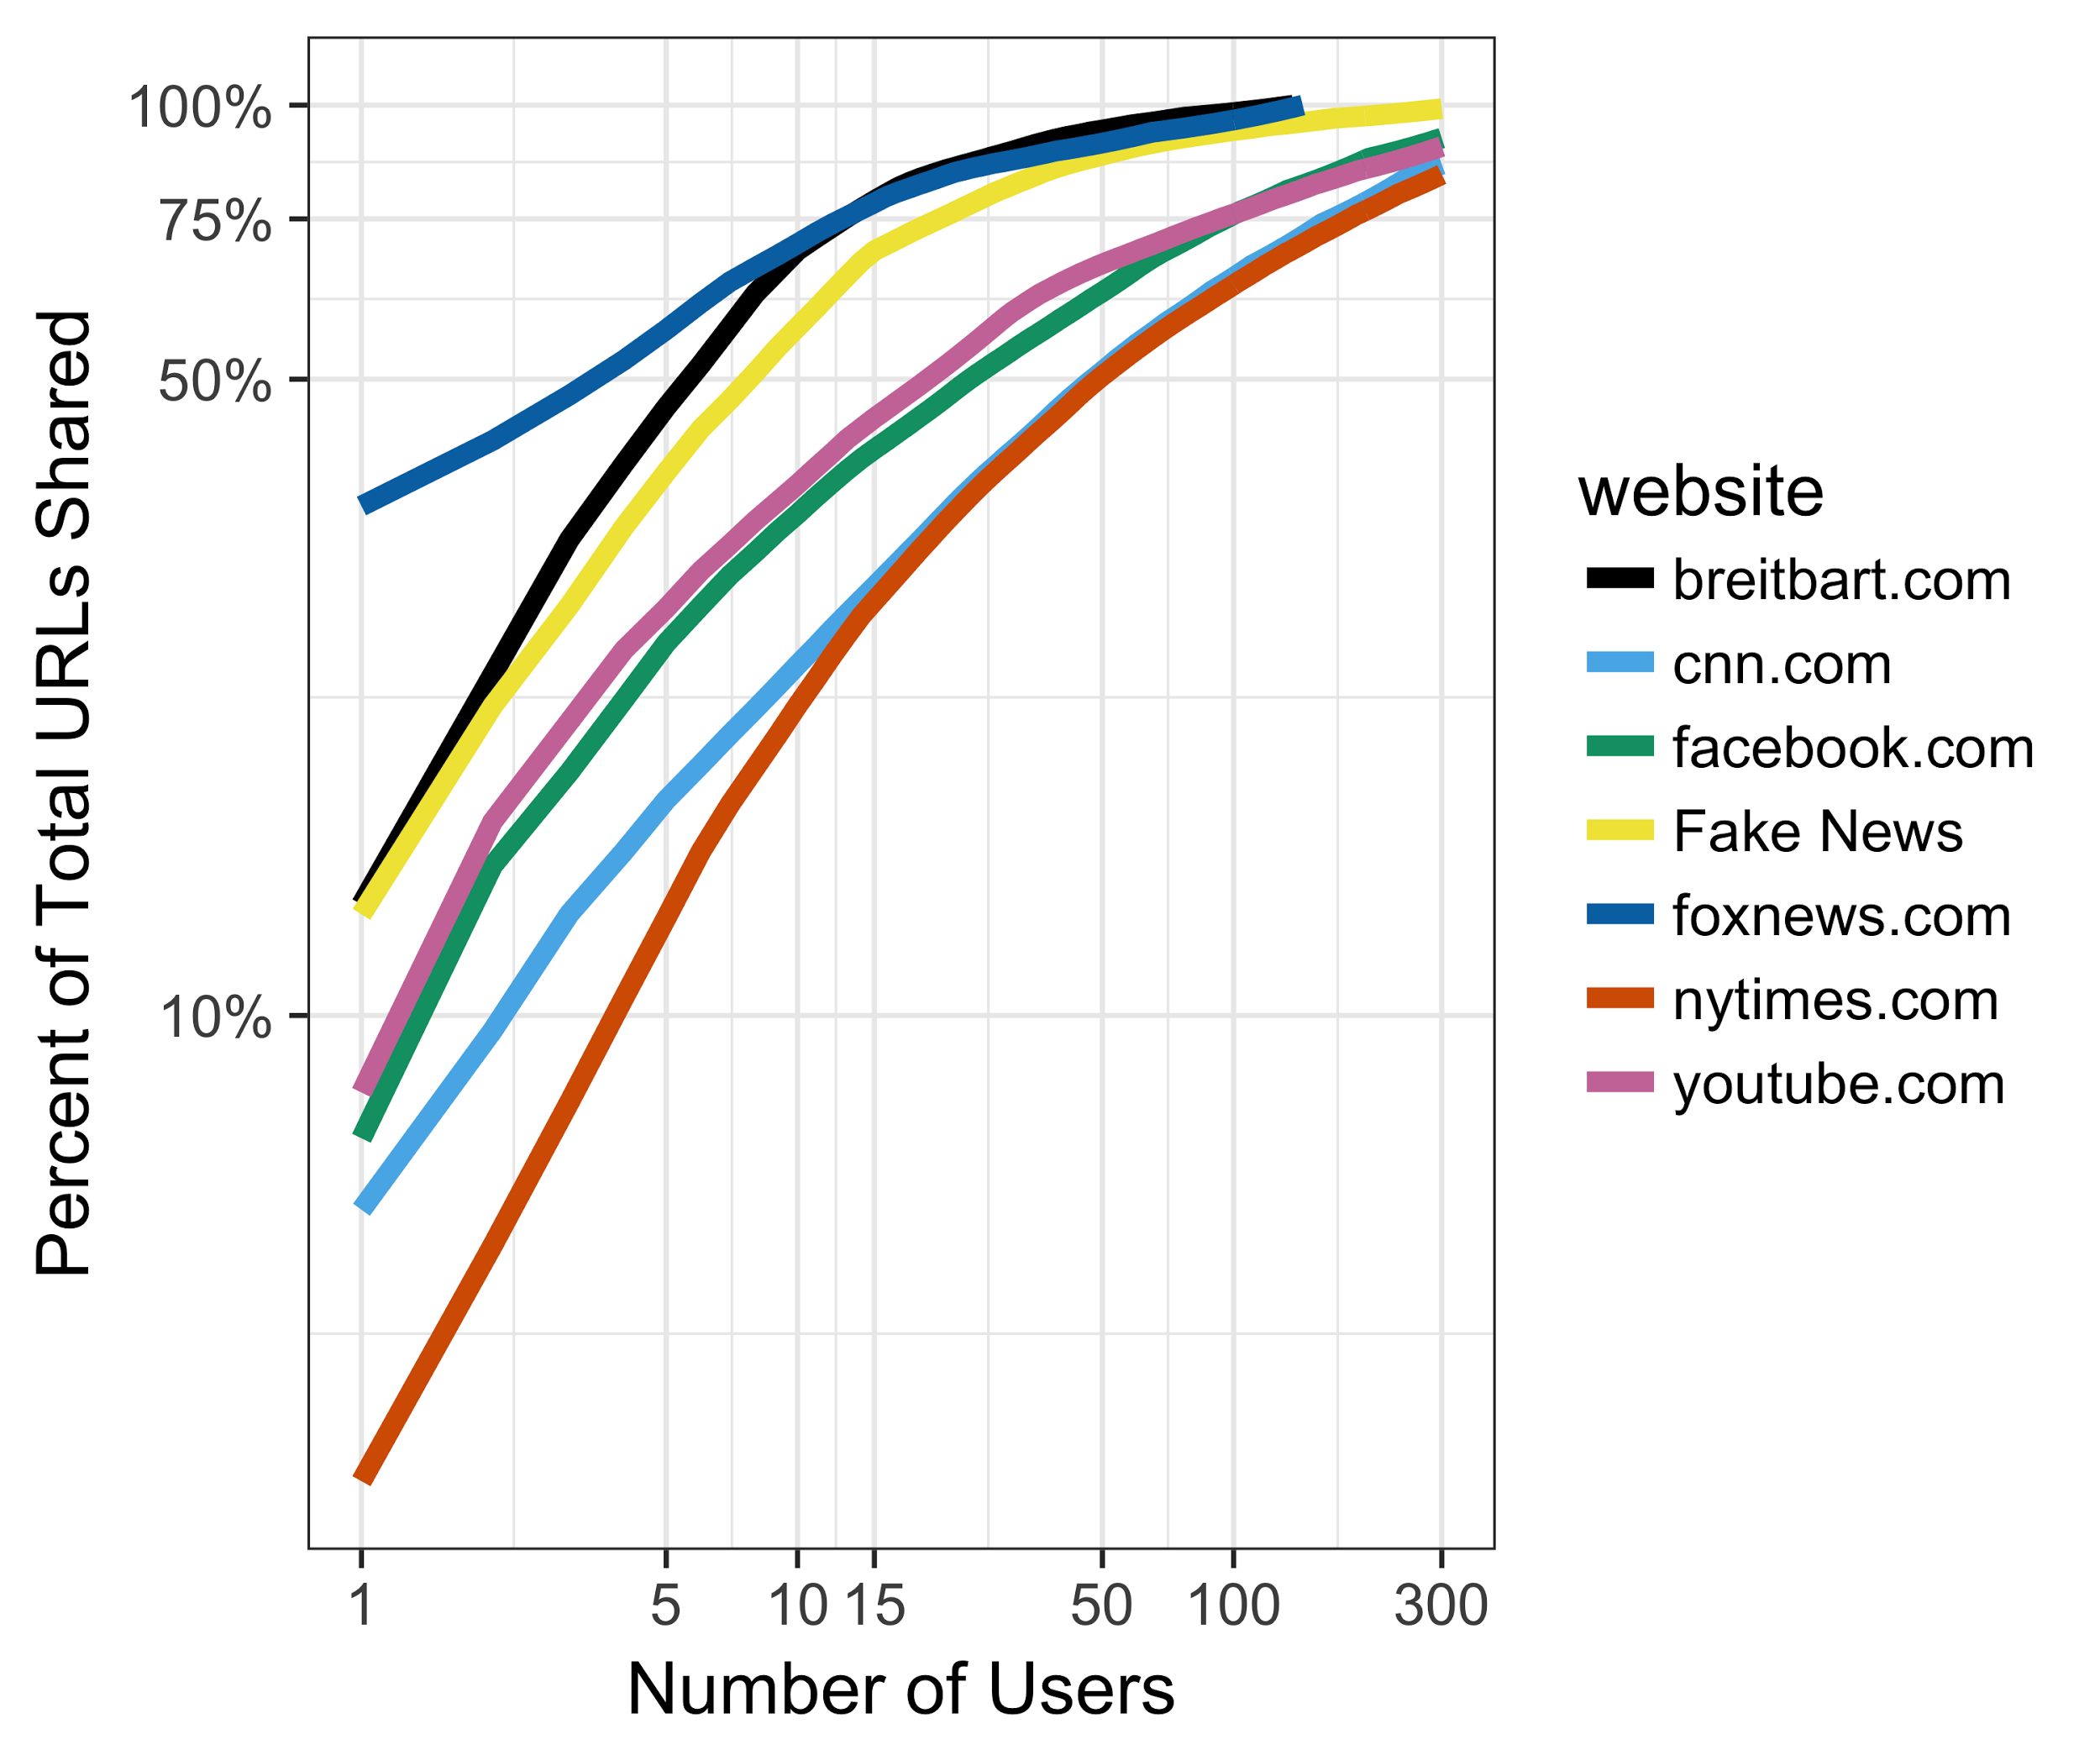
Fake news sharing dominated by a few “super-sharers
5,503 out of 95,660 (5.8%) Twitter links in one study were to fake news in 2016
4,790 users (of 22K) shared at least 1 “political URL”
Of those, 7% (348) shared a fake news URL
70% of fake news was shared by a set of 15 people!
Source: Grinberg et al. (2019)
Notes:
Most shared by a few “super spreaders”

Slide 36
Impact of Fake News (2016 Election)
72 percent said they saw
Hillary story; 69 percent
said they saw Pope
Francis sotry
Source: Ispos poll, Nov-Dec 2016.

Slide 37
The Power of Fake to Attract Our Attention
On average, fake stories travel
six times faster on social media
than true stories
Source: Soroush Vosoughi, Deb Roy, and Sinan Aral, “The spread of true and false news online,” Science 369 (2018): 1146-1151.

Slide 38
Contributing to the problem- our flight from reliable news sources
Accurate information counters misinformation but only if you have it.

Slide 39
Also, traditional news sources are not as reliable as they once were
    “News organizations play a major role in propagating hoaxes, false claims, questionable rumors, and dubious viral content.”
    Craig Silverman, et al, “Lies, Damn Lies and Viral Content,” Columbia University, February 10, 2015.
Although traditional news outlets don’t typically twist the facts, they report the words of political leaders who do shade the truth – over 80 percent of false claims are disseminated without mention that they’re inaccurate.

Slide 40
The News Media and Trump’s Tweets
A NY Times fact check found that a third of Trump’s tweets contained a significant falsehood.
How did Americans learn of Trump’s tweets?
1% directly from his Twitter feed
99% directly or indirectly through the media
Sources: Fact check, https://www.nytimes.com/2020/06/03/us/politics/trump-twitter-fact-check.html; tweet exposure, http://www.newsweek.com/trump-tweets-one-percent-mainstream-media-769207

Slide 41
Lying and Political Leaders
Deception at the highest levels of government is not new – e.g., Pentagon Papers
But the norm against lying by political leaders has weakened
Lying is now endemic at the highest levels of our politics
  “[Misinformation is highest for issues “on which elites prominently and persistently [make] incorrect claims.”
      Josh Pasek, et, Journal of Communication, 2015.

Slide 42
Elite-Driven Disinformation Example
Source: Associated Press-GfK survey, 2012

Slide 43
Misinformation Effect –
Covid Vaccine

Slide 44
Fixing our misinformation problem
We could hold political leaders to account for lying
BUT: We don’t detect it when our side’s leaders say it, and we don’t value truth enough to base our vote on it.
We could get our information from reliable sources
BUT: Many of us prefer sources that tell us what we want to believe – there’s high demand for confirming information.
We could hold ourselves to a higher standard
BUT: Confirmation bias is ingrained – we don’t know when we’re wrong and tend to reject conflicting information.

Slide 45
Fixing our misinformation problem
1. Fact checking – studies don’t show it to be all that effective and might contribute to spread of misinformation in some instances
2. Media literacy courses – the effect might be short lived
3. Platform intervention (removing false claims, delisting serial abusers, noting that a story is suspect) – most promising but more research on efficacy is needed.

Slide 46
Fixing our misinformation problem
Breaking the hold of party polarization on our politics
  If history is a guide, that will only happen when one of our parties becomes much stronger than the other.

Slide 47
Thank you –
Questions, Observations, Objections

