Slide 1
Using
Poll Everywhere in Classroom
McGraw-Hill Webinar, Feb 11, 2022
Tom Patterson, author of McGraw-Hill’s We The People

Slide 2
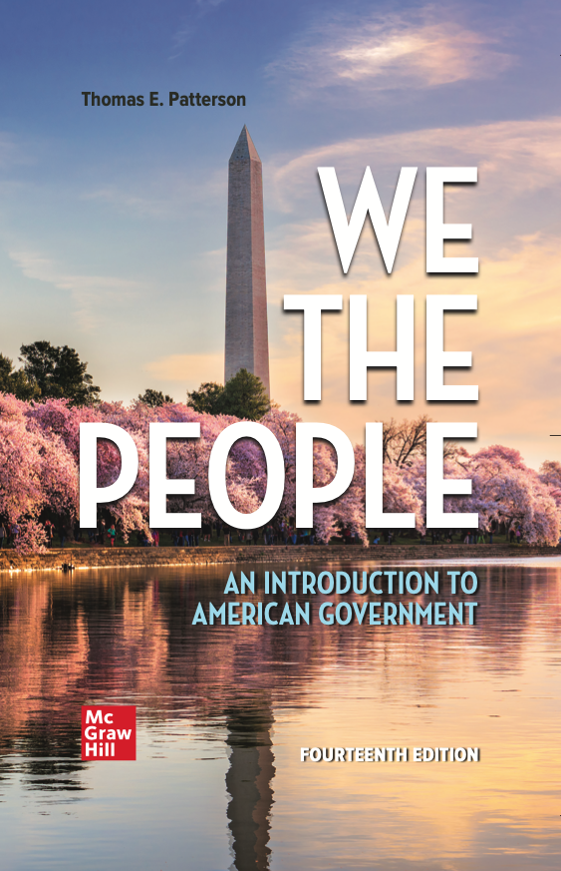
WE THE PEOPLE, 14e
NUMBER ONE in American Government
Accessibility through Readability
Critical Thinking Emphasis—Case Studies & Pedagogy
Even-handed approach with broad appeal
Unparalleled Instructor Support—24 Complimentary HarvardX/EdX Video Lectures
To obtain a free instructor’s copy of We the People, please enter your name and affiliation in the Chat Room.

Slide 3
Using
Poll Everywhere in Classroom
McGraw-Hill Webinar, Feb 11, 2022
Tom Patterson, author of McGraw-Hill’s We The People

Slide 4
The classroom challenge
1. Getting students to participate
2. Getting them to think critically
                “Education is not the learning of facts,
                but the training of minds to think.”
                Albert Einstein, asked in 1921 about purpose of a college education

Slide 5
How Poll Everywhere addresses the challenge
Poll Everywhere questions prompt:
in-class participation – begins with responding to the question and then explaining and defending one’s position
critical thinking – begins when choosing a question alternative and considering why its better than the others, and then judging it in context of what other students say

Slide 6
Flexibility
In using Poll Everywhere, more of the class hour is devoted to class discussion than would be the case with a straight lecture.
But the amount can be controlled:
Adding a single Poll Everywhere question into a lecture can enhance the student experience without having to trim most of what you would otherwise say.
On the other end of the scale, you can build the entire class around Poll Everywhere, using it to highlight main points only.
I use Poll Everywhere both ways, depending on the session’s topic and how much students already know about it.

Slide 7
Quick Note:
Getting started with Poll Everywhere
Poll Everywhere app is easy to install and use.
There are brief tutorials on the internet that cover everything you need to know to start using Poll Everywhere.

Slide 8
Using Poll Everywhere in the Classroom

Slide 9
“Warm Up” Question
As students are coming into the classroom, I have a Poll Everywhere slide on the screen.
The slide is intended as a “warm-up question” to get them thinking about the day’s topic. It’s not meant to take up class time.
Students like it, perhaps for the same reason they like puzzles or trivia games.

Slide 10
Example warm-up question
Poll Everywhere can be used to generate a Word Cloud.
In this case, I typically ask something along the lines of “in one or two words, what comes to mind when you think about _________?

Slide 11
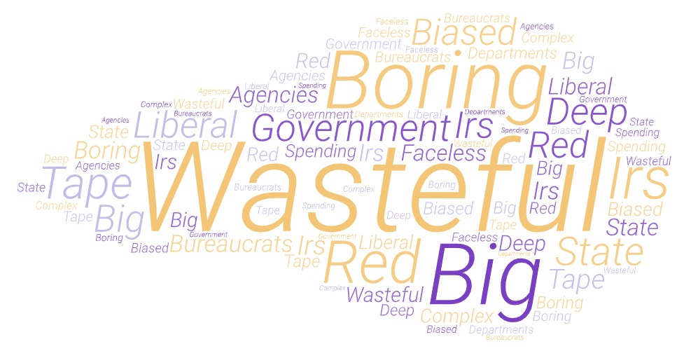
WHILE WAITING: In one or two words, what comes to mind when you think of the federal bureaucracy?

Slide 12
Another warm-up question example
I sometimes ask a warm-up question designed to make a substantive point about the day’s topic.
Frequently it’s intended to counter a stereotype that students might have.

Slide 13
WHILE WAITING: What is the party loyalty of federal employees?
Federal employees are heavily Democratic
Federal employees are roughly evenly balanced between Democrats and Republicans
Federal employees are heavily Republican

Slide 14
POLL: What is the party loyalty of federal employees?

Slide 15
Party Identification of Federal Employees
Source: Government Executive poll, 2015

Slide 16
Explaining Partisan Makeup of Federal Employees
Although tendency is to think most work in vicinity of DC, two-thirds work elsewhere. In fact, California has more federal employees than DC, Virginia, or Maryland.
Federal employees’ partisanship reflects their local area – e.g., many of nation’s largest military installations are in South and that civilian workforce leans Republican.
Even in the DC vicinity, partisanship varies across government agencies –
  Agencies related to national security, for example, have a largely Republican workforce whereas agencies related to social services have a largely Democratic workforce.

Slide 17
Another warm-up question example
I sometimes ask a warm-up question designed to make a substantive point about the day’s topic that then gets amplified later in the session.

Slide 18
WHILE WAITING: What is the best predictor of who will become party’s presidential nominee?
Candidate who wins Iowa caucuses
Candidate who wins New Hampshire primary
Candidate who gets most news coverage in advance of Iowa and New Hampshire
Candidate who raises most money in advance of Iowa and New Hampshire
Candidate who leads in the national polls in advance of Iowa and New Hampshire

Slide 19
POLL: What’s best predictor of who will become party’s presidential nominee?

Slide 20
Best Predictor of Nominee
Percentage of time (1972-2000) the nominee was . . .

Slide 21
Poll Everywhere - Discussion Questions
Poll Everywhere questions work best when there are at least a couple of plausible alternatives.
Unlike a test, where the correct answer is the goal, the goal with Poll Everywhere is to encourage thought and participation.
In the example that follows, my aim is to get them to think about the President’s legislative influence.

Slide 22
POLL: Which factor is most important in presidents’ ability to get their legislative agenda enacted into law?
1. Stage of president’s term – success is more likely early in term than later
2. Partisan makeup of Congress
3. National conditions – degree of urgency in responding to nation’s policy needs
4. Communication ability – president’s skill at using the “bully pulpit”
5. President’s public approval rating – success is more likely when president is popular

Slide 23
POLL: Which factor is most important in presidents’ ability to get their legislative agenda enacted into law?
1. After results are displayed,
I ask students the reason for
their choice, focusing on the
2 or 3 most frequent selections
2. After a few minutes of discussion, I repoll
to see if what was said led to change in opinions
3. After the repoll, I ask those who changed their opinion,
what led them to do so

Slide 24
Presidents’ Legislative Success
Source: CQ data

Slide 25
Presidents’ Legislative Success
Source: CQ data

Slide 26
Presidents’ Legislative Success
Source: CQ Voting Studies, 1952-2020

Slide 27
President Trump’s Legislative Success Rate
Source: CQ Vote Studies

Slide 28
President Obama’s Legislative Success Rate
Source: CQ, 2012

Slide 29
Key Point about Presidents’ Legislative Power
The American system is based on the principle of divided power – presidents have the power to present legislative ideas to Congress and can put pressure on Congress, but the power to enact laws rests with Congress.
    When one or both legislative chambers is controlled by the opposite party, the president’s task is much harder.

Slide 30
Poll Everywhere Example
This is a question that asks students to think about a range of factors in reaching an opinion about the best alternative.

Slide 31
POLL EVERYWHERE: Which is the larger constitutional restraint on bureaucrats’ power?
Congress’s constitutional authority over programs and funding
President’s constitutional authority as Chief Executive, which places the president at the head of all federal agencies and gives president the power to appoint all agency heads (e.g., Secretary of Defense).

Slide 32
POLL EVERYWHERE: Which is the larger constraint on bureaucrats’ power?
Classroom management:
This question is suited to an alternative way of getting students to participate.
Have students form into small groups consisting of those sitting close to them and ask them to discuss the pros and cons of the alternatives.
After roughly five minutes, either
  1) open the discussion to the full class before repolling or
  2) repoll immediately and then discuss.

Slide 33
The Major Constraint on Bureaucracy
Although the president is chief executive, Congress has stronger tools through which to control the bureaucracy, e.g.,
- No agency or major program can exist unless authorized by Congress
- Congress determines the funding that will be granted to each agency and agency program
- Congress can kill or modify an agency’s program
- Through oversight hearings, Congress can question bureaucrats and demand compliance with the law
- Through its Government Accountability Office (GAO), Congress tracks agency spending and program implementation to ensure that they comply with congressional authorizations.

Slide 34
Poll Everywhere Example
This is a question that asks students to apply what they know to a political development in order to form an opinion.
Such questions often provoke the liveliest discussion because the answer often can’t be derived directly from class readings – students need to make the connection.
Example is from my class session on interest groups.

Slide 35
2010 Dodd-Frank
Wall Street Reform and Consumer Protection Act
In 2008, major U.S. financial institutions nearly collapsed, sending the economy into a deep recession.
A major reason for the collapse was that financial institutions had engaged in risky loans. When markets began to weaken, many of those holding the loans, including millions of homeowners, started to default, which contributed to the economy’s downward spiral.
To try to prevent a recurrence, Congress enacted the 2010 Dodd-Frank Act, which tightened restrictions on the lending practices of financial institutions.

Slide 36
As the Dodd-Frank Act was making its way through Congress, one lobbying group was able to getting its loans exempted from the requirements.
POLL: Which loans do you think were exempted?
Home mortgage loans
Credit card loans
Student loans
Auto loans
Commercial bank loans
Savings bank loans
Credit union loans

Slide 37
As the Dodd-Frank Act was making its way through Congress, one lobbying group was able to getting its loans exempted from the requirements.
POLL: Which loans do you think were exempted?

Slide 38

Auto loans were stripped from bill

Slide 39
Why do you think the auto industry’s lobbying effort succeeded?
Power of Information - Auto industry provided Congress with research showing auto loans did not pose same risk to economy as home mortgages
Lobbying Power – 500 auto industry lobbyists spent time on Capitol Hill trying to influence members of Congress on Dodd-Frank bill
Electoral Power –
auto and auto-supply plants are located in nearly every state and many congressional districts;
auto dealers are often prominent local business leaders & major campaign donors
the automobile sector is one of America’s largest employers (e.g., service stations, repair shops, auto supply stores)
Notes:
Question for students

Slide 40
Another Use of Poll Everywhere: In-Class Debate
If there’s extra time, I use Poll Everywhere to stage an in-class debate.
For the class debate, I don’t suggest that there’s a “right answer,” but I do indicate that there are weak arguments (opinions that lack reference to values or empirical evidence) and strong arguments (those that stem from a clearly stated value and/or are backed by empirical evidence).
When holding an in-class debate, I typically reserve about 10 minutes at the end of the class session.

Slide 41
My Debate Rules
1. Civility
2. Openness to hearing the other side
“He who knows only his own side of the case knows little of that. [If he is] unable to refute the reasons on the opposite side, if he does not so much as know what they are, he has no ground for preferring either opinion...
John Stuart Mill, political theorist

Slide 42
The U.S. immigration level has varied widely at different times in the nation’s history.
POLL: Thinking of today’s situation, do you believe immigration to the United States should be kept at its current level, increased, or decreased?
Kept at its current level
Increased
Decreased.
Procedure is same. Some students will be given a chance to voice their opinion, after which question is repolled, followed by asking students who changed their mind what they heard that led them to do so.

Slide 43
What Americans think about immigration level
Source: Gallup poll, 2021

Slide 44
Thank You
Questions, Comments, Objections, Suggestions?

Slide 45
WE THE PEOPLE, 14e
NUMBER ONE in American Government
Accessibility through Readability
Critical Thinking Emphasis—Case Studies & Pedagogy
Even-handed approach with broad appeal
Unparalleled Instructor Support—24 Complimentary HarvardX/EdX Video Lectures
To obtain a free instructor’s copy of We the People, please enter your name and affiliation in the Chat Room.

