Slide 1
McGraw-Hill Webinar October 21, 2021
Using
Poll Everywhere in Classroom
Tom Patterson, author of McGraw-Hill’s We The People

Slide 2
The classroom challenge
1. Getting students to participate
2. Getting them to engage in critical thinking
“Education is not the learning of facts,
but the training of minds to think.”
Albert Einstein, asked in 1921 about purpose of a college education

Slide 3
How Poll Everywhere addresses the challenge
Poll Everywhere questions promote:
in-class participation – begins with responding to the question and then explaining and defending one’s position to others in the class
critical thinking – begins when deciding between the question alternatives and forming an explanation for why it’s the best alternative and then judging it in the context of what other students are saying

Slide 4
The Trade Off –
Poll Everywhere vs. Straight Lecture
The use of Poll Everywhere involves a trade-off: an instructor cannot cover as many topics as would be the case with a straight lecture.
In using Poll Everywhere, my approach is to first determine the 3 or 4 main ideas that I’d like to get across during the class session and then to create Poll Everywhere and related slides that highlight these ideas.

Slide 5

Getting started with Poll Everywhere
Poll Everywhere app is easy to install and use.
There are brief tutorials on the internet that cover everything you need to know to start using Poll Everywhere.

Slide 6
Today’s Session
Some examples how I use Poll Everywhere in the classroom
  - examples are from my session on the federal bureaucracy - a subject that students often say is “boring”
My pedagogical strategy in designing Poll Everywhere questions and handling student responses.

Slide 7
Use of Poll Everywhere: “Warm Up” Question
As students are coming into the classroom, I often have a Poll Everywhere slide on the screen.
The slide is intended as a “warm-up question” to ease them into the day’s subject. It’s not meant to spark discussion.

Slide 8
POLL EVERYWHERE: While waiting for everyone to arrive– where do the largest number of federal employees reside?
District of Columbia
Maryland
Virginia
California
Florida
Texas

Slide 9
POLL EVERYWHERE: While waiting for everyone to arrive– where do the largest number of federal employees reside?

Slide 10
Another version of a warm-up question
Poll Everywhere can be used to generate a Word Cloud.
In this case, I typically ask something along the lines of “in one or two words, what comes to mind when you think about _________?

Slide 11
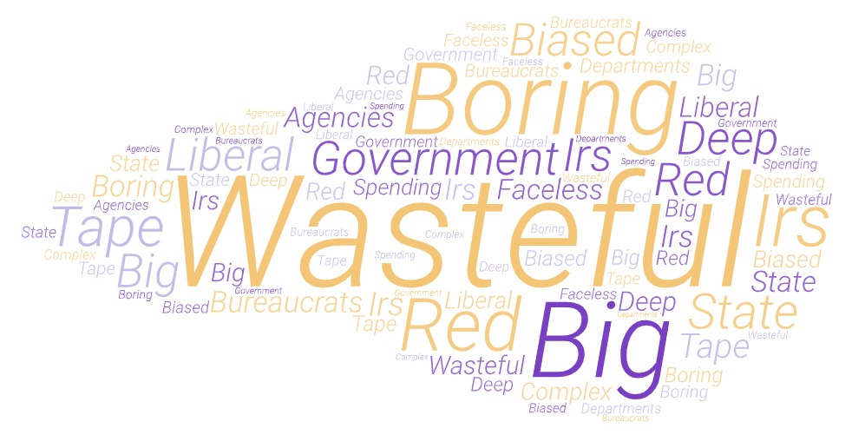
Poll Everywhere: In one or two words, what comes to mind when you think of the federal bureaucracy?

Slide 12
Poll Everywhere - Discussion Questions
My primary use of Poll Everywhere is to spark in-class discussion and provoke critical thinking.
The best Poll Everywhere questions tend to be ones where several alternatives appear plausible. Clear-cut answers deflate critical thinking and discussion.
Unlike a test, where the correct answer is the goal, the goal with Poll Everywhere is to encourage participation and thought.

Slide 13
Discussion Question Example
My goal with this Poll Everywhere example is to get students to think about the nature of bureaucratic power.

Slide 14
Types of Federal Agencies
Cabinet (executive) Departments: Fifteen in number, each has responsibility for a general policy area, such as defense (Department of Defense) and social services (Department of Health and Human Services).
Independent Agencies: Typically have responsibility for a narrower policy area than a department, such as space (NASA).
Regulatory Agencies: Have responsibility for regulating economic activity, either sector-specific (e.g., Securities and Exchange Commission) or cross-sector (e.g., Environmental Protection Agency).
Government Corporations: Charge for their services and are governed by a board of directors. Some of their budget is provided by Congress. Examples: Federal Deposit Insurance Corporation (FDIC) and National Railroad Passenger Corporation (Amtrak).
Presidential Commissions: Designed to provide advice to the president, they can be either permanent (e.g., Commission on Fine Arts) or temporary (a recent example is the Law Enforcement and Administration of Justice Commission).

Slide 15
Bureaucratic Power
Bureaucrats are unelected officials and yet exercise power. They exert influence over public policy through, for example:
  Rulemaking – devising the rules and regulations for carrying out an act of Congress or a presidential order. Congressional and presidential directives are often general in nature, with the details for how they will be implemented left to bureaucrats to determine.
Policy implementation – when administering policies and programs, bureaucrats frequently have discretion on how they will be carried out, as when those in the Justice Department decide how vigorously they will pursue white-collar crime.

Slide 16
POLL EVERYWHERE: In which type of agency do bureaucrats typically have the most power over agency decisions?
Cabinet (executive) agencies
Independent agencies
Regulatory agencies

Slide 17
POLL EVERYWHERE: In which type of agency do bureaucrats typically exert the most power over agency decisions?

Slide 18
POLL EVERYWHERE: In which type of agency do bureaucrats typically exert the most power over agency decisions?
Classroom management:
After a few minutes of discussion, repoll the question.
If there’s been a shift in the distribution, I’ll say in effect: “Some of you changed your mind. What did you hear that led you to do so?”

Slide 19
How the type of agency affects bureaucrats’ power
Regulatory agencies – arguably the type of agency where bureaucrats have most power. Some regulatory agencies have greater independence from presidential and congressional authority than other agencies and have a larger set of powers – they not only issue regulations but also monitor firms for compliance and can fine violators.
Independent agencies – a good case can also be made for independent agencies such as NASA and the National Institutes of Health (NIH). Top bureaucrats in these agencies are typically highly trained (engineers, physicians, etc). Knowledge is power in any agency, and these agencies exemplify it.
Executive (cabinet) departments – These departments have authority over large and important policy areas, yet those same features tilt power in the departments away from bureaucrats and toward the presidential appointees (cabinet secretary, deputy secretary, assistant secretaries) at the top of the department.

Slide 20
Another Example
My goal with this example is to get students think about bureaucratic bias.
The example differs from the previous one in that one of the answers is demonstrably better than the others.
In such cases, it is nonetheless important to have alternatives that some students will find convincing because of conventional wisdom, stereotypes, partisan bias, conflation, etc.

Slide 21
It is sometimes said that federal bureaucrats are “biased” in their policy decisions.
POLL EVERYWHERE: Which statement about bureaucrats’ “bias” is mostly clearly supported by evidence?
1. Federal bureaucrats have a liberal bias – they promote policies favored by the Democratic Party.
2. Federal bureaucrats have a conservative bias – they promote policies favored by the Republican Party.
3. Federal bureaucrats have a bias resulting from their commitment to their agency’s mission.
4. Federal bureaucrats have a “Beltway” bias - most of them work in the vicinity of Washington, D.C. and have adopted the outlook characteristic of government insiders.

Slide 22
It is sometimes said that federal bureaucrats are “biased” in their policy decisions.
POLL EVERYWHERE: Which statement about bureaucrats’ “bias” is backed by the strongest evidence?

Slide 23
It is sometimes said that federal bureaucrats are “biased” in their policy decisions.
POLL EVERYWHERE: Which statement about bureaucrats’ “bias” is backed by the strongest evidence?
Classroom management:
I say something to the effect – “good work, most of you picked the option for which the evidence is most solid.”

Slide 24
Why bureaucrats have an
“Agency Point of View”
“Agency Point of View” results from:
1. belief in importance of agency programs as a result of working on them for years
2. specialized training (e.g., physicians in NIH) that heightens belief in importance of agency’s work
3. self-preservation (holding onto job and authority)

Slide 25
Example of Agency Point of View: social welfare bureaucrats vs. all others
Source: Aberbach and Rockman, “Clashing Beliefs within the Executive Branch,” APSR (1976): 461.

Slide 26
Ways that Bureaucrats Promote Their Agency
Specialized knowledge – bureaucrats are usually better informed on their agency’s issues than are members of Congress or the president
Help of friends in high places – agencies naturally have backers in Congress and/or White House – for example, farm-state representatives tend to support Department of Agriculture programs and funding
Clientele groups – agencies can count on the backing of groups that benefit from the agency’s programs

Slide 27
Party Identification of Federal Employees
Source: Gallup poll, 2010

Slide 28
Explaining the distribution of Republicans & Democrats in federal bureaucracy
Only a third of federal employees work in Washington, DC and adjoining states, which are Democratic areas.
Most federal employees are hired from the community where they live. For instance, almost all civilian employees at military bases are “locals.”

Slide 29
Federal employees – top 7 locations
CALIFORNIA 152,466
VIRGINIA 144,295
DISTRICT OF COLUMBIA 141,367
TEXAS 132,952
MARYLAND 120,705
FLORIDA 89,504
GEORGIA 71,739

Slide 30
Another Example
My goal with this example is to get students to think about constitutional restraints on bureaucrats’ power.

Slide 31
POLL EVERYWHERE: Which is the larger constitutional restraint on bureaucrats’ power?
Congress’s constitutional authority over programs and funding
President’s constitutional authority as Chief Executive, which places the president at the head of all federal agencies and gives president the power to appoint all agency heads (e.g., Secretary of Defense).
Not sure

Slide 32
POLL EVERYWHERE: Which is the larger constraint on bureaucrats’ power?
Classroom management:
This question is suited to an alternative way of getting students to participate.
Have students form into small groups consisting of those sitting close to them and ask them to discuss the pros and cons of the alternatives.
After roughly five minutes, either
  1) open the discussion to the full class before repolling or
  2) repoll immediately.

Slide 33
The Major Constraint on Bureaucracy
Although the president is chief executive, Congress has stronger tools through which to control the bureaucracy, e.g.,
- No agency or major program can exist unless authorized by Congress
- Congress determines the funding that will be granted to each agency and agency program
- Congress can kill or modify an agency’s program
- Through oversight hearings, Congress can question bureaucrats and demand compliance with the law
- Through its Government Accountability Office (GAO), Congress tracks agency spending and program implementation to ensure that they comply with congressional authorizations.

Slide 34
Another Use of Poll Everywhere: In-Class Debate
If there’s extra time, I use Poll Everywhere to stage an in-class debate.
For the class debate, I don’t suggest that there’s a “right answer,” but I do indicate that there are weak arguments (opinions that lack reference to values or empirical evidence) and strong arguments (those that stem from a clearly stated value and/or are backed by empirical evidence).
In my session on public opinion, for example, the in-class debate centers on the question of gun control versus gun rights.
I typically reserve about 10 minutes at the end of the class session for an in-class debate.

Slide 35
In-Class Bureaucracy Debate –
The Deep State Theory
The “Deep State Theory” holds that a set of unelected bureaucrats (particularly those in the defense, intelligence, and justice agencies) secretly conspire to control and manipulate national policy. When they disagree with the president over policy, they are said to engage in a coordinated effort to thwart it – for example, by ignoring or delaying presidential orders, leaking information to the news media, and encouraging prominent leaders outside of government to act as proxies in attacking the president’s policy.

Slide 36
POLL EVERYWHERE: Does the Deep State . . . ?
1. Definitely or probably exist
2. Definitely or probably not exist
3. Not sure

Slide 37
When staging an in-class debate
I poll the students at the start and then again at the end of the debate to see if opinions shifted as a result of what students heard during the debate.
If there’s been a noticeable shift in opinion, I ask students what they heard that led them to change their mind.
At the end of the debate, I typically show students a slide that shows Americans’ opinions on the debate question.

Slide 38
Americans’ opinions on the likelihood of a Deep State -
Source: Ispos Survey, 2020

Slide 39
Thank You
Questions, Comments, Objections, Suggestions?

