Slide 1
The Right to Vote:
U.S. Constitution, Law, and Partisan Politics
McGraw-Hill Webinar September 14, 2021
Tom Patterson

Slide 2
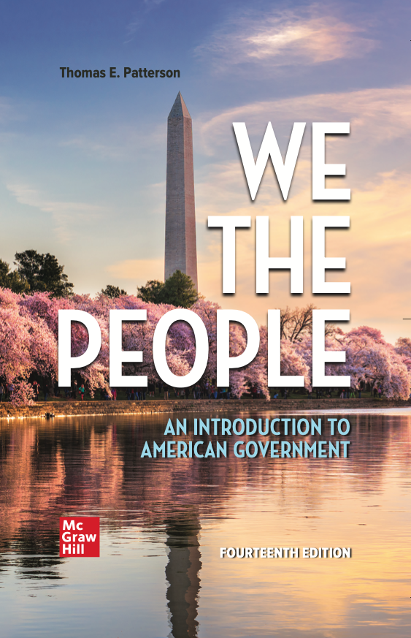
WE THE PEOPLE, 14e
NUMBER ONE in American Government
Accessibility through Readability
Critical Thinking Emphasis—Case Studies & Pedagogy
Even-handed approach with broad appeal
Unparalleled Instructor Support—24 Complimentary HarvardX/EdX Video Lectures
AVAILABLE FOR SUMMER & FALL 2021 CLASSES!

Slide 3
The Right to Vote:
U.S. Constitution, Law, and Partisan Politics
McGraw-Hill Webinar September 14, 2021
Tom Patterson

Slide 4
Key Points for Today
Voting as a constitutional right – constitutional guarantees of the right to vote are inexact and conflicting, which has given Supreme Court justices leeway in deciding voting rights cases.
Politics of ballot access – There is no historical instance where a political party has made a sustained effort to change voting laws unless it improved its chances of winning elections.

Slide 5
The Constitution and Individual Rights
The Constitution as originally written, including Bill of Rights
  Spoke directly about rights of free expression and due process, e.g..
  “The Privilege of the Writ of Habeas Corpus shall not be suspended, unless when in Cases of Rebellion or Invasion the public Safety may require it.” (Article 1, Section 9)
    ”Congress shall make no law . . . abridging the freedom of speech . . .” (1st Amendment)
    Spoke indirectly about voting rights in federal elections –
    “the Electors [voters] in each State shall have the Qualifications requisite for Electors [voters] of the most numerous Branch of the State Legislature.
    Not until later did the Constitution refer directly to voting rights:
  “The right of citizens of the United States to vote shall not be denied or abridged by the United States or by any State on account of race, color, or previous condition of servitude.” (15th Amendment, 1870)
  “The right of citizens of the United States to vote shall not be denied or abridged by the United States or by any State on account of sex.” (19th Amendment, 1920)

Slide 6
The Nation’s First Century –
Expanding Suffrage
Initially
Most states had a property requirement for eligibility and nearly all restricted voting to free white males – about two-thirds of white males were eligible, nearly all others were not
Jacksonian Era
Nearly all states by now dropped property requirement, which extended voting eligibility to all white males
Post-Civil War
Passage of 15th Amendment granted suffrage to newly freed Black Americans
But – White southerners concocted laws to keep blacks from voting-
  grandfather clause, Whites only primaries, poll tax, literacy test
Source: Alexander Keyssar, The Right to Vote: The Contested History of Democracy in the United States (2000), pp.15, 23-24..

Slide 7
Supreme Court’s Response to the Suppression of Black Voters
One option was to privilege the 15th Amendment (perhaps even the 14th), which would have invalidated the state laws. The second option was to privilege state power over elections granted by Article 1, Section 2 and uphold the laws. For long periods, It chose the second:
Waited three decades (Guinn v. U.S., 1915 ) before striking down the “grandfather clause”
Waited four decades (Smith v. Allwright, 1944) before striking down “whites-only primaries”
Waited seven decades (Harper v. Virginia Board of Elections, 1966) before striking down the poll tax, doing so only after the 24th Amendment (ratified in 1964) barred its use in federal elections
Waited seven decades (Katzenbach v. Morgan, 1966) before striking down the literacy test, doing so only after the 1965 Voting Rights Act outlawed it

Slide 8
Early Supreme Court Rulings –
Example of Williams v Mississippi (1898)
The 1890 Mississippi Constitution specified the poll tax, literacy tests, and grandfather clause as conditions affecting voting eligibility.
In Williams v. Mississippi (1898), the Supreme Court upheld the provisions, holding that because the provisions theoretically applied to every citizen and did not explicitly apply to African Americans, the provisions were a valid exercise of the state’s authority over voting qualifications.

Slide 9
What accounts for the Supreme Court’s weak defense of voting rights
Constitution’s Article 1, Section 2, which grants gives states broad authority over voter eligibility, conflicts with 15th Amendment (denial on basis of race) and 14th Amendment (denial of equal protection)
Judicial discretion, which is substantial when constitutional provisions are sparse or in conflict. In such instances, justices have usually responded to interests of political elites rather than of citizens.
  “We are under a Constitution, but the Constitution is what the judges say it is.”
  Charles Evans Hughes, US Supreme Court associate justice (1910-1916) and chief justice (1930-1941)
Source: Lawrence Baum, “Why the Supreme Court Cares about Elites . . .”

Slide 10
Black vote was suppressed throughout the South –
Mississippi was the extreme case
Source: Whites percentage was estimated from multiple sources; black percentage from US Comission on Civil Rights..

Slide 11
The 1965 Voting Rights Act –
Key Provisions
Section 4. Contained formula that defined which jurisdictions were subject to provisions of the Act. A jurisdiction was subject to the Act if:
  A. It had used a “test or device” (such as literacy test) as a condition for voter eligibility
  B. Its voting rate was less than 50% of eligible voters.
Section 5. (Preclearance requirement) Required covered jurisdictions receive US Justice Department approval to implement changes to their election laws. The burden of proving that the change was not discriminatory rested with the jurisdiction, not the Justice Department.

Slide 12
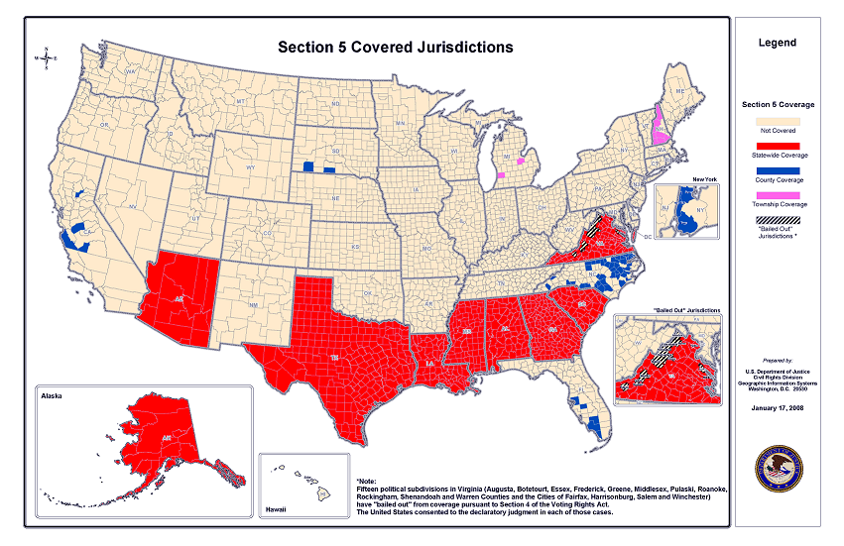
Jurisdictions Subject to Preclearance under Voting Rights Act
Note:
Texas, Alaska, & Arizona were added to list in 1975

Slide 13
Congressional Vote on 1965 Voting Rights Act –
Region was the dividing line
Senate
house
NOTE: South is defined as AL, AR, FL, GA, LA, MS, NC, SC, TX & VA

Slide 14
Effect of 1965 Voting Rights Act on Black Registration
March 1965, before passage of VRA
Source: US Commission for Civil Rights, “Minority Representation and the Quest for Voting Equality.”

Slide 15
In this same period. . .
The Supreme Court, for one of the first times, explicitly recognizes the right to vote as a basic constitutional right of citizenship, e.g.,
  “No right is more precious in a free country than that of having a voice in the election of those who make the laws under which, as good citizens, we must live. Other rights, even the most basic, are illusory if the right to vote is undermined. Our Constitution leaves no room for classification of people in a way that unnecessarily abridges this right.”
                Justice Hugo Black, Wesberry v. Sanders (1964)

Slide 16
Partisan Advantage Intrudes on Ballot Access –
Democrats and 1993 Motor Voter Act
House
Senate
Bill Clinton signed
act into law. Two
years earlier, George
H.W. Bush had
vetoed the bill.

Slide 17
Democrats’ Incentive in Pushing for Motor Voter Act
Registration Level (1992)
Vote preference (1992)
Income Level
Income Level
Source: US Census Bureau for registration data; election surveys for voting data.

Slide 18
Constitutionality of Motor Voter Act
Several Republican-controlled states challenged the Act, claiming it violated their Article I and Tenth Amendment authority and imposed an unfunded mandate (they would now be required to staff and equip the new registration process).
Six federal district courts and two federal circuit courts rejected the lawsuits. The Supreme Court declined to take the case, thus upholding the circuit court rulings.
    The circuit courts cited Article I, Section 4 of the Constitution, which grants Congress the power to determine “the times, places, and manner” of electing federal officials.

Slide 19
Impact of Motor Voter Act
Turnout was 3-4 percent higher than if it hadn’t been enacted
No clear partisan advantage - although a somewhat larger number of new registrants were Democrats, that advantage was largely offset by a higher turnout rate among the newly registered Republicans
Source: Joseph Lawler, “Motor Voter and Turnout 15 Years after the NVRA.”

Slide 20
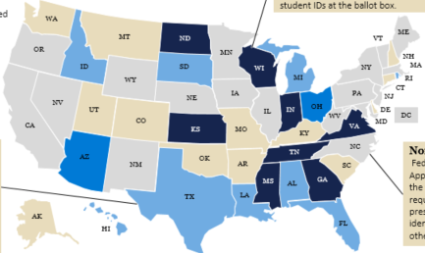
Partisan Advantage and Voter Access –
Republicans and Voter ID Laws
States with photo ID requirement
Blue-colored states have photo ID requirement
2003 – Republican-controlled Georgia and Indiana state legislatures enacted laws requiring citizens to have a government-issued voter ID in order to register to vote
Over the next decade, more than two dozen states enacted similar laws – all but one (Rhode Island) by Republican-controlled legislatures

Slide 21
Citizens without Government-Issued Photo ID
Source: American National Election Studies survey, 2012.

Slide 22
Republicans’ Partisan Incentive – vote preference of those without government-issued photo ID
Source: Exit polls. Based on average percentage for 2012-2020 presidential elections.

Slide 23
Constitutionality of Voter ID Laws –
Crawford v Marion County (2008)
Supreme Court in 6-3 decision upheld Indiana’s strict voter ID law, concluding it was valid exercise of states’ power over elections that’s granted them in Article 1, Section 2 of the US Constitution.
The Court’s majority acknowledged that partisan motivation played a part in law’s enactment:
“[The law] should not be disregarded simply because partisan interests may have provided one motivation for the votes of individual legislators.”
Crawford v. Marion County Election Board (2008)

Slide 24
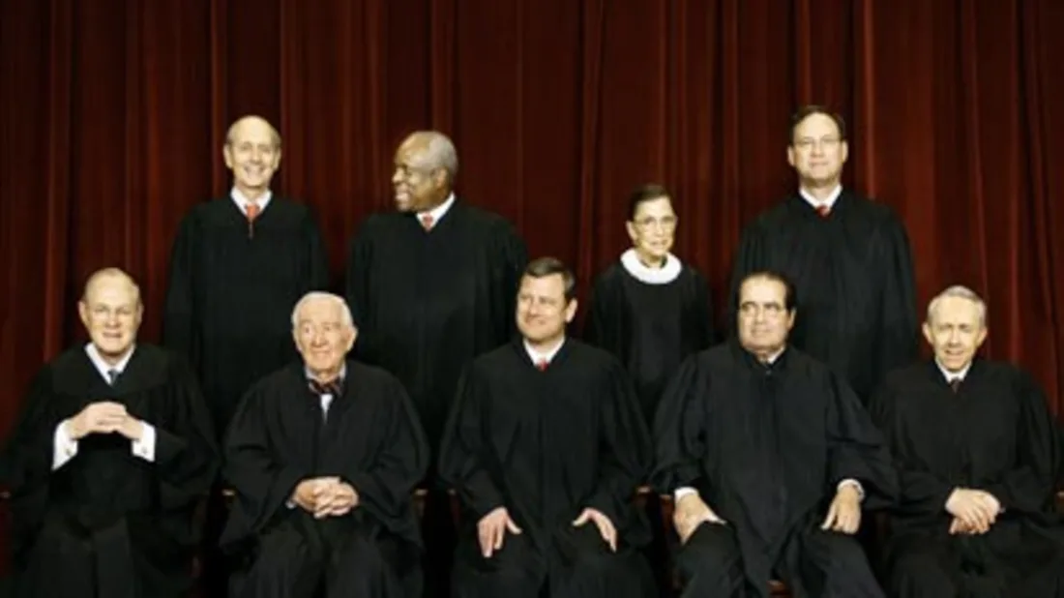
The 6 Justices in the Crawford majority – common denominator – all were Republican appointees

Slide 25
Justice Souter’s Dissenting Opinion in Crawford
Souter argued the law violates the 1st (free expression) and 14th (equal protection) Amendments by burdening those without a government issued ID. To get one, Souter noted that otherwise eligible voters would have to obtain:
  a. an official copy of their birth certificate (for which there’s a fee)
  b. travel to a specified government office to present birth certificate and obtain a government-issued ID
  Souter argued that these were unreasonable burdens on potential voters who are poor, don’t have a car, or are infirm (as in the case of those in a nursing home)

Slide 26
Voting Rights Act –
Shelby County v. Holder (2013)
Republican officials in Shelby County, Alabama filed suit, claiming that federal oversight of their election proceedings violated their constitutional rights.
Supreme Court in a 5-4 decision sided with Shelby County, invalidating as unconstitutional Section 4 of Voting Rights Act on grounds that its formula for determining which jurisdictions were subject to oversight was outdated.
The decision made Section 5 (preclearance provision) inapplicable because there was now no way to identify the jurisdictions subject to preclearance (receiving Justice Department approval prior to making any change affecting ballot access).

Slide 27
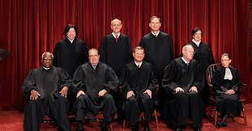
The Five Justices in the Shelby majority – common denominator – all were Republican appointees

Slide 28
Effect of the Shelby ruling
Within a year of Shelby, every state previously subject to the preclearance requirement (all of which had Republican-controlled legislatures) had changed its voter eligibility rules.
  The new Texas law, for example, required voters to show an acceptable form of photo ID to be eligible to vote. One of the acceptable forms of photo ID was a concealed handgun license. Not acceptable, for example, was a student photo ID.
In 2014, Supreme court upheld the Texas law with the Republican-appointed justices supporting the law and the Democratic-appointed justices dissenting.
Source: “Supreme Court Allows Texas to Use Controversial Voter ID Law,” Washington Post, October 18, 2014.

Slide 29
2020 Presidential Election
Conducted during Covid pandemic, which prompted unprecedented levels of early voting and mail-in voting.
Turnout among eligible voters was highest in a century. And turnout was high for both parties:
  - Trump drew 11 million more votes than he had in 2016
  - Biden drew 15 million more votes than Clinton did in 2016
  Biden’s victory led many Republican leaders and two-thirds of Republican voters to claim that he won as a result of illegal voting and rigged vote counting related to mail-in and absentee voting.

Slide 30
Vote Preference & Form of Ballot (2020)

Slide 31
Republican Response to 2020 Loss
In 17 Republican-controlled states,* laws have been enacted that put limits on absentee and mail-in voting
Lawsuits challenging some of these laws are in state and lower federal courts.
          The U.S. Justice Department
              - has filed suit against Georgia’s law
              - could challenge Texas’s law
* The states are AL, AZ, AR, FL, GA, ID, IA, IN, KS, KY, MT, ND, NH, NV, TN, UT, WY

Slide 32
Democrats’ Response in Congress
H.R. 1 For The People Act. Would end gerrymandering of congressional districts, set mandates for early and mail-in voting and increase transparency in campaign financing. Passed the House 220-210 on March 3, 2021 with all Democrats but one voting for it and all Republican voting against it
H.R. 4, the John Lewis Voting Rights Advancement Act. Would update formula in Section 4 of Voting Rights Act, which would reinstate the preclearance requirement of Section 5. Passed the House on August 24 by a 216-211 vote with all Democrats in favor and all Republicans opposed.
Neither bill is likely to pass the Senate without suspending or voiding the filibuster and, if H.R.1 was to pass, its gerrymandering and mandate provisions would face challenge in the courts, with the possibility the Supreme Court would declare them to be unconstitutional violations of powers held by the states under the US Constitution. H.R. 4 could pass constitutional muster – in Shelby, the Supreme Court said Congress could reinstate Section 4 by updating the formula for which jurisdictions were covered.

Slide 33
Democrats’ Action in the States
Since 2016, 18 states*, all but a few controlled by the Democrats, have instituted Automatic Voter Registration (AVR) in the context of the Motor Voter Act
  -originally, registration was “opt in” – when at a state motor vehicle or social welfare office, individuals had to agree to be added to the voter registration rolls
  - AVR is an “opt-out” system – individuals are automatically registered unless they refuse to be added to the rolls
            Oregon was the first state to adopt AVR and its registration rate under Motor Voter Act tripled
            Vermont was second, and its rate doubled
The 18 states are AK, CA, CO, CT, IL, ME, MD, MA, NJ, NM, NY, NV, OR, RI, VT, VA, WA, WV.

Slide 34
Frequency of Possible Fraudulent Voting in Federal Elections
With mail-in
voting, about 1
in 400,000 votes might be illegal
Source: Justin Levitt, Loyal Law School, US Elections Project, for in person voting (based on 2000-2102 election; Electronic Registation Information Center, for mail-in voting (based on 2016 and 2018 elections).

Slide 35
Relationship between Barriers to Voting and Voter Turnout Rate (2020 presidential election)
highest
State turnout
rate
lowest
lowest
highest
State rank in voting barriers
Source: For barriers: Scot Schranfruagal, et al, “Cost of Voting in the American States:2020,” Election Law Journal (cost index is based
registration deadlines and restrictions; For turnout, US Census Bureau (based on percentage of vote-eligible citizens who voted).

Slide 36
Thank You
Questions, Comments, Corrections, Criticisms?

